Slide 1
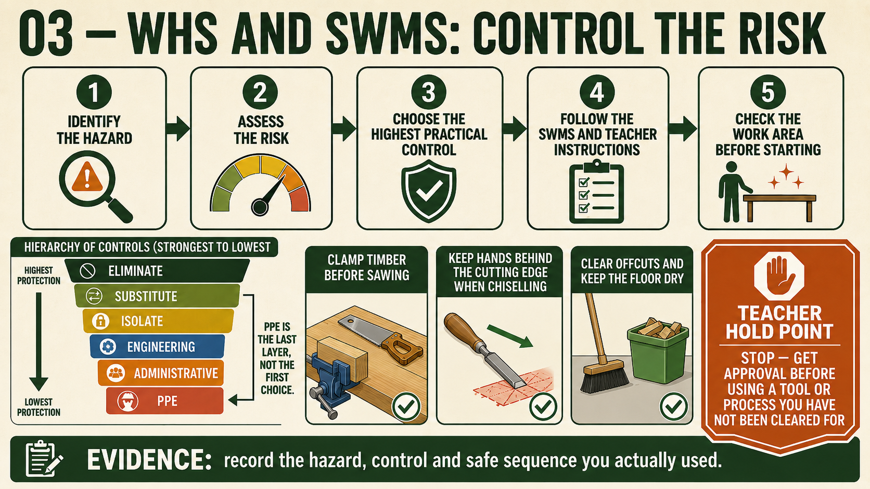
CARRY-ALL
Weeks 15–16 · 1/8
Handling, sequencing and surface preparation
Weeks 15–16 guided learning
Read the theory. Check your understanding. Save useful evidence.
Notes:
Introduce the module purpose and connect it to the current project stage.
[Sources]
- Authorised local course theory: weeks15-16/index.html

Slide 2
CARRY-ALL
Weeks 15–16 · 2/8
What you will learn
Use the module in order. Each idea supports the checks and written evidence that follow.
1
Manual handling and workshop housekeeping
2
Sequencing the Carry-All work in a useful SWMS
3
Preparing Carry-All surfaces for finish
Notes:
Preview the learning sequence without giving check answers.
[Sources]
- Authorised local course theory: weeks15-16/index.html

Slide 3
CARRY-ALL
Weeks 15–16 · 3/8
Manual handling and workshop housekeeping
Main idea
Manual handling means moving, carrying, lifting, lowering or positioning materials and project components.
Check 2
Before moving anything for the Carry-All, assess the load and the path.
Check 3
Consider the object’s size, shape, weight, balance and whether it is awkward to grip.
Return to the module page for the full explanation, visual and section video.
Notes:
Teach the source-grounded theory for Manual handling and workshop housekeeping.
[Sources]
- Authorised local course theory: weeks15-16/index.html

Slide 4
CARRY-ALL
Weeks 15–16 · 4/8
Sequencing the Carry-All work in a useful SWMS
Main idea
A useful Safe Work Method Statement, or SWMS, should follow the real sequence used to manufacture the Carry-All.
Check 2
It is more than a general list of workshop rules.
Check 3
It breaks the project into ordered stages, identifies the hazards connected with each stage and records the controls required before work begins.
Return to the module page for the full explanation, visual and section video.
Notes:
Teach the source-grounded theory for Sequencing the Carry-All work in a useful SWMS.
[Sources]
- Authorised local course theory: weeks15-16/index.html

Slide 5
CARRY-ALL
Weeks 15–16 · 5/8
Preparing Carry-All surfaces for finish
Main idea
Surface preparation creates a clean, even foundation for the approved finish.
Check 2
It does not begin by sanding every surface heavily.
Check 3
First inspect the assembled Carry-All for machining marks, dents, torn grain, scratches, adhesive contamination and uneven joint areas.
Return to the module page for the full explanation, visual and section video.
Notes:
Teach the source-grounded theory for Preparing Carry-All surfaces for finish.
[Sources]
- Authorised local course theory: weeks15-16/index.html

Slide 6
CARRY-ALL
Weeks 15–16 · 6/8
Pause and check your understanding
What is the controlling idea?
Manual handling and workshop housekeeping
Which check would prevent a mistake?
Sequencing the Carry-All work in a useful SWMS
What evidence would show your decision?
Preparing Carry-All surfaces for finish
Notes:
Use these prompts for retrieval before students open the interactive checks.
[Sources]
- Authorised local course theory: weeks15-16/index.html

Slide 7
CARRY-ALL
Weeks 15–16 · 7/8
Build a stronger written response
Read
Underline the command word and the project detail.
Select
Return to the exact theory section and choose relevant evidence.
Explain
Connect the decision, reason and likely result.
Check
Make sure the response answers the question and stays source-accurate.
Notes:
Model the response process without supplying an answer to a live student question.
[Sources]
- Authorised local course theory: weeks15-16/index.html

Slide 8
CARRY-ALL
Weeks 15–16 · 8/8
Exit ticket
Before you finish this module, answer these in your own words:
1. One idea I can now explain: Manual handling and workshop housekeeping
2. One practical check I must remember before the next stage
3. One piece of evidence I should save or improve
Return to the module page to complete the checks, written response and folio evidence.
Notes:
Students complete the exit ticket, then return to the website to save evidence.
[Sources]
- Authorised local course theory: weeks15-16/index.html

