Slide 1
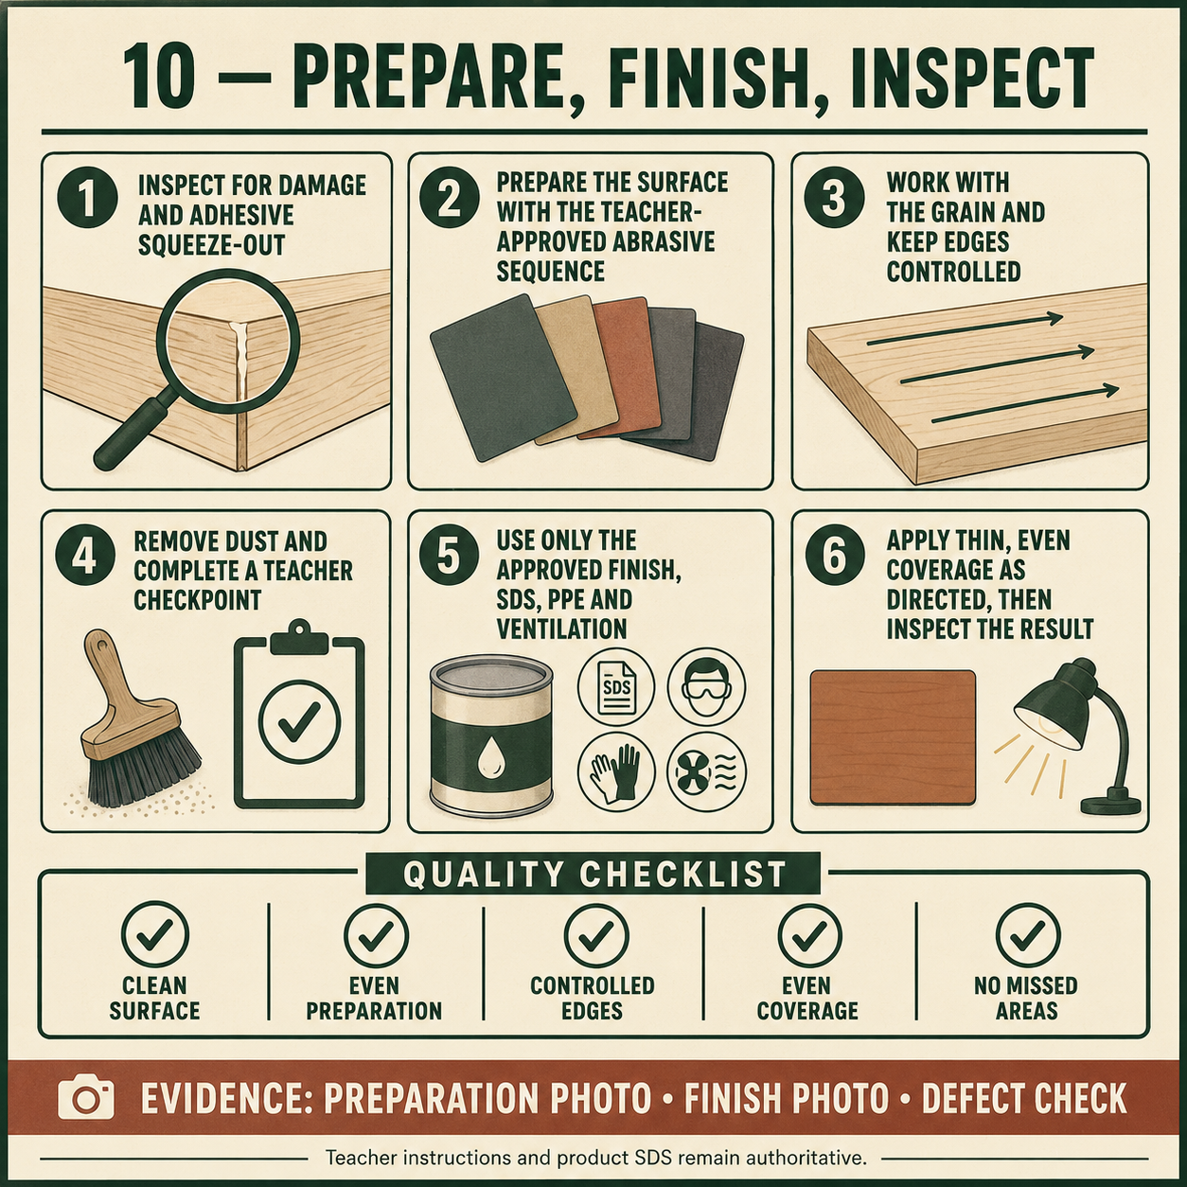
CARRY-ALL
Weeks 17–18 · 1/8
Finish and final workmanship
Weeks 17–18 guided learning
Read the theory. Check your understanding. Save useful evidence.
Notes:
Introduce the module purpose and connect it to the current project stage.
[Sources]
- Authorised local course theory: weeks17-18/index.html

Slide 2
CARRY-ALL
Weeks 17–18 · 2/8
What you will learn
Use the module in order. Each idea supports the checks and written evidence that follow.
1
Selecting an approved finish for the Carry-All
2
Applying and inspecting the approved finish
3
Checking accuracy, function and workmanship
Notes:
Preview the learning sequence without giving check answers.
[Sources]
- Authorised local course theory: weeks17-18/index.html

Slide 3
CARRY-ALL
Weeks 17–18 · 3/8
Selecting an approved finish for the Carry-All
Main idea
The finish applied to the Carry-All should protect the timber, improve its appearance and suit the product’s intended use.
Check 2
A finish can affect resistance to handling, dirt, moisture and normal wear, but no product makes timber indestructible.
Check 3
Selection should begin by considering how the Carry-All will be used, where it may be stored, the level of durability required and the appearance expected in the…
Return to the module page for the full explanation, visual and section video.
Notes:
Teach the source-grounded theory for Selecting an approved finish for the Carry-All.
[Sources]
- Authorised local course theory: weeks17-18/index.html

Slide 4
CARRY-ALL
Weeks 17–18 · 4/8
Applying and inspecting the approved finish
Main idea
Applying the approved finish is a controlled manufacturing stage, not simply adding colour or shine.
Check 2
Before beginning, confirm that the Carry-All has passed its surface-preparation inspection and that the work area, product and required safety controls are ready.
Check 3
The product label, Safety Data Sheet, teacher directions, SWMS and school procedures control application, ventilation, personal protective equipment, handling,…
Return to the module page for the full explanation, visual and section video.
Notes:
Teach the source-grounded theory for Applying and inspecting the approved finish.
[Sources]
- Authorised local course theory: weeks17-18/index.html

Slide 5
CARRY-ALL
Weeks 17–18 · 5/8
Checking accuracy, function and workmanship
Main idea
Quality checking means comparing the completed Carry-All with the working drawing, teacher directions and project brief using clear evidence.
Check 2
Appearance matters, but a product is not successful simply because it looks neat from a distance.
Check 3
Accuracy, function, stability, safety and finish must all be inspected.
Return to the module page for the full explanation, visual and section video.
Notes:
Teach the source-grounded theory for Checking accuracy, function and workmanship.
[Sources]
- Authorised local course theory: weeks17-18/index.html

Slide 6
CARRY-ALL
Weeks 17–18 · 6/8
Pause and check your understanding
What is the controlling idea?
Selecting an approved finish for the Carry-All
Which check would prevent a mistake?
Applying and inspecting the approved finish
What evidence would show your decision?
Checking accuracy, function and workmanship
Notes:
Use these prompts for retrieval before students open the interactive checks.
[Sources]
- Authorised local course theory: weeks17-18/index.html

Slide 7
CARRY-ALL
Weeks 17–18 · 7/8
Build a stronger written response
Read
Underline the command word and the project detail.
Select
Return to the exact theory section and choose relevant evidence.
Explain
Connect the decision, reason and likely result.
Check
Make sure the response answers the question and stays source-accurate.
Notes:
Model the response process without supplying an answer to a live student question.
[Sources]
- Authorised local course theory: weeks17-18/index.html

Slide 8
CARRY-ALL
Weeks 17–18 · 8/8
Exit ticket
Before you finish this module, answer these in your own words:
1. One idea I can now explain: Selecting an approved finish for the Carry-All
2. One practical check I must remember before the next stage
3. One piece of evidence I should save or improve
Return to the module page to complete the checks, written response and folio evidence.
Notes:
Students complete the exit ticket, then return to the website to save evidence.
[Sources]
- Authorised local course theory: weeks17-18/index.html

