Slide 1
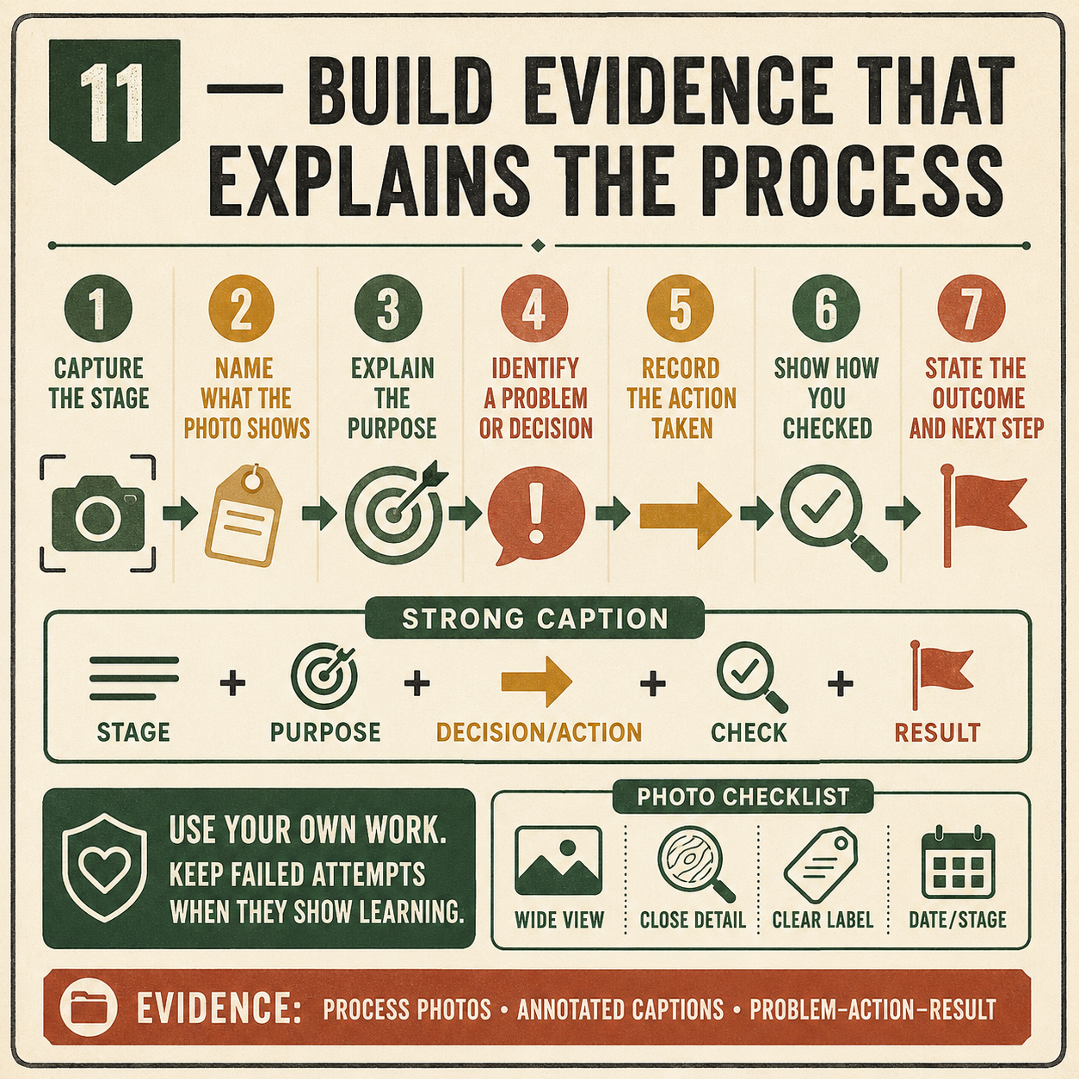
CARRY-ALL
Weeks 19–20 · 1/8
Evidence, problem solving and evaluation
Weeks 19–20 guided learning
Read the theory. Check your understanding. Save useful evidence.
Notes:
Introduce the module purpose and connect it to the current project stage.
[Sources]
- Authorised local course theory: weeks19-20/index.html

Slide 2
CARRY-ALL
Weeks 19–20 · 2/8
What you will learn
Use the module in order. Each idea supports the checks and written evidence that follow.
1
Building a traceable Carry-All evidence folio
2
Diagnosing and correcting Carry-All problems
3
Using PMI to evaluate the completed Carry-All
Notes:
Preview the learning sequence without giving check answers.
[Sources]
- Authorised local course theory: weeks19-20/index.html

Slide 3
CARRY-ALL
Weeks 19–20 · 3/8
Building a traceable Carry-All evidence folio
Main idea
A traceable evidence folio shows how the Carry-All developed from the working drawing into a completed product.
Check 2
It should connect planning, safe work, practical decisions, quality checks and evaluation in a clear sequence.
Check 3
The folio is not simply a collection of attractive final photographs.
Return to the module page for the full explanation, visual and section video.
Notes:
Teach the source-grounded theory for Building a traceable Carry-All evidence folio.
[Sources]
- Authorised local course theory: weeks19-20/index.html

Slide 4
CARRY-ALL
Weeks 19–20 · 4/8
Diagnosing and correcting Carry-All problems
Main idea
Problem-solving begins by separating the visible symptom from its possible cause .
Check 2
A tight joint, loose joint, out-of-square dry assembly or visible finish defect tells you that something is wrong, but not necessarily why.
Check 3
Acting on the first guess can make the problem worse.
Return to the module page for the full explanation, visual and section video.
Notes:
Teach the source-grounded theory for Diagnosing and correcting Carry-All problems.
[Sources]
- Authorised local course theory: weeks19-20/index.html

Slide 5
CARRY-ALL
Weeks 19–20 · 5/8
Using PMI to evaluate the completed Carry-All
Main idea
PMI stands for Plus, Minus and Interesting .
Check 2
It provides a clear structure for evaluating the completed Carry-All without reducing the judgement to “good” or “bad”.
Check 3
A strong PMI uses evidence from the working drawing, project brief, SWMS, process photographs and final quality checks.
Return to the module page for the full explanation, visual and section video.
Notes:
Teach the source-grounded theory for Using PMI to evaluate the completed Carry-All.
[Sources]
- Authorised local course theory: weeks19-20/index.html

Slide 6
CARRY-ALL
Weeks 19–20 · 6/8
Pause and check your understanding
What is the controlling idea?
Building a traceable Carry-All evidence folio
Which check would prevent a mistake?
Diagnosing and correcting Carry-All problems
What evidence would show your decision?
Using PMI to evaluate the completed Carry-All
Notes:
Use these prompts for retrieval before students open the interactive checks.
[Sources]
- Authorised local course theory: weeks19-20/index.html

Slide 7
CARRY-ALL
Weeks 19–20 · 7/8
Build a stronger written response
Read
Underline the command word and the project detail.
Select
Return to the exact theory section and choose relevant evidence.
Explain
Connect the decision, reason and likely result.
Check
Make sure the response answers the question and stays source-accurate.
Notes:
Model the response process without supplying an answer to a live student question.
[Sources]
- Authorised local course theory: weeks19-20/index.html

Slide 8
CARRY-ALL
Weeks 19–20 · 8/8
Exit ticket
Before you finish this module, answer these in your own words:
1. One idea I can now explain: Building a traceable Carry-All evidence folio
2. One practical check I must remember before the next stage
3. One piece of evidence I should save or improve
Return to the module page to complete the checks, written response and folio evidence.
Notes:
Students complete the exit ticket, then return to the website to save evidence.
[Sources]
- Authorised local course theory: weeks19-20/index.html

