Slide 1
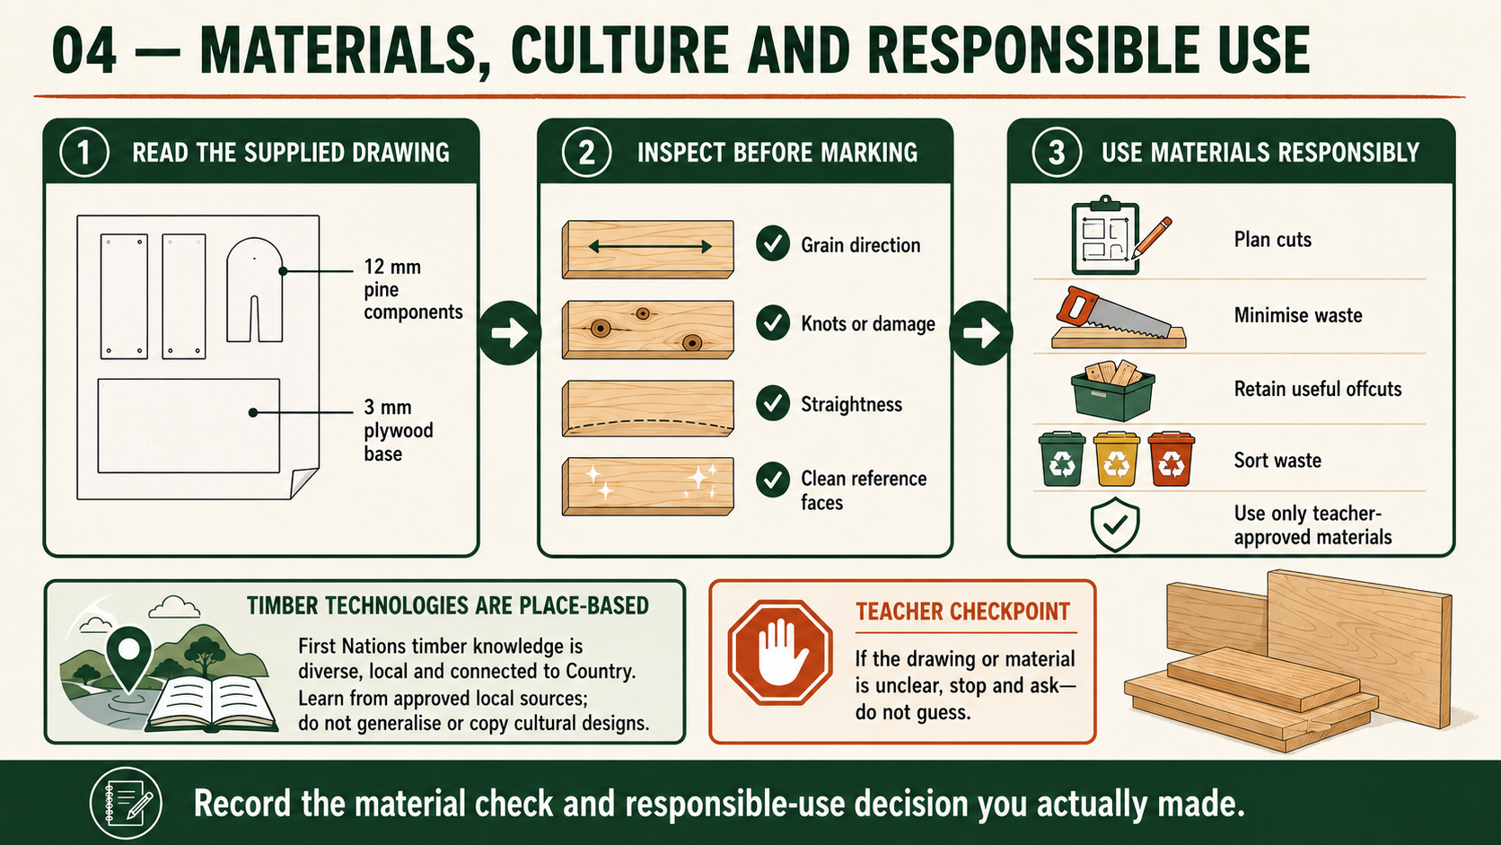
CARRY-ALL
Weeks 3–4 · 1/8
Materials, culture and responsible use
Weeks 3–4 guided learning
Read the theory. Check your understanding. Save useful evidence.
Notes:
Introduce the module purpose and connect it to the current project stage.
[Sources]
- Authorised local course theory: weeks3-4/index.html

Slide 2
CARRY-ALL
Weeks 3–4 · 2/8
What you will learn
Use the module in order. Each idea supports the checks and written evidence that follow.
1
Selecting pine and plywood for the Carry-All
2
Learning respectfully from Aboriginal and Torres Strait Islander timber…
3
Using timber responsibly and reducing project waste
Notes:
Preview the learning sequence without giving check answers.
[Sources]
- Authorised local course theory: weeks3-4/index.html

Slide 3
CARRY-ALL
Weeks 3–4 · 3/8
Selecting pine and plywood for the Carry-All
Main idea
The working drawing specifies 12 mm pine for the Carry-All’s timber components and a 3 mm plywood base.
Check 2
These materials have different properties and purposes, so they must be selected carefully rather than treated as interchangeable.
Check 3
Pine provides the solid timber needed for the sides, central handle or handle panel, dividers and other components shown on the drawing.
Return to the module page for the full explanation, visual and section video.
Notes:
Teach the source-grounded theory for Selecting pine and plywood for the Carry-All.
[Sources]
- Authorised local course theory: weeks3-4/index.html

Slide 4
CARRY-ALL
Weeks 3–4 · 4/8
Learning respectfully from Aboriginal and Torres Strait…
Main idea
Aboriginal and Torres Strait Islander timber technologies are not one single tradition.
Check 2
They include many distinct knowledge systems developed by different Nations, language groups, families and communities over long periods of time.
Check 3
This knowledge is connected to Country, local plants, seasons, material properties, purpose and cultural responsibility.
Return to the module page for the full explanation, visual and section video.
Notes:
Teach the source-grounded theory for Learning respectfully from Aboriginal and Torres Strait Islander timber technologies.
[Sources]
- Authorised local course theory: weeks3-4/index.html

Slide 5
CARRY-ALL
Weeks 3–4 · 5/8
Using timber responsibly and reducing project waste
Main idea
Responsible material use begins before any component is marked or cut.
Check 2
The Carry-All working drawing and teacher directions identify what must be made from the approved 12 mm pine and 3 mm plywood.
Check 3
Cutting-list thinking means identifying every required component, checking its material and planning how the parts can be arranged on the available stock.
Return to the module page for the full explanation, visual and section video.
Notes:
Teach the source-grounded theory for Using timber responsibly and reducing project waste.
[Sources]
- Authorised local course theory: weeks3-4/index.html

Slide 6
CARRY-ALL
Weeks 3–4 · 6/8
Pause and check your understanding
What is the controlling idea?
Selecting pine and plywood for the Carry-All
Which check would prevent a mistake?
Learning respectfully from Aboriginal and Torres Strait Islander timber technologies
What evidence would show your decision?
Using timber responsibly and reducing project waste
Notes:
Use these prompts for retrieval before students open the interactive checks.
[Sources]
- Authorised local course theory: weeks3-4/index.html

Slide 7
CARRY-ALL
Weeks 3–4 · 7/8
Build a stronger written response
Read
Underline the command word and the project detail.
Select
Return to the exact theory section and choose relevant evidence.
Explain
Connect the decision, reason and likely result.
Check
Make sure the response answers the question and stays source-accurate.
Notes:
Model the response process without supplying an answer to a live student question.
[Sources]
- Authorised local course theory: weeks3-4/index.html

Slide 8
CARRY-ALL
Weeks 3–4 · 8/8
Exit ticket
Before you finish this module, answer these in your own words:
1. One idea I can now explain: Selecting pine and plywood for the Carry-All
2. One practical check I must remember before the next stage
3. One piece of evidence I should save or improve
Return to the module page to complete the checks, written response and folio evidence.
Notes:
Students complete the exit ticket, then return to the website to save evidence.
[Sources]
- Authorised local course theory: weeks3-4/index.html

