Slide 1
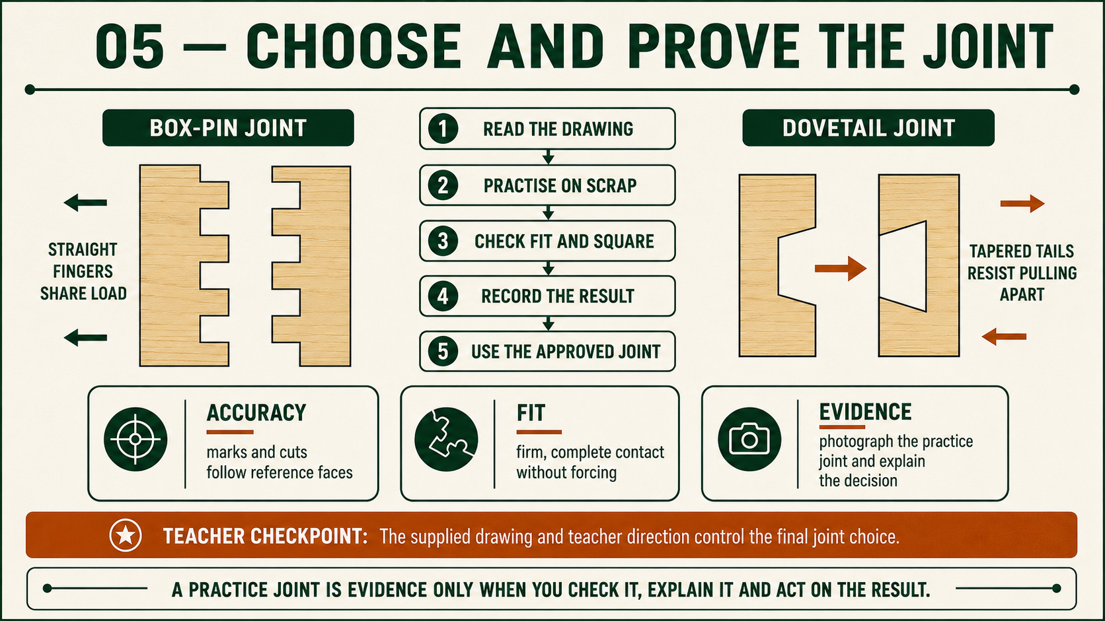
CARRY-ALL
Weeks 5–6 · 1/8
Required construction and comparative joints
Weeks 5–6 guided learning
Read the theory. Check your understanding. Save useful evidence.
Notes:
Introduce the module purpose and connect it to the current project stage.
[Sources]
- Authorised local course theory: weeks5-6/index.html

Slide 2
CARRY-ALL
Weeks 5–6 · 2/8
What you will learn
Use the module in order. Each idea supports the checks and written evidence that follow.
1
Comparing box-pin joints as alternative knowledge
2
Comparing dovetail joints as alternative knowledge
3
Applying the assessed rebate-and-housing construction
Notes:
Preview the learning sequence without giving check answers.
[Sources]
- Authorised local course theory: weeks5-6/index.html

Slide 3
CARRY-ALL
Weeks 5–6 · 3/8
Comparing box-pin joints as alternative knowledge
Main idea
A box-pin joint connects two timber components through alternating rectangular pins and spaces.
Check 2
The pins on one piece fit the spaces on the other, creating an interlocking corner.
Check 3
This makes the joint useful comparative knowledge when studying how timber joints gain alignment, gluing area and visible evidence of accuracy.
Return to the module page for the full explanation, visual and section video.
Notes:
Teach the source-grounded theory for Comparing box-pin joints as alternative knowledge.
[Sources]
- Authorised local course theory: weeks5-6/index.html

Slide 4
CARRY-ALL
Weeks 5–6 · 4/8
Comparing dovetail joints as alternative knowledge
Main idea
A dovetail joint connects two timber components through matching tails and pins .
Check 2
The sloping form helps the assembled joint resist pulling apart in one direction.
Check 3
Dovetails are useful comparative knowledge because they show how joint geometry, component orientation and close-fitting surfaces can affect strength and workmanship.
Return to the module page for the full explanation, visual and section video.
Notes:
Teach the source-grounded theory for Comparing dovetail joints as alternative knowledge.
[Sources]
- Authorised local course theory: weeks5-6/index.html

Slide 5
CARRY-ALL
Weeks 5–6 · 5/8
Applying the assessed rebate-and-housing construction
Main idea
The Barbecue Carry-All must be manufactured from the supplied working drawing and teacher direction.
Check 2
These are the authoritative sources for the assessed construction.
Check 3
Do not scale the page, guess a missing detail or add a joint that is not shown.
Return to the module page for the full explanation, visual and section video.
Notes:
Teach the source-grounded theory for Applying the assessed rebate-and-housing construction.
[Sources]
- Authorised local course theory: weeks5-6/index.html

Slide 6
CARRY-ALL
Weeks 5–6 · 6/8
Pause and check your understanding
What is the controlling idea?
Comparing box-pin joints as alternative knowledge
Which check would prevent a mistake?
Comparing dovetail joints as alternative knowledge
What evidence would show your decision?
Applying the assessed rebate-and-housing construction
Notes:
Use these prompts for retrieval before students open the interactive checks.
[Sources]
- Authorised local course theory: weeks5-6/index.html

Slide 7
CARRY-ALL
Weeks 5–6 · 7/8
Build a stronger written response
Read
Underline the command word and the project detail.
Select
Return to the exact theory section and choose relevant evidence.
Explain
Connect the decision, reason and likely result.
Check
Make sure the response answers the question and stays source-accurate.
Notes:
Model the response process without supplying an answer to a live student question.
[Sources]
- Authorised local course theory: weeks5-6/index.html

Slide 8
CARRY-ALL
Weeks 5–6 · 8/8
Exit ticket
Before you finish this module, answer these in your own words:
1. One idea I can now explain: Comparing box-pin joints as alternative knowledge
2. One practical check I must remember before the next stage
3. One piece of evidence I should save or improve
Return to the module page to complete the checks, written response and folio evidence.
Notes:
Students complete the exit ticket, then return to the website to save evidence.
[Sources]
- Authorised local course theory: weeks5-6/index.html

