Slide 1
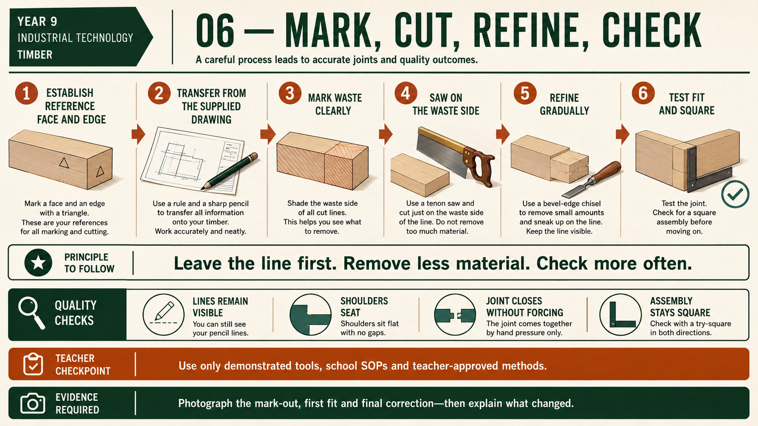
CARRY-ALL
Weeks 7–8 · 1/8
Accurate marking and hand-tool control
Weeks 7–8 guided learning
Read the theory. Check your understanding. Save useful evidence.
Notes:
Introduce the module purpose and connect it to the current project stage.
[Sources]
- Authorised local course theory: weeks7-8/index.html

Slide 2
CARRY-ALL
Weeks 7–8 · 2/8
What you will learn
Use the module in order. Each idea supports the checks and written evidence that follow.
1
Establishing reference faces and marking accurately
2
Controlling approved cuts for rebate-and-housing features
3
Refining required rebates and housings
Notes:
Preview the learning sequence without giving check answers.
[Sources]
- Authorised local course theory: weeks7-8/index.html

Slide 3
CARRY-ALL
Weeks 7–8 · 3/8
Establishing reference faces and marking accurately
Main idea
Accurate Carry-All components begin with consistent reference surfaces.
Check 2
The face side is the selected flat surface used as the main reference, while the face edge is a straight edge confirmed as square to it.
Check 3
These surfaces should be clearly marked and used whenever measurements or lines are transferred.
Return to the module page for the full explanation, visual and section video.
Notes:
Teach the source-grounded theory for Establishing reference faces and marking accurately.
[Sources]
- Authorised local course theory: weeks7-8/index.html

Slide 4
CARRY-ALL
Weeks 7–8 · 4/8
Controlling approved cuts for rebate-and-housing features
Main idea
A tenon saw can be used for controlled, accurate cuts when forming approved Carry-All joint features.
Check 2
Accuracy begins before the saw touches the timber.
Check 3
The component must be correctly identified, its reference faces and waste areas clearly marked, and the layout checked against the working drawing and teacher…
Return to the module page for the full explanation, visual and section video.
Notes:
Teach the source-grounded theory for Controlling approved cuts for rebate-and-housing features.
[Sources]
- Authorised local course theory: weeks7-8/index.html

Slide 5
CARRY-ALL
Weeks 7–8 · 5/8
Refining required rebates and housings
Main idea
Chiselling may be used through the teacher-approved process to refine required Carry-All rebate and housing surfaces after the main waste has been removed.
Check 2
The aim is not to reshape the feature quickly, but to bring uneven or remaining material carefully towards the verified layout line.
Check 3
This process is often called paring to the line .
Return to the module page for the full explanation, visual and section video.
Notes:
Teach the source-grounded theory for Refining required rebates and housings.
[Sources]
- Authorised local course theory: weeks7-8/index.html

Slide 6
CARRY-ALL
Weeks 7–8 · 6/8
Pause and check your understanding
What is the controlling idea?
Establishing reference faces and marking accurately
Which check would prevent a mistake?
Controlling approved cuts for rebate-and-housing features
What evidence would show your decision?
Refining required rebates and housings
Notes:
Use these prompts for retrieval before students open the interactive checks.
[Sources]
- Authorised local course theory: weeks7-8/index.html

Slide 7
CARRY-ALL
Weeks 7–8 · 7/8
Build a stronger written response
Read
Underline the command word and the project detail.
Select
Return to the exact theory section and choose relevant evidence.
Explain
Connect the decision, reason and likely result.
Check
Make sure the response answers the question and stays source-accurate.
Notes:
Model the response process without supplying an answer to a live student question.
[Sources]
- Authorised local course theory: weeks7-8/index.html

Slide 8
CARRY-ALL
Weeks 7–8 · 8/8
Exit ticket
Before you finish this module, answer these in your own words:
1. One idea I can now explain: Establishing reference faces and marking accurately
2. One practical check I must remember before the next stage
3. One piece of evidence I should save or improve
Return to the module page to complete the checks, written response and folio evidence.
Notes:
Students complete the exit ticket, then return to the website to save evidence.
[Sources]
- Authorised local course theory: weeks7-8/index.html

