Slide 1
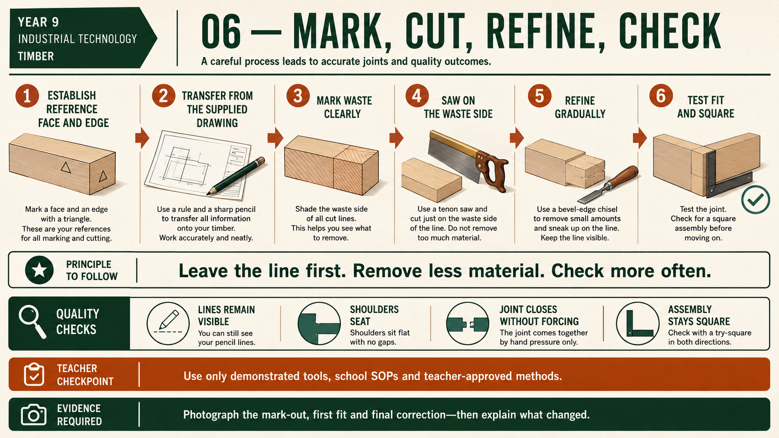
CARRY-ALL
Weeks 9–10 · 1/8
Rebates, housings and dry assembly
Weeks 9–10 guided learning
Read the theory. Check your understanding. Save useful evidence.
Notes:
Introduce the module purpose and connect it to the current project stage.
[Sources]
- Authorised local course theory: weeks9-10/index.html

Slide 2
CARRY-ALL
Weeks 9–10 · 2/8
What you will learn
Use the module in order. Each idea supports the checks and written evidence that follow.
1
Forming the base rebate accurately
2
Locating dividers and the handle with housing joints
3
Dry fitting the Carry-All structure
Notes:
Preview the learning sequence without giving check answers.
[Sources]
- Authorised local course theory: weeks9-10/index.html

Slide 3
CARRY-ALL
Weeks 9–10 · 3/8
Forming the base rebate accurately
Main idea
The base rebate is a recessed edge formed where shown in the Carry-All working drawing.
Check 2
Its purpose is to support and locate the 3 mm plywood base within the surrounding pine components.
Check 3
Instead of relying only on an edge connection, the rebate provides a ledge that helps control the base position during dry assembly and final construction.
Return to the module page for the full explanation, visual and section video.
Notes:
Teach the source-grounded theory for Forming the base rebate accurately.
[Sources]
- Authorised local course theory: weeks9-10/index.html

Slide 4
CARRY-ALL
Weeks 9–10 · 4/8
Locating dividers and the handle with housing joints
Main idea
Housing joints are recessed channels formed where shown in the Carry-All working drawing.
Check 2
Their purpose is to locate and support internal parts such as the dividers and the central handle or handle panel.
Check 3
A correctly formed housing helps prevent these parts from shifting during dry assembly, adhesive application and clamping.
Return to the module page for the full explanation, visual and section video.
Notes:
Teach the source-grounded theory for Locating dividers and the handle with housing joints.
[Sources]
- Authorised local course theory: weeks9-10/index.html

Slide 5
CARRY-ALL
Weeks 9–10 · 5/8
Dry fitting the Carry-All structure
Main idea
Dry fitting means assembling the Carry-All without adhesive so the complete structure can be checked before the parts are permanently joined.
Check 2
The sides, 3 mm plywood base, dividers and central handle or handle panel should be placed in their correct orientation according to the working drawing and teacher…
Check 3
This stage confirms that the separate components work together, not just that each part looks accurate on its own.
Return to the module page for the full explanation, visual and section video.
Notes:
Teach the source-grounded theory for Dry fitting the Carry-All structure.
[Sources]
- Authorised local course theory: weeks9-10/index.html

Slide 6
CARRY-ALL
Weeks 9–10 · 6/8
Pause and check your understanding
What is the controlling idea?
Forming the base rebate accurately
Which check would prevent a mistake?
Locating dividers and the handle with housing joints
What evidence would show your decision?
Dry fitting the Carry-All structure
Notes:
Use these prompts for retrieval before students open the interactive checks.
[Sources]
- Authorised local course theory: weeks9-10/index.html

Slide 7
CARRY-ALL
Weeks 9–10 · 7/8
Build a stronger written response
Read
Underline the command word and the project detail.
Select
Return to the exact theory section and choose relevant evidence.
Explain
Connect the decision, reason and likely result.
Check
Make sure the response answers the question and stays source-accurate.
Notes:
Model the response process without supplying an answer to a live student question.
[Sources]
- Authorised local course theory: weeks9-10/index.html

Slide 8
CARRY-ALL
Weeks 9–10 · 8/8
Exit ticket
Before you finish this module, answer these in your own words:
1. One idea I can now explain: Forming the base rebate accurately
2. One practical check I must remember before the next stage
3. One piece of evidence I should save or improve
Return to the module page to complete the checks, written response and folio evidence.
Notes:
Students complete the exit ticket, then return to the website to save evidence.
[Sources]
- Authorised local course theory: weeks9-10/index.html

