Slide 1
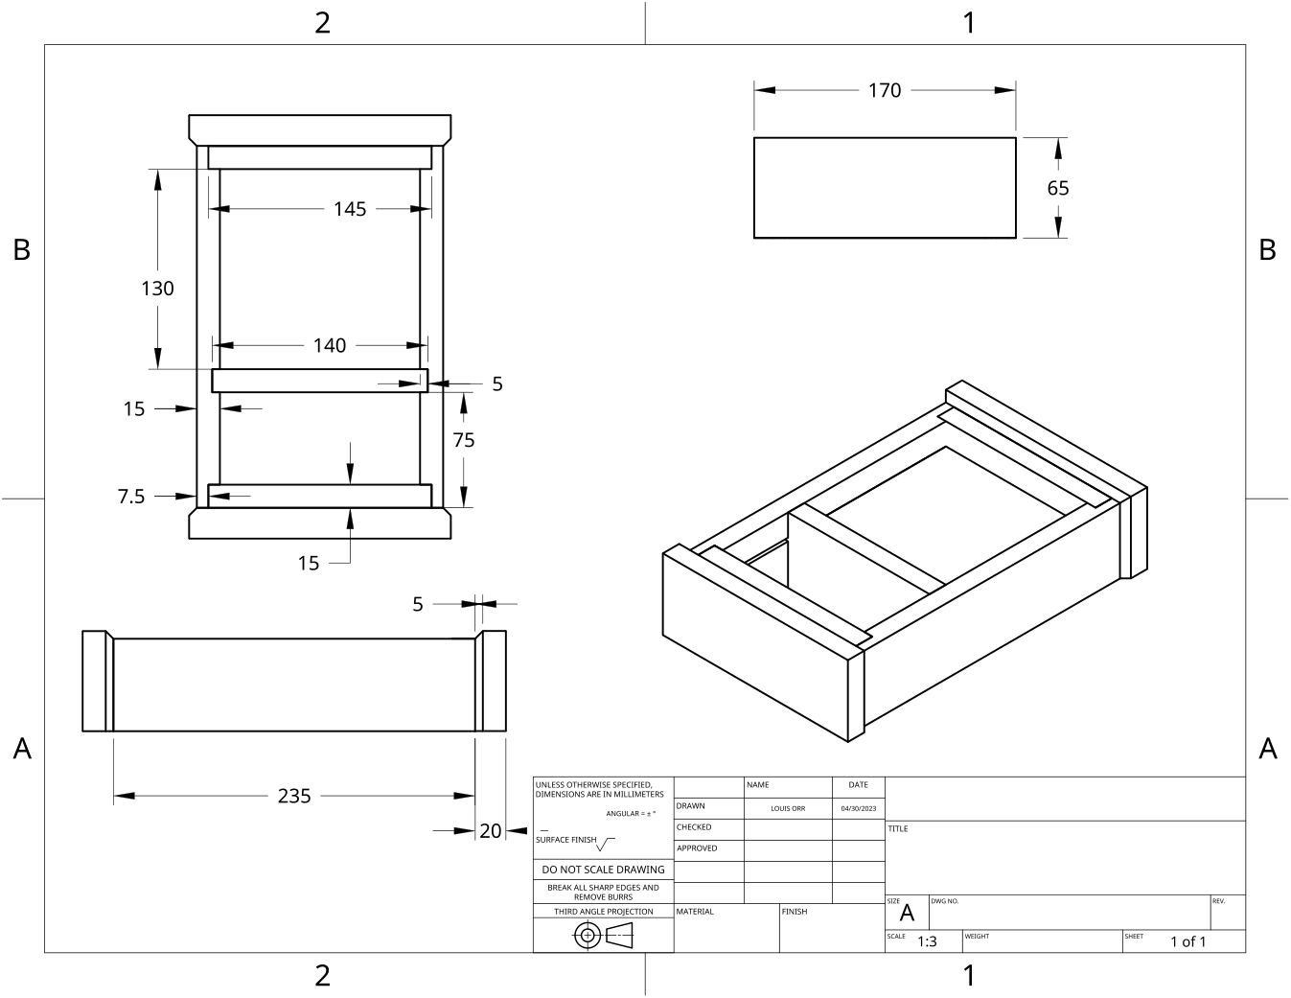
MODULE 1 OF 10 · WEEKS 1–2
Brief, plans and workshop safety
Use the Clock drawing, the three theory sections and the module evidence in sequence.
Clock Guided Course

Slide 2
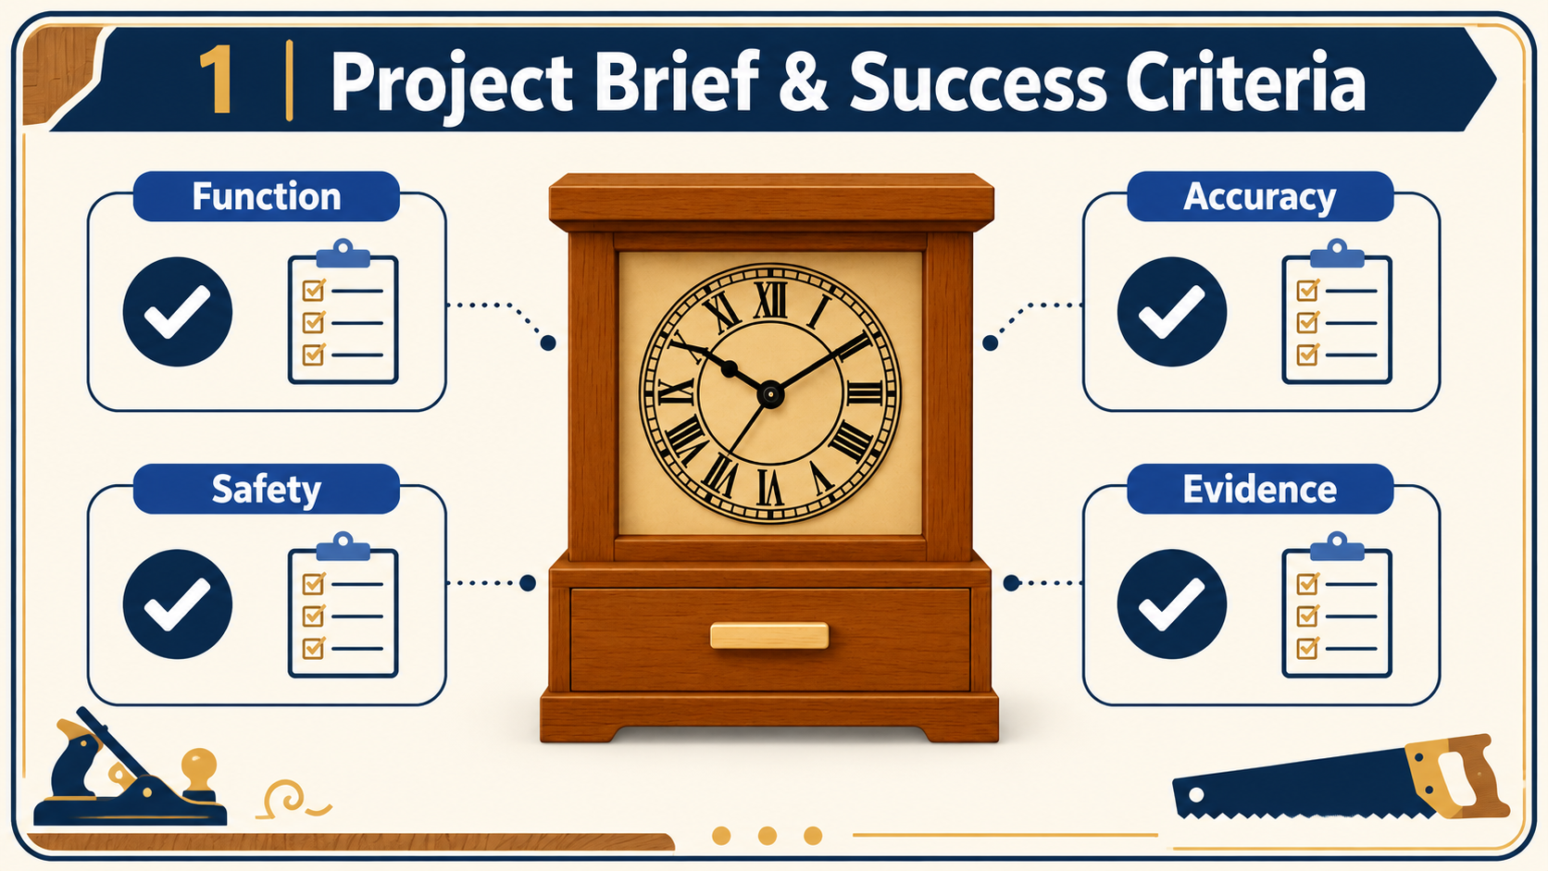
MODULE 1 OF 10 · WEEKS 1–2
Understanding the Clock project brief and success criteria
A project brief explains what you are expected to design, make and document. For this project, you will produce a free-standing timber clock with a hidden drawer.
Success means producing a safe, accurate and well-finished clock while also providing clear evidence that shows how you planned, made and evaluated it.
2

Slide 3
MODULE 1 OF 10 · WEEKS 1–2
Reading the Clock working drawing without scaling
The Clock working drawing is the main source of information for the project’s shape, size and arrangement. It presents the object through orthographic views and a pictorial view.
Read the written dimensions, trace where they apply and cross-check the views. Never take measurements directly from the printed Clock drawing.
3

Slide 4
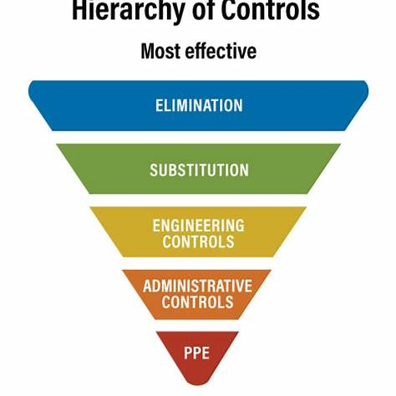
MODULE 1 OF 10 · WEEKS 1–2
Managing workshop hazards and risks for the Clock
Safe workshop practice begins with understanding the difference between a hazard , a risk and a control . A hazard is something with the potential to cause harm, such as moving machinery, timber dust, an unsecured component or a damaged power lead.
Identify the hazard, judge the risk and apply the strongest available controls before work begins. PPE is the final layer, not the whole safety system.
4

Slide 5
BEFORE YOU MOVE ON
Use these three Clock ideas to complete the Weeks 1–2 checks and evidence.
Complete the knowledge checks and written responses, then download your evidence as directed.
5

