Slide 1
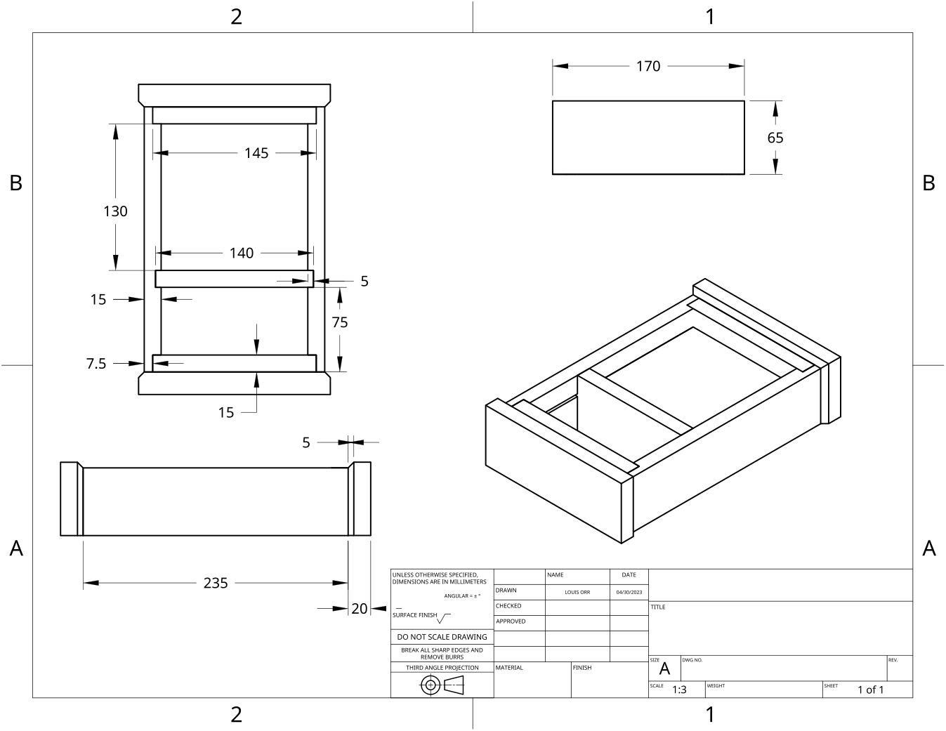
MODULE 6 OF 10 · WEEKS 11–12
Timber stability, material choice and surface preparation
Use the Clock drawing, the three theory sections and the module evidence in sequence.
Clock Guided Course

Slide 2
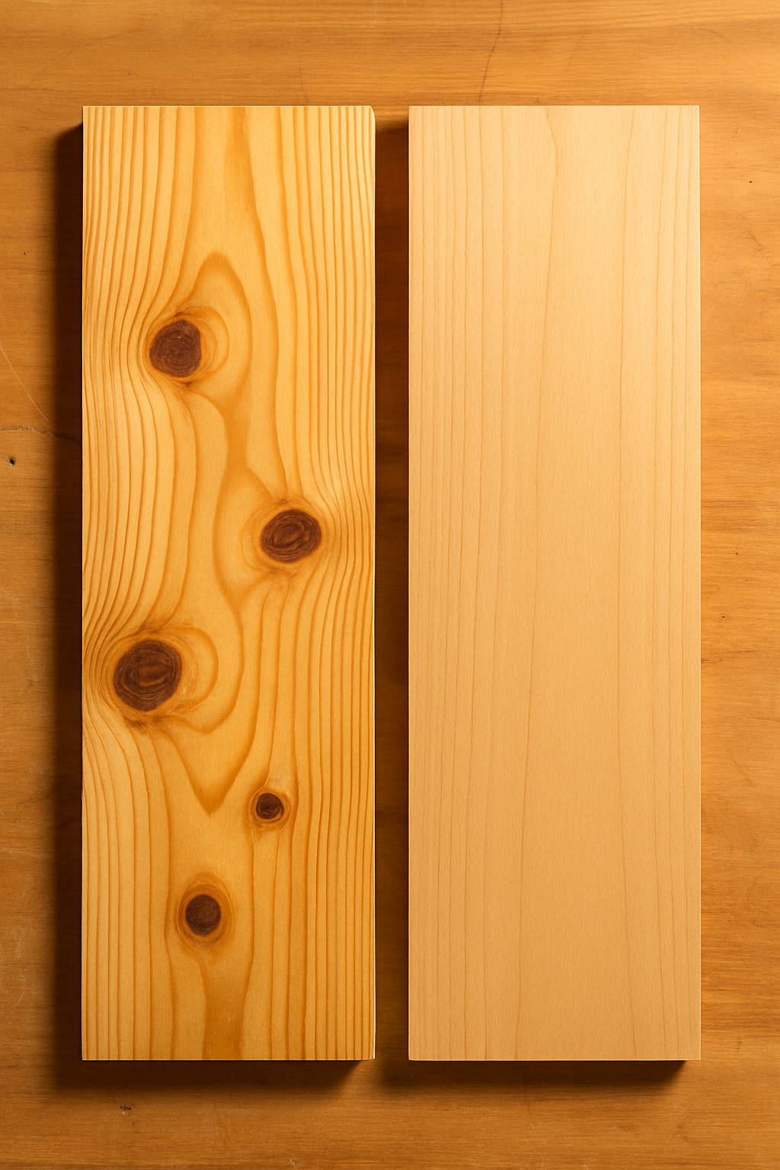
MODULE 6 OF 10 · WEEKS 11–12
Timber moisture, seasoning and dimensional stability
Timber contains moisture because a tree naturally carries water through its structure while growing. After timber is cut, it continues to exchange moisture with the surrounding air. In damp conditions, timber may absorb moisture and expand.
Timber continues to respond to moisture after it is cut, so well-seasoned, stable material is essential for accurate Clock joints, reliable drawer movement and a consistent finished surface.
2

Slide 3

MODULE 6 OF 10 · WEEKS 11–12
Selecting timber for function, appearance and responsible use
Selecting timber is more than choosing the best-looking piece. Each Clock component has a particular job, so the timber assigned to it must be suitable for its function, appearance and position in the finished project.
Select timber by matching its actual qualities to the component’s function, appearance and accuracy needs, while using approved material efficiently and recording the reasons for your…
3

Slide 4
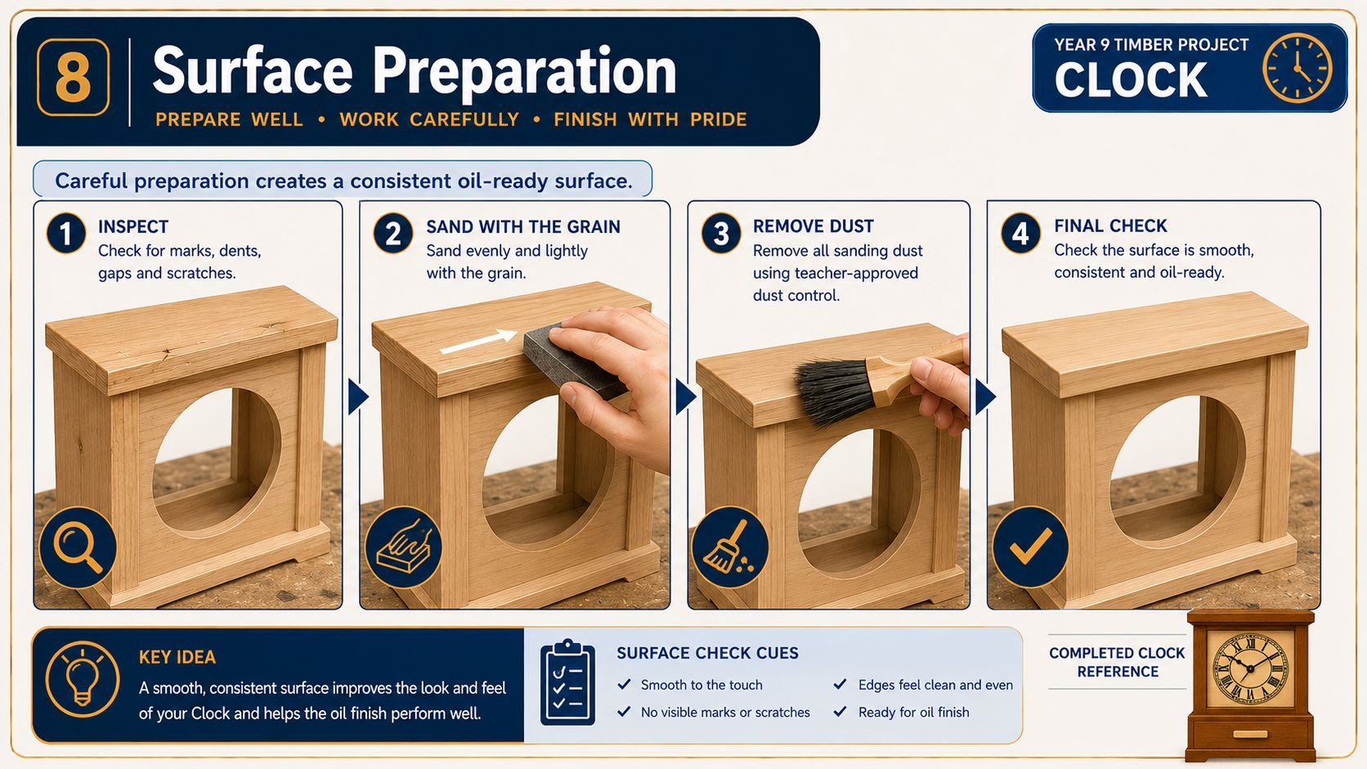
MODULE 6 OF 10 · WEEKS 11–12
Sanding for a consistent oil-ready surface
Sanding prepares the Clock surfaces for the approved three-coat oil finish. Its purpose is not simply to make the timber feel smooth. Careful sanding removes machining marks, small scratches and minor surface irregularities while keeping the Clock’s edges, faces and…
Sand progressively, follow the grain, protect accurate edges and inspect carefully before oiling. A finish cannot hide poor preparation; it usually makes the faults easier to see.
4

Slide 5
BEFORE YOU MOVE ON
Use these three Clock ideas to complete the Weeks 11–12 checks and evidence.
Complete the knowledge checks and written responses, then download your evidence as directed.
5

