Slide 1
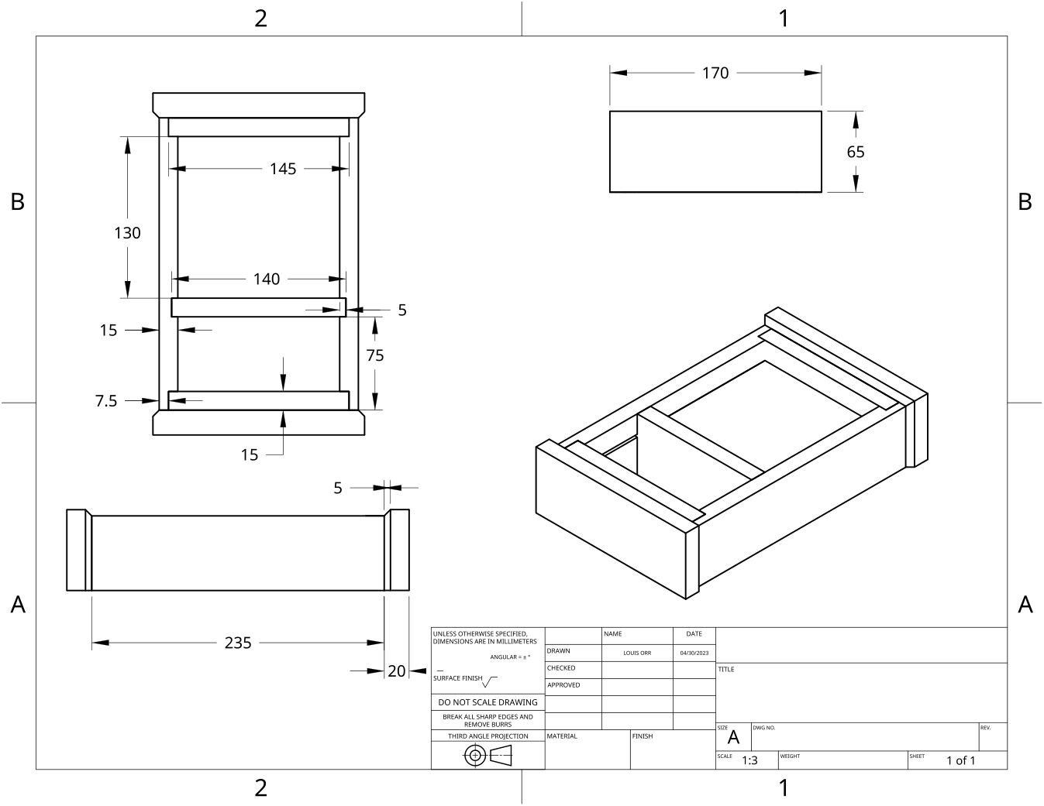
MODULE 7 OF 10 · WEEKS 13–14
Oil finish and clock mechanism fit-up
Use the Clock drawing, the three theory sections and the module evidence in sequence.
Clock Guided Course

Slide 2
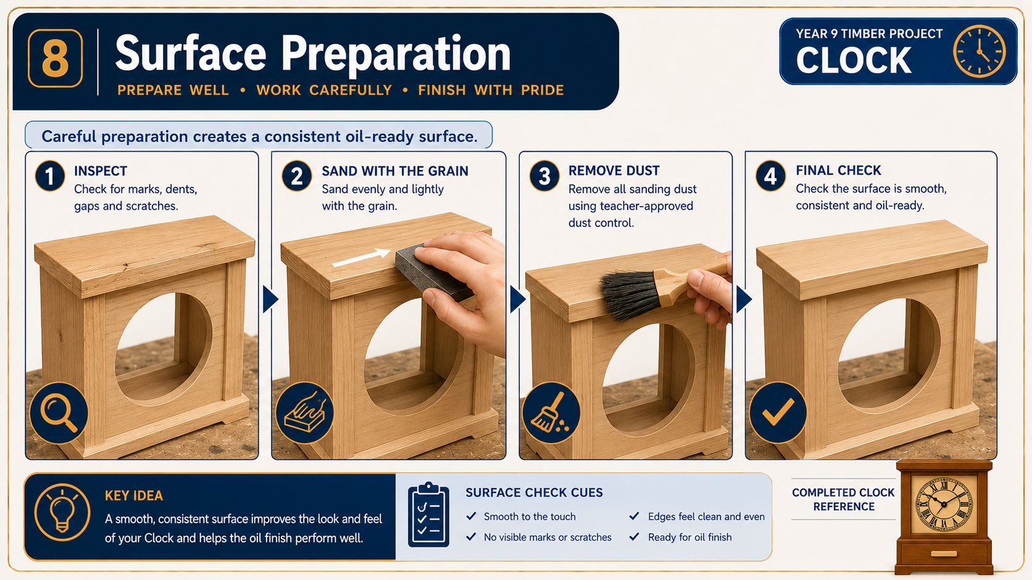
MODULE 7 OF 10 · WEEKS 13–14
Planning the three-coat oil finish
A three-coat oil finish should be treated as a planned sequence, not as one long finishing session. Each coat must be applied under teacher direction using the approved product information.
A reliable three-coat finish comes from repeating the same approved preparation, application, inspection and recording process for every coat.
2

Slide 3
MODULE 7 OF 10 · WEEKS 13–14
Oil finish safety, application and between-coat quality
An oil finish can improve the appearance of the Clock and protect its prepared timber surfaces, but it must be treated as a chemical product rather than simply “painted on”.
A successful three-coat finish depends on following the actual product instructions, applying controlled coverage and using recorded evidence to decide when each coat is safe and ready for…
3

Slide 4
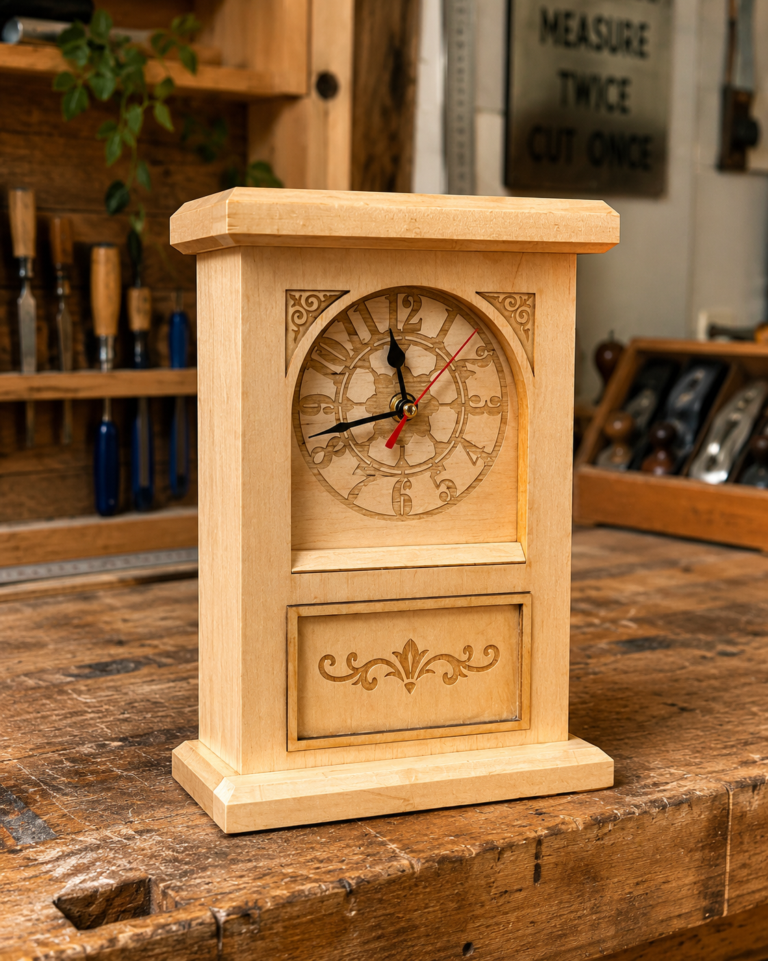
MODULE 7 OF 10 · WEEKS 13–14
Accurate fit-up of the battery clock mechanism
Fitting the battery clock mechanism is a precision stage, not a force-fit task. The aim is to connect the completed timber body with the supplied mechanism so the Clock is secure, correctly aligned and able to operate without interference.
Accurate fit-up comes from checking compatibility, alignment, clearance and function against the supplied mechanism information—not from forcing parts or making unapproved alterations.
4

Slide 5
BEFORE YOU MOVE ON
Use these three Clock ideas to complete the Weeks 13–14 checks and evidence.
Complete the knowledge checks and written responses, then download your evidence as directed.
5

