Slide 1
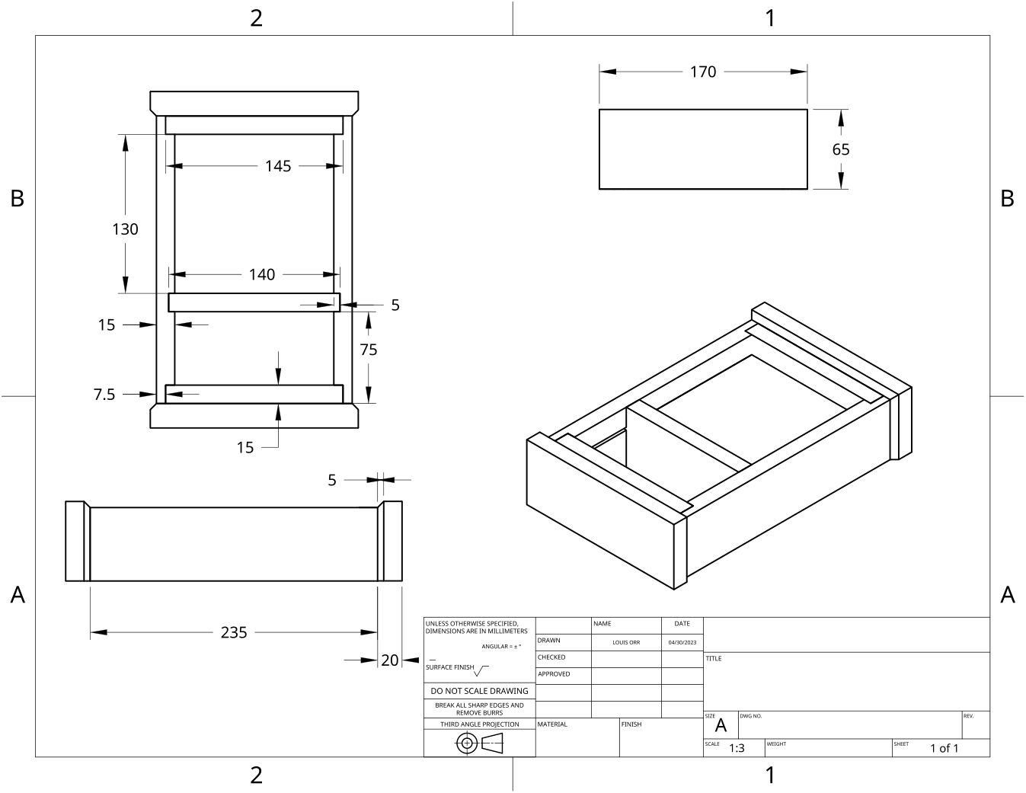
MODULE 8 OF 10 · WEEKS 15–16
Design, drawings and timber technology
Use the Clock drawing, the three theory sections and the module evidence in sequence.
Clock Guided Course

Slide 2
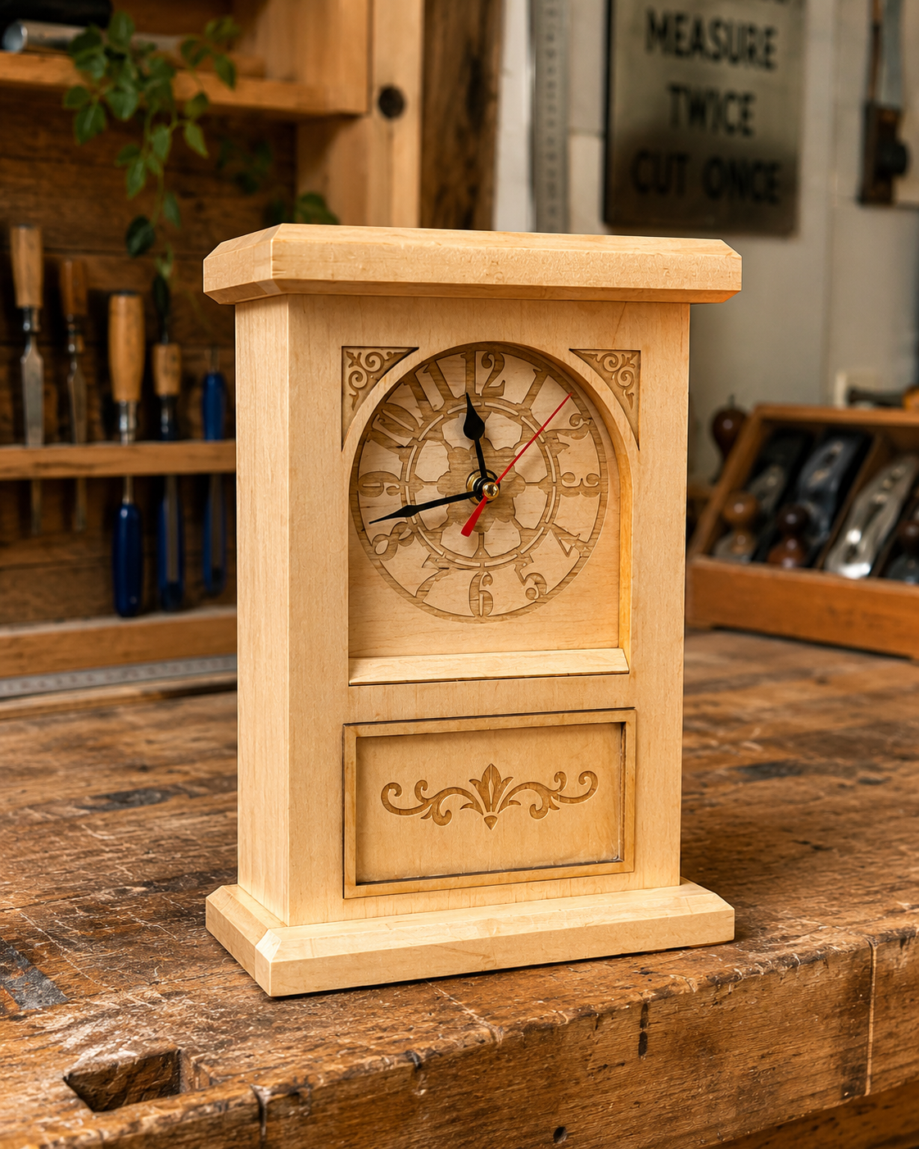
MODULE 8 OF 10 · WEEKS 15–16
Applying design principles to the Clock
Design principles help you judge whether the Clock looks resolved and works as intended. They are not decorations added at the end. They guide decisions about the visible face, carcass, chamfered edges, hidden drawer and finished surfaces.
Good design brings proportion, balance, emphasis, unity, contrast and function together while keeping every decision consistent with the brief, approved plans and teacher direction.
2

Slide 3
MODULE 8 OF 10 · WEEKS 15–16
Technical sketches, orthographic views and clear communication
Technical drawings help you communicate what the Clock should look like, how its parts relate to one another and what must be checked during construction. A freehand concept sketch is useful at the beginning because it records an idea quickly.
Clear sketches, accurate reading of written dimensions and honest as-built records allow your design decisions and construction results to be understood, checked and assessed.
3

Slide 4

MODULE 8 OF 10 · WEEKS 15–16
Current and emerging timber technologies connected to the Clock
Timber products can be planned and manufactured using hand processes, digital technologies or a combination of both. For the Clock, traditional methods may include freehand sketches, written measurements, careful marking and checking components against an approved…
Evaluate timber technologies by their accuracy, safety, waste, skill requirements and availability—not simply by whether they are new.
4

Slide 5
BEFORE YOU MOVE ON
Use these three Clock ideas to complete the Weeks 15–16 checks and evidence.
Complete the knowledge checks and written responses, then download your evidence as directed.
5

