Slide 1
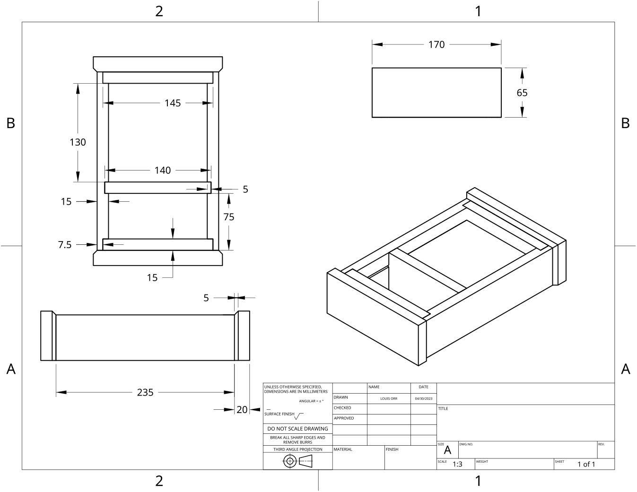
MODULE 9 OF 10 · WEEKS 17–18
Portfolio evidence and PMI evaluation
Use the Clock drawing, the three theory sections and the module evidence in sequence.
Clock Guided Course

Slide 2
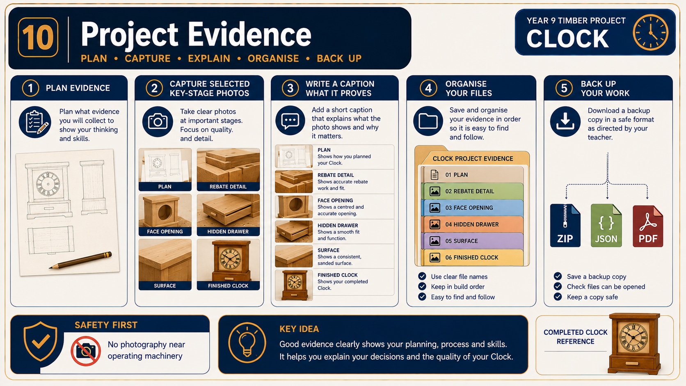
MODULE 9 OF 10 · WEEKS 17–18
Building an authentic Clock project folio
Your Clock project folio should tell the clear story of how the project was planned, made, checked and evaluated. It is not a scrapbook of unrelated worksheets and photographs.
A strong Clock folio links planning, practical evidence, quality checks and evaluation into one honest, organised account of how the project developed.
2

Slide 3
MODULE 9 OF 10 · WEEKS 17–18
Photographing and captioning key Clock construction stages
Photographs in your Clock folio should provide evidence of how the project developed, not simply prove that you were in the workshop. A strong set of images shows important stages, decisions and quality checks in a logical order.
Take each photograph for a clear reason, then write a caption that names the stage, explains the decision or quality check, and records the work safely and honestly.
3

Slide 4
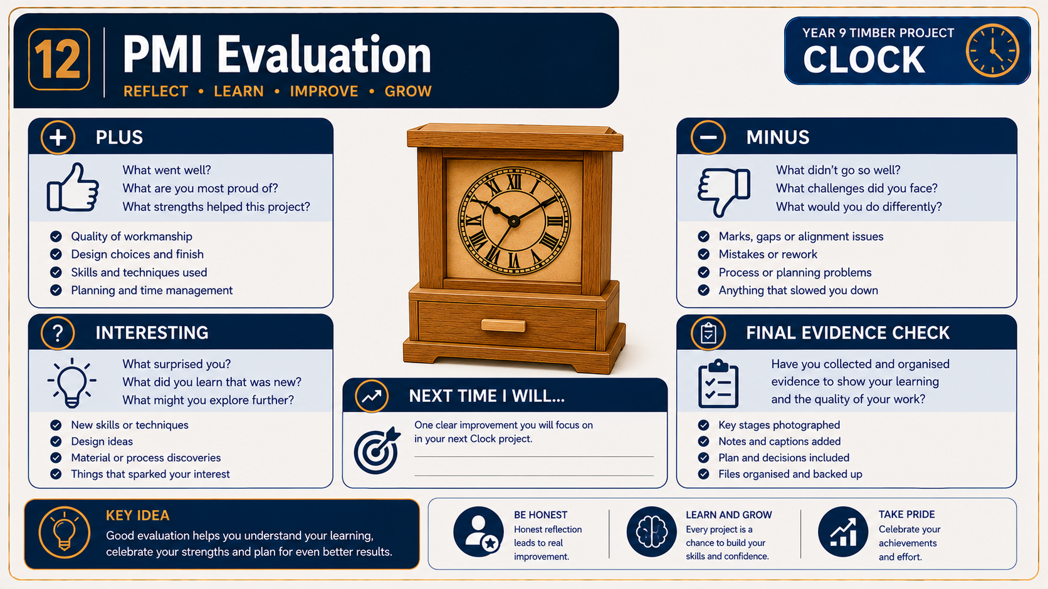
MODULE 9 OF 10 · WEEKS 17–18
Using PMI to evaluate the finished Clock
A PMI evaluation uses three viewpoints: Plus , Minus and Interesting . It helps you move beyond saying that the finished Clock is simply “good” or “bad”.
A strong PMI evaluation uses specific evidence from the finished Clock to explain what succeeded, what needs improvement, what was learned and what realistic change would produce a better…
4

Slide 5
BEFORE YOU MOVE ON
Use these three Clock ideas to complete the Weeks 17–18 checks and evidence.
Complete the knowledge checks and written responses, then download your evidence as directed.
5

