Slide 1
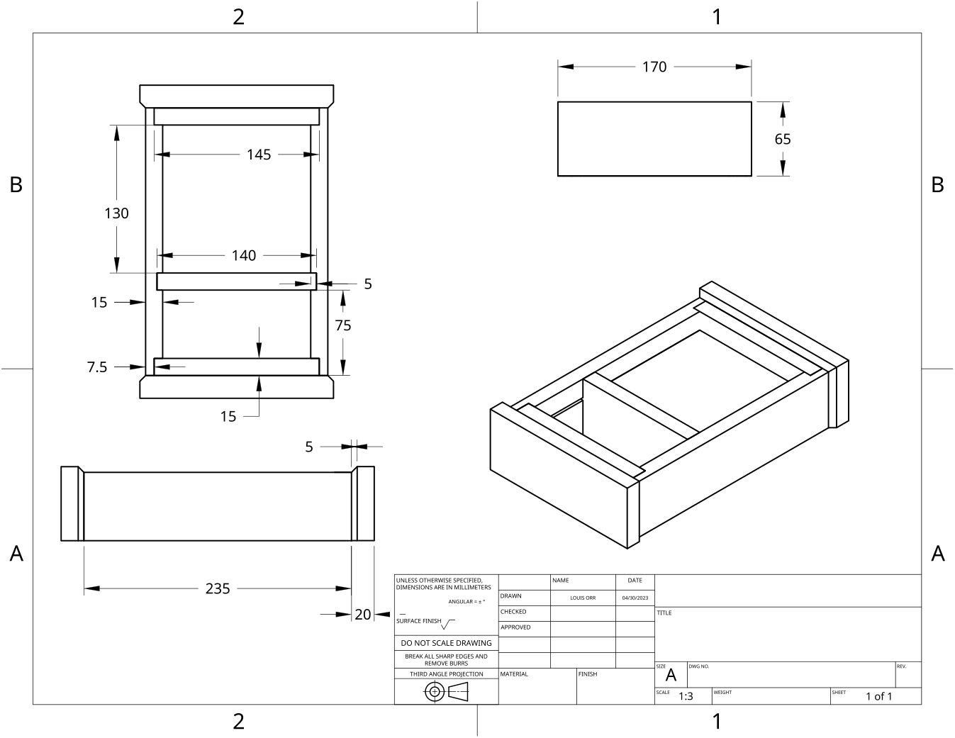
MODULE 10 OF 10 · WEEKS 19–20
Final quality, revision and reflection
Use the Clock drawing, the three theory sections and the module evidence in sequence.
Clock Guided Course

Slide 2
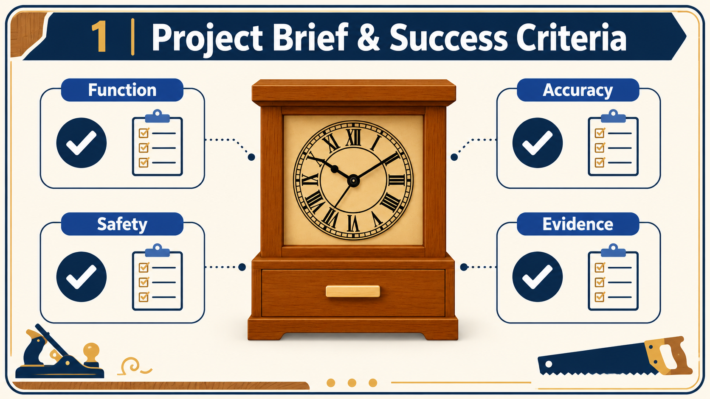
MODULE 10 OF 10 · WEEKS 19–20
Final quality assurance for the completed Clock
Final quality assurance, or QA, is the last systematic check before the Clock is declared complete. It is not a quick glance or a chance to hide faults.
Final quality assurance means checking the completed Clock in a deliberate order, testing both function and appearance, recording faults honestly and confirming that the physical project and…
2

Slide 3
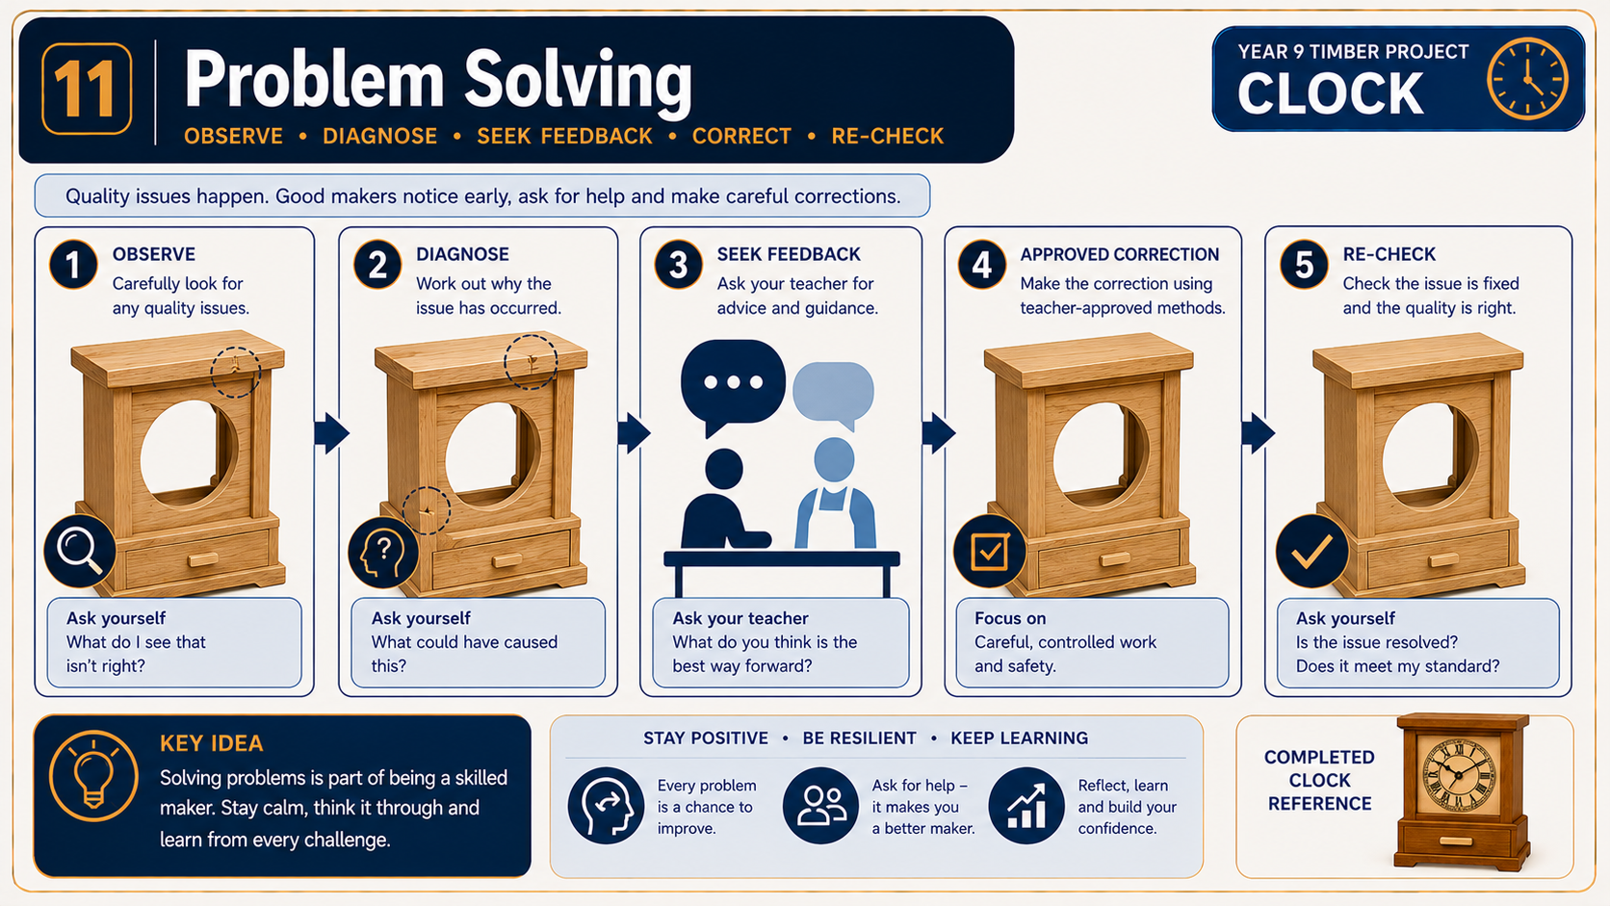
MODULE 10 OF 10 · WEEKS 19–20
Revising Clock theory and using feedback
Effective revision is not simply rereading notes or remembering which option was correct in a quiz. It means retrieving an idea from memory, checking it against accurate feedback and correcting any misunderstanding.
Useful revision retrieves knowledge, identifies the exact error, records the corrected idea and applies it to a specific Clock decision so the learning can transfer beyond one quiz question.
3

Slide 4
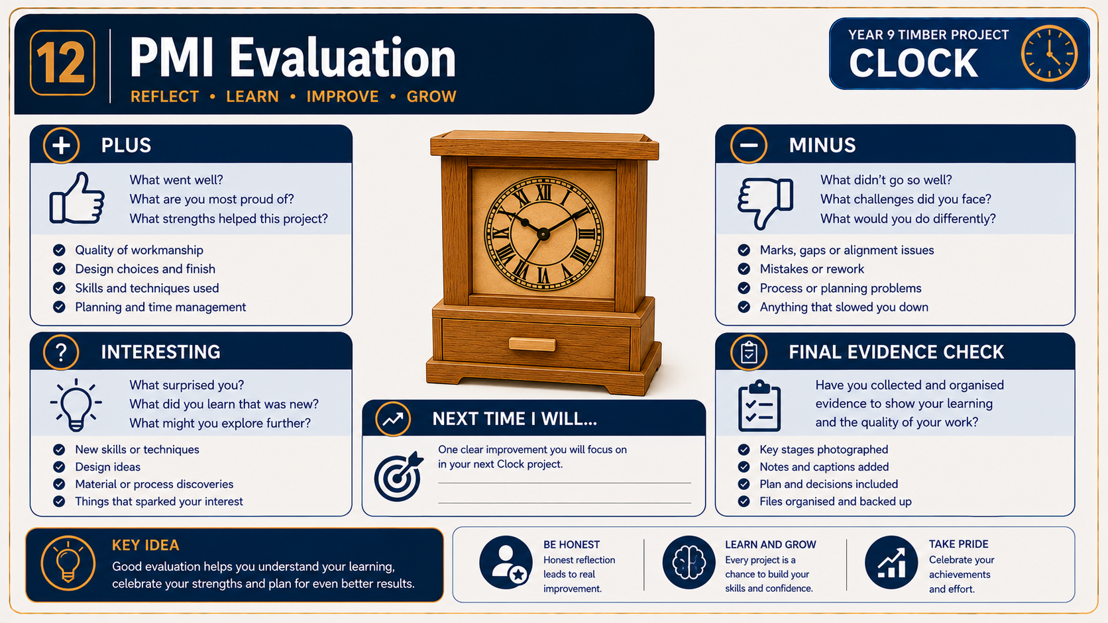
MODULE 10 OF 10 · WEEKS 19–20
Submission, reflection and transferable workshop skills
Completing the Clock is not the same as completing the submission. A finished project must be supported by a complete and organised hand-off of evidence.
A complete Clock submission combines an officially uploaded evidence file, a secure backup and an honest reflection that shows how specific planning, accuracy, safety, quality-checking and…
4

Slide 5
BEFORE YOU MOVE ON
Use these three Clock ideas to complete the Weeks 19–20 checks and evidence.
Complete the knowledge checks and written responses, then download your evidence as directed.
5

