Slide 1
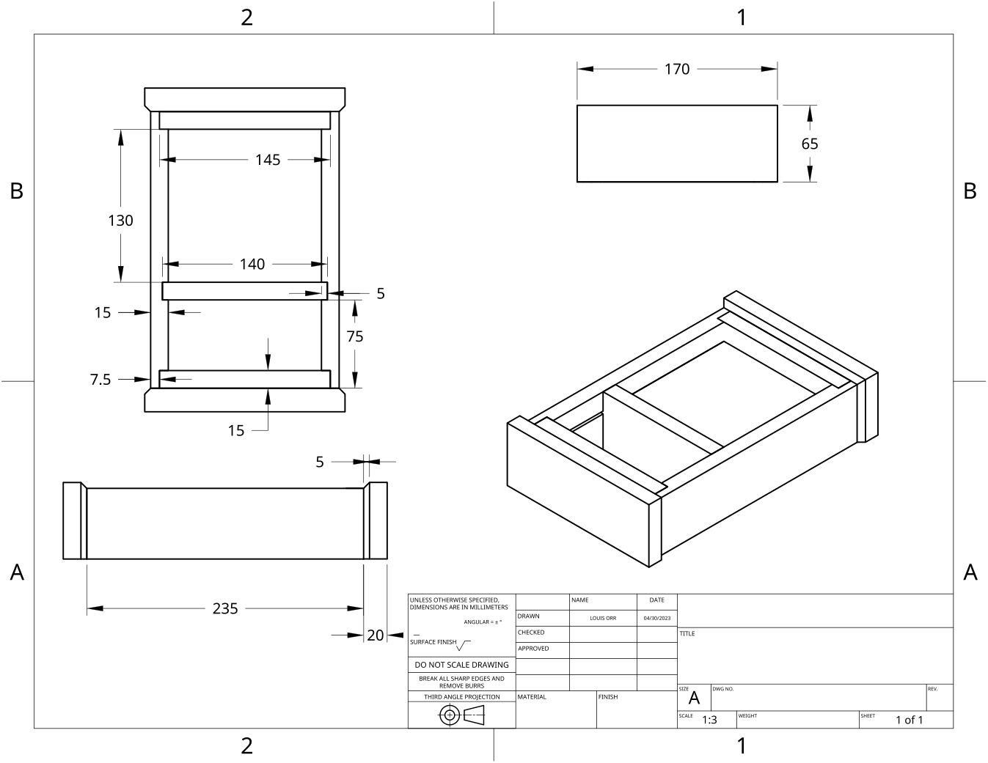
MODULE 2 OF 10 · WEEKS 3–4
Materials, WMS and cutting-list planning
Use the Clock drawing, the three theory sections and the module evidence in sequence.
Clock Guided Course

Slide 2
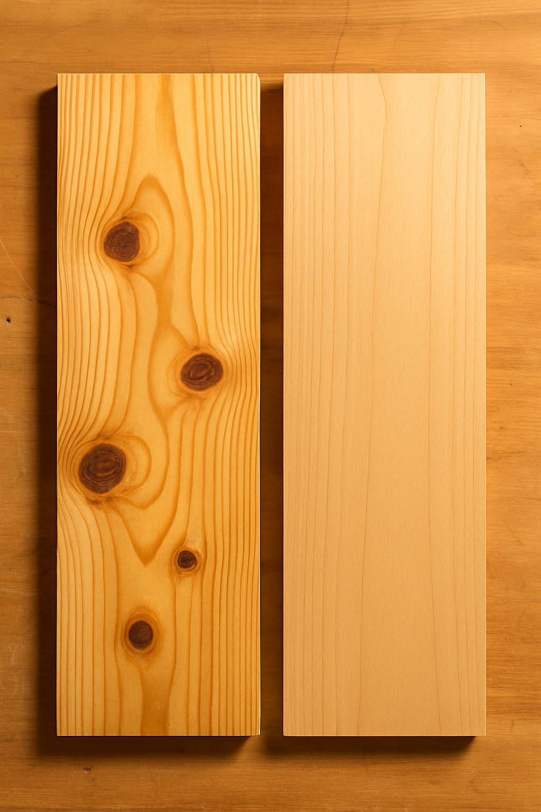
MODULE 2 OF 10 · WEEKS 3–4
Timber grain, structure and defects in Clock components
Timber is a natural material, so each piece has its own grain pattern, colour and features. Before a Clock component is marked out or shaped, the timber should be inspected carefully.
Inspect the grain, structure and defects before marking out so each Clock component is placed for strength, accurate fitting, good appearance and responsible material use.
2

Slide 3
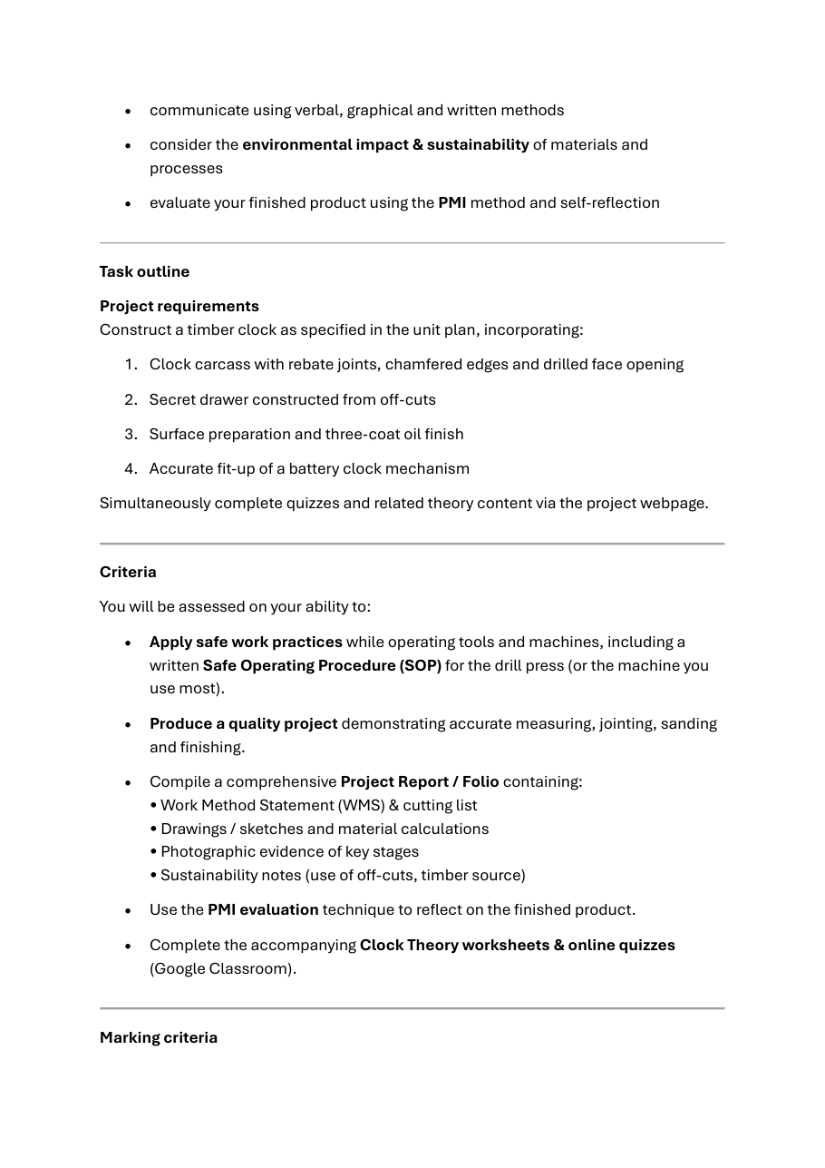
MODULE 2 OF 10 · WEEKS 3–4
Writing a Work Method Statement for the Clock
A Work Method Statement, or WMS, is a planned sequence showing how the Clock project will be completed safely, accurately and efficiently. It is more than a general list of workshop rules.
A strong WMS connects each Clock stage to its hazards, controls and quality checks, creating a clear path from the drawing to the completed project.
3

Slide 4
MODULE 2 OF 10 · WEEKS 3–4
Cutting lists, material calculations and cost planning
A cutting list turns the Clock working drawing into an organised record of the timber components required for the project. It identifies each component, its approved dimensions, the required quantity and any notes needed to distinguish it from similar parts.
A reliable cutting list links approved drawing information to quantities, material use and cost, while an honest planned-versus-actual record shows what really happened during the project.
4

Slide 5
BEFORE YOU MOVE ON
Use these three Clock ideas to complete the Weeks 3–4 checks and evidence.
Complete the knowledge checks and written responses, then download your evidence as directed.
5

