Slide 1
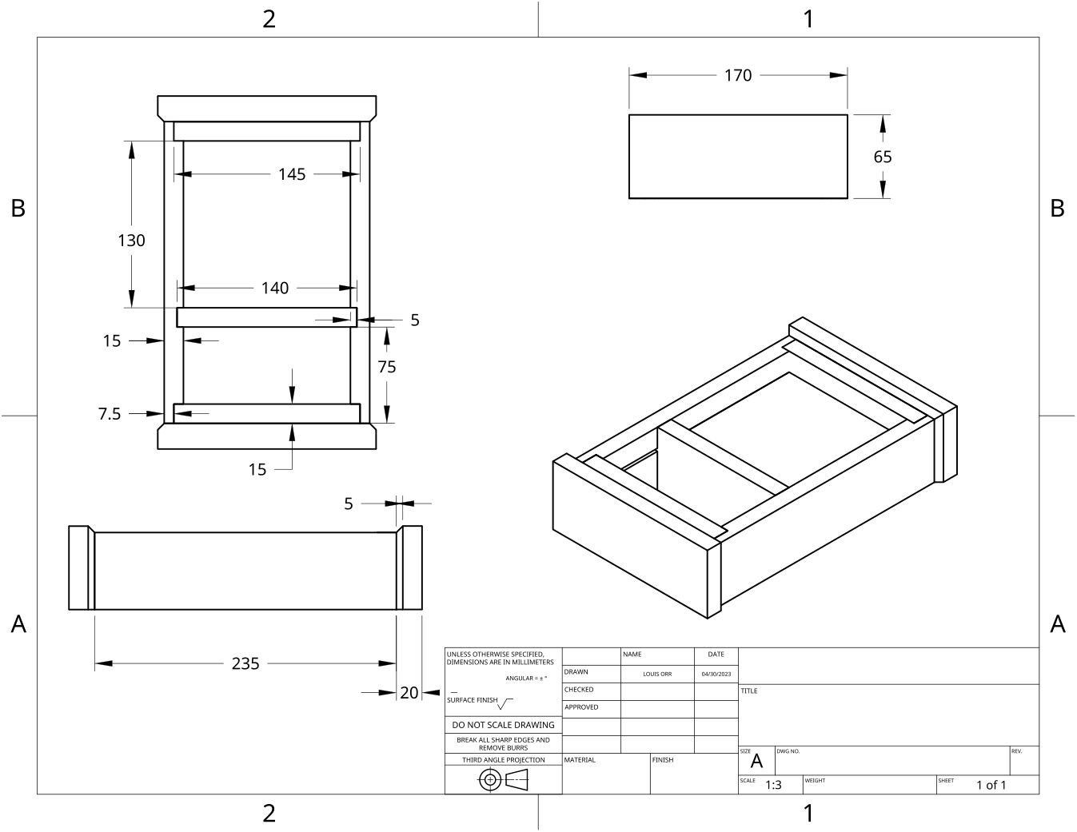
MODULE 3 OF 10 · WEEKS 5–6
Face opening, drill press SOP and tool care
Use the Clock drawing, the three theory sections and the module evidence in sequence.
Clock Guided Course

Slide 2
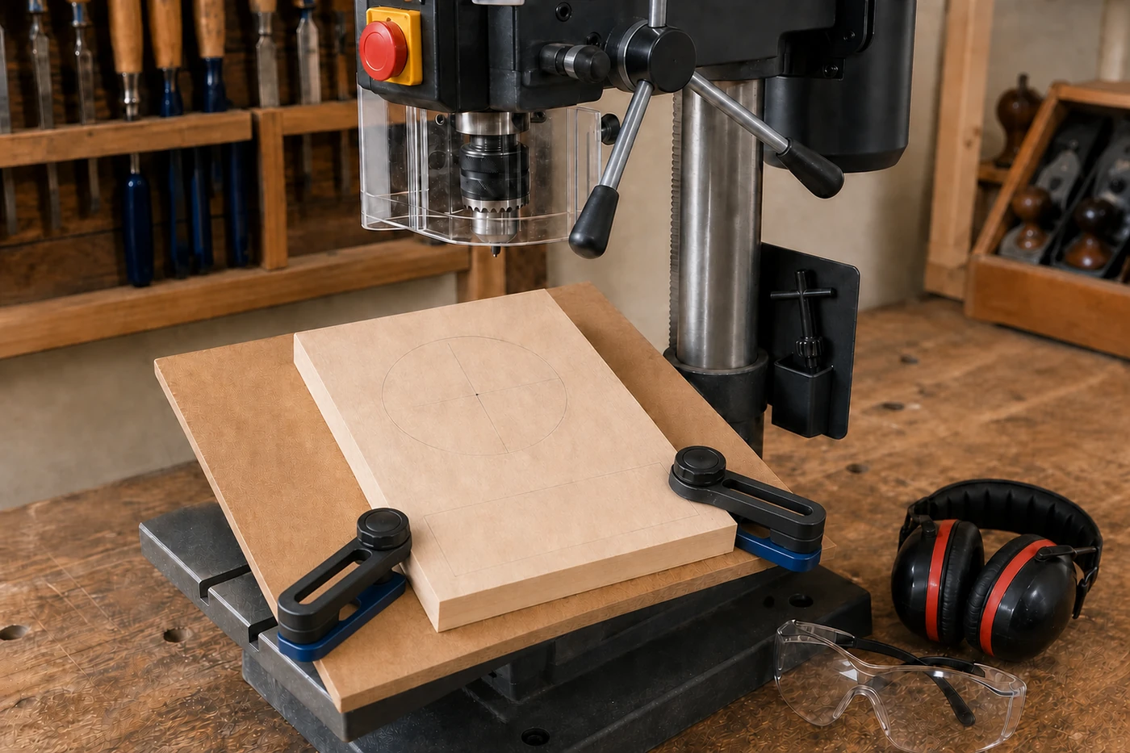
MODULE 3 OF 10 · WEEKS 5–6
Planning and drilling the Clock face opening
The Clock face opening must be positioned accurately because it affects both the appearance and function of the finished project. If the opening is off-centre, too close to an edge or incorrectly located, the clock mechanism may not fit as intended and the front face…
Accurate marking, secure work and strict use of the school SOP turn the Clock face opening from a risky guess into a controlled and assessable operation.
2

Slide 3
MODULE 3 OF 10 · WEEKS 5–6
Building an accurate drill press Safe Operating Procedure
A Safe Operating Procedure, or SOP, is a written guide that explains how a machine is prepared, used and left safely. It does more than list hazards. A useful SOP places information in a clear order so the operator can identify the machine, check the work area, confirm…
An SOP is accurate only when it reflects the actual school machine, approved controls and teacher-directed process; it must never be completed from memory or guesswork.
3

Slide 4
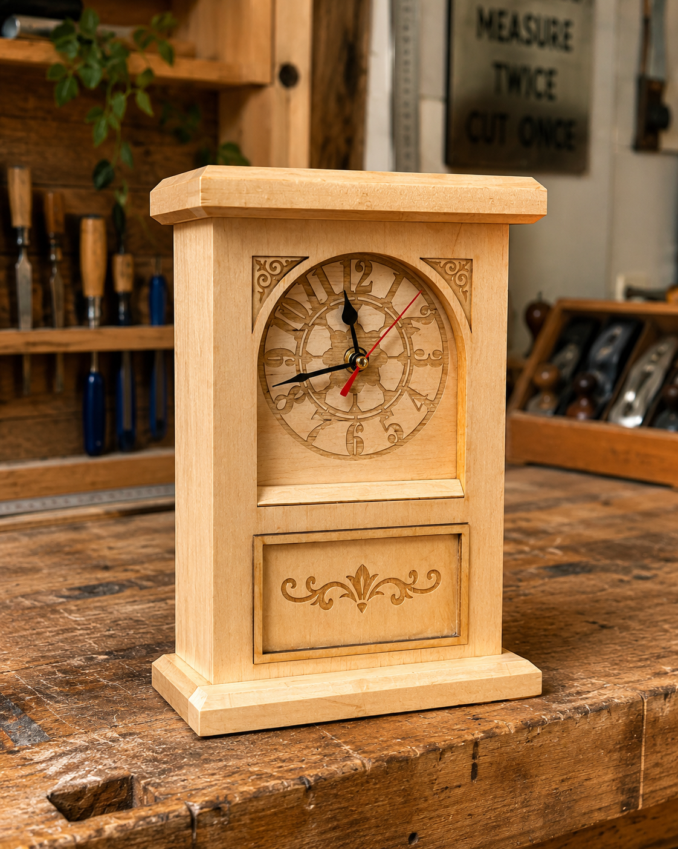
MODULE 3 OF 10 · WEEKS 5–6
Workshop housekeeping and care of Clock tools
Good workshop housekeeping is part of making an accurate and safe timber Clock. A crowded bench, loose off-cuts, dust and tools left in the wrong place can interfere with measuring, marking and checking components.
A tidy bench and well-cared-for tools improve safety, protect accuracy and leave the workshop ready for the next student.
4

Slide 5
BEFORE YOU MOVE ON
Use these three Clock ideas to complete the Weeks 5–6 checks and evidence.
Complete the knowledge checks and written responses, then download your evidence as directed.
5

