Slide 1
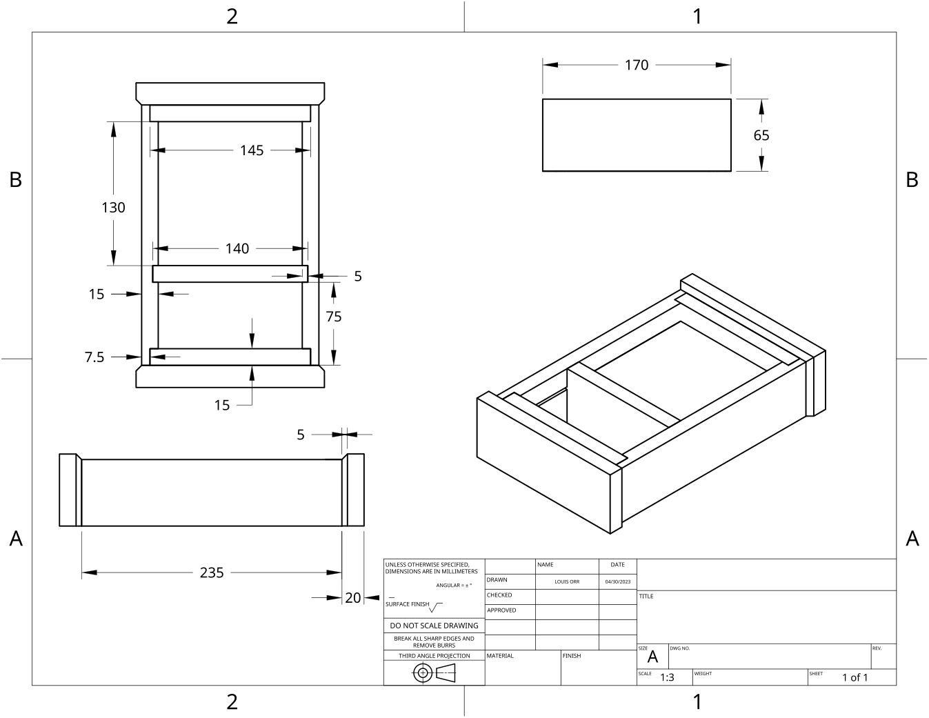
MODULE 4 OF 10 · WEEKS 7–8
Rebates, chamfers and carcass assembly
Use the Clock drawing, the three theory sections and the module evidence in sequence.
Clock Guided Course

Slide 2
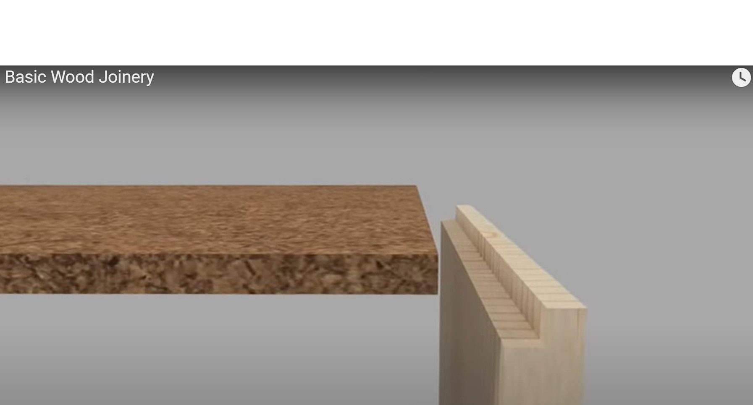
MODULE 4 OF 10 · WEEKS 7–8
Rebate joints in the Clock carcass
A rebate joint is formed by removing a rectangular step from the edge or end of a timber component. This creates a shoulder and a recessed surface that allows another component to sit partly inside it.
An accurate rebate joint depends on a correctly positioned shoulder, controlled depth and careful checking so the Clock carcass aligns properly and finishes flush.
2

Slide 3
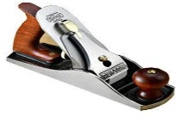
MODULE 4 OF 10 · WEEKS 7–8
Chamfered edges: controlled shaping and design effect
A chamfer is a flat, sloping surface formed by removing the sharp corner where two faces of a timber component meet. On the Clock project, chamfered edges are a required design feature.
A successful chamfer is shaped from accurate references, developed with controlled and grain-aware passes, and checked for straightness, symmetry and an even surface.
3

Slide 4
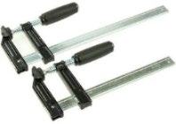
MODULE 4 OF 10 · WEEKS 7–8
Adhesive assembly, squareness and clamping
Accurate assembly begins before any adhesive is applied. A dry fit means bringing the Clock carcass components together without adhesive to check that the joints meet correctly. During this check, the parts should sit in their intended positions without being forced.
A successful Clock carcass assembly depends on a careful dry fit, clean mating surfaces, controlled adhesive application, balanced clamping and repeated checks for square before the assembly…
4

Slide 5
BEFORE YOU MOVE ON
Use these three Clock ideas to complete the Weeks 7–8 checks and evidence.
Complete the knowledge checks and written responses, then download your evidence as directed.
5

