Slide 1
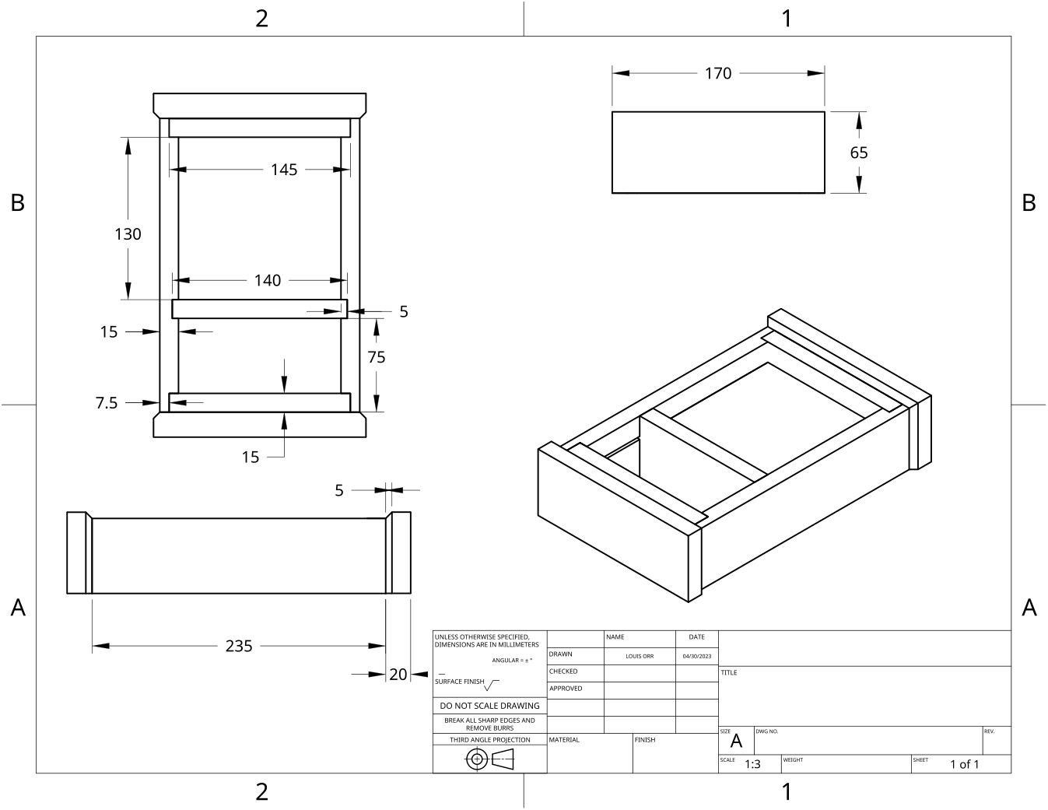
MODULE 5 OF 10 · WEEKS 9–10
Hidden drawer, off-cuts and fault diagnosis
Use the Clock drawing, the three theory sections and the module evidence in sequence.
Clock Guided Course

Slide 2
MODULE 5 OF 10 · WEEKS 9–10
The hidden drawer: accuracy, clearance and fit
The hidden drawer adds function and interest to the Clock, but it will only work well if its components are accurately prepared and assembled. Because the drawer is made from off-cuts, each piece must still be checked against the Clock drawing and the teacher-approved…
A well-fitted hidden drawer depends on accurate components, square assembly, consistent clearance and careful testing against the Clock drawing and approved cutting list.
2

Slide 3
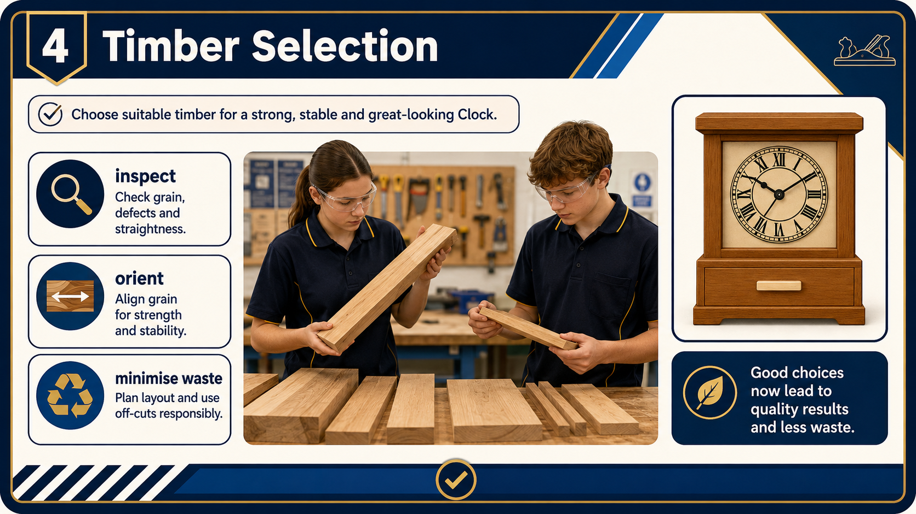
MODULE 5 OF 10 · WEEKS 9–10
Responsible material use and off-cut selection
The hidden drawer gives suitable timber off-cuts a useful purpose instead of treating them automatically as waste. An off-cut is a piece left after another component has been prepared.
Responsible material use means selecting sound, correctly sized off-cuts from approved information, not forcing unsuitable scraps into the project.
3

Slide 4
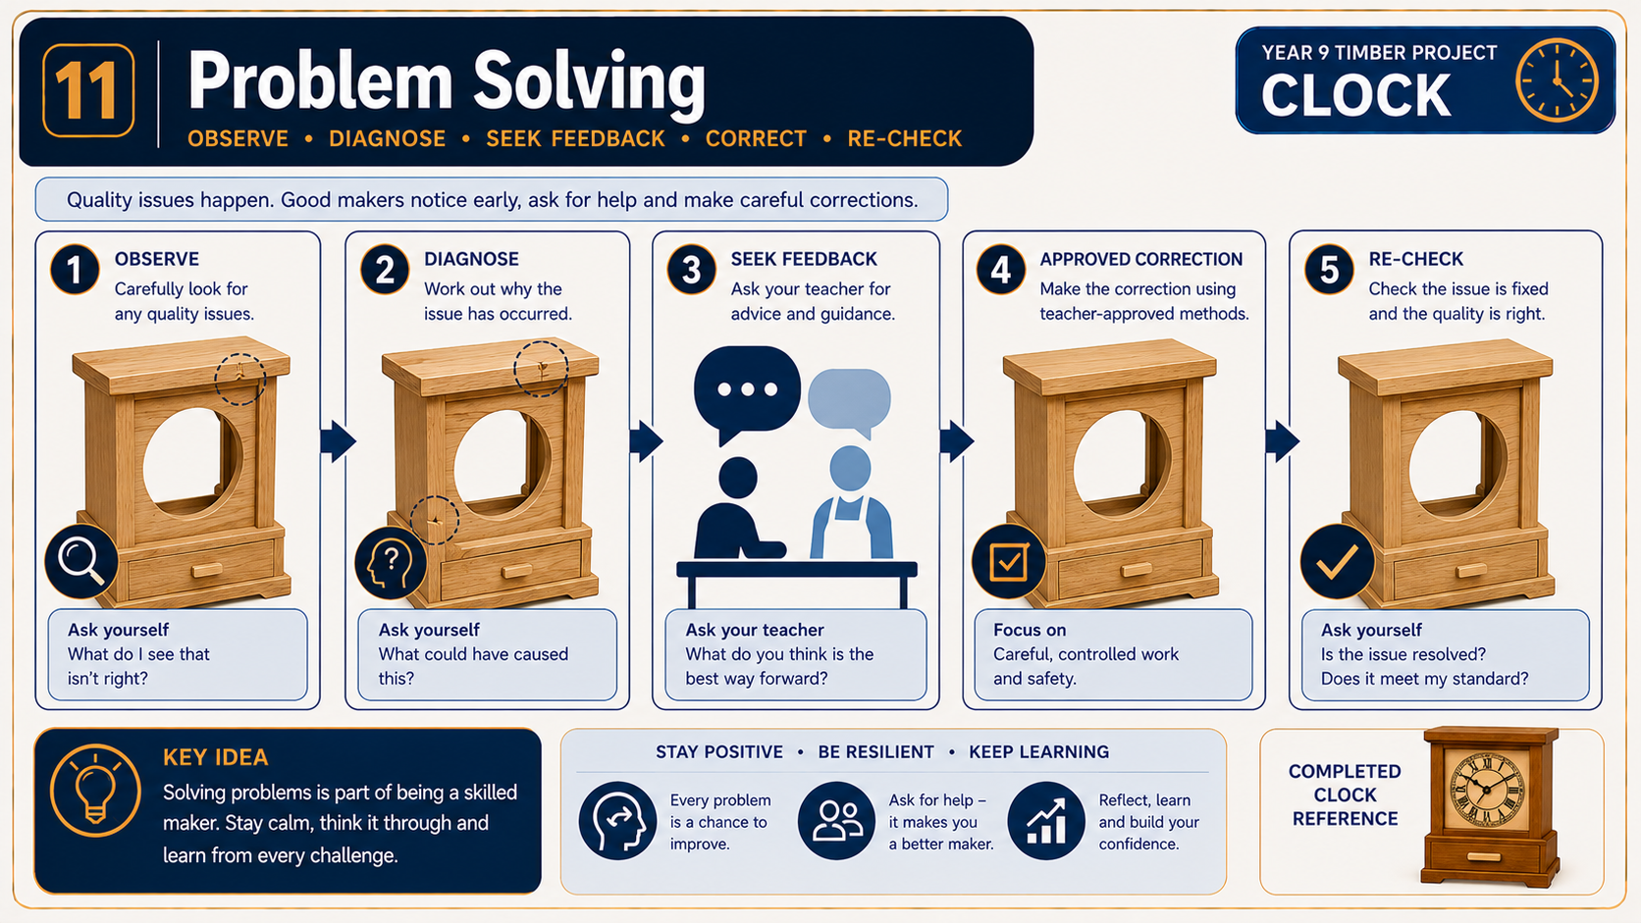
MODULE 5 OF 10 · WEEKS 9–10
Testing drawer fit and diagnosing faults
A hidden drawer must move smoothly, sit in the correct position and align neatly with the Clock. Testing the fit is not simply a matter of pushing the drawer in and deciding whether it works.
Diagnose the evidence before making a correction. Never force the drawer or remove material by guesswork.
4

Slide 5
BEFORE YOU MOVE ON
Use these three Clock ideas to complete the Weeks 9–10 checks and evidence.
Complete the knowledge checks and written responses, then download your evidence as directed.
5

