Slide 1
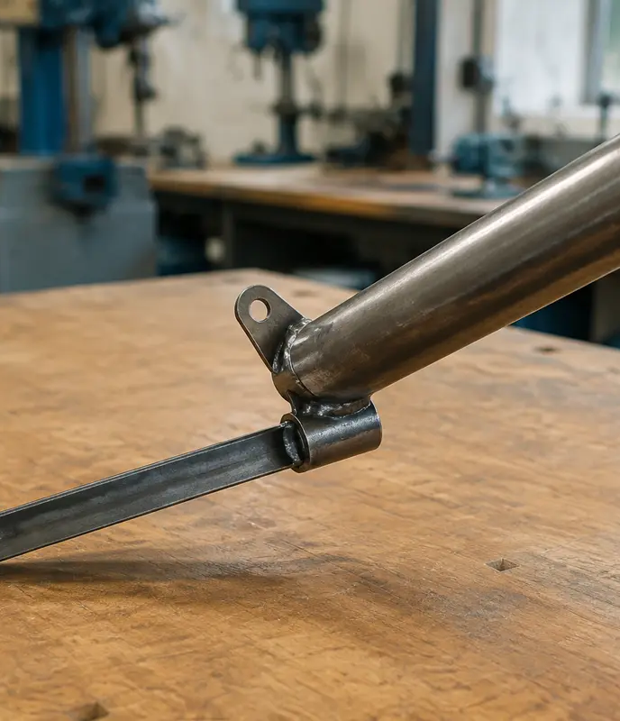
MODULE 2 · WEEKS 3–4
Fishing Rod Holder brief, materials and planning
Connect material properties to performance, then turn the Fishing Rod Holder brief and components drawing into a controlled production plan.
Presentation → theory → guided checks → written evidence

Slide 2
FISHING ROD HOLDER · MODULE 2
THEORY 1
Choose metal for the job
UNDERSTAND THE IDEA
APPLY IT TO THIS PROJECT
Metals are often grouped as ferrous or non-ferrous. Ferrous metals contain iron and are commonly strong and magnetic, but many can rust if left unprotected. Non-ferrous metals may offer lower mass, corrosion resistance or easier forming, depending on the metal. A property is a characteristic such as hardness, strength, ductility or corrosion resistance; performance describes how well the material works in its intended situation.
Choose material by matching properties to function, fabrication processes, corrosion exposure, availability and finish. A metal may perform well but still be unsuitable if it cannot be safely processed using the approved workshop equipment. Use the teacher-issued plan to identify the project-specific metal, then justify why its properties support the Fishing Rod Holder.
Link material properties to required performance and available processes.
Follow the teacher-issued fishing rod holder drawings, demonstrations and workshop instructions for every practical step.

Slide 3
FISHING ROD HOLDER · MODULE 2
THEORY 2
The Fishing Rod Holder brief and production context
UNDERSTAND THE IDEA
APPLY IT TO THIS PROJECT
The existing program identifies a Fishing Rod Holder, supported by the teacher-issued components drawing. The teacher-issued brief and plan define the exact requirements; this unit does not substitute its own geometry.
Separate requirements from preferences. Record the user, function, environment, approved materials and processes, then identify which evidence will demonstrate that the finished Fishing Rod Holder meets the brief.
Keep the project brief, drawing and production evidence connected.
Follow the teacher-issued fishing rod holder drawings, demonstrations and workshop instructions for every practical step.

Slide 4
FISHING ROD HOLDER · MODULE 2
THEORY 3
Design and project planning
UNDERSTAND THE IDEA
APPLY IT TO THIS PROJECT
Begin with the design brief, research relevant products, generate concept ideas and develop the approved direction. A working drawing communicates the information needed for production; a cutting list records the teacher-specified parts, material and dimensions.
A production plan sequences work, identifies checkpoints and notes demonstrations or permissions required. Review the plan when evidence shows a change is needed rather than improvising during an irreversible process.
Plans control production; folio evidence explains decisions.
Follow the teacher-issued fishing rod holder drawings, demonstrations and workshop instructions for every practical step.

Slide 5
FISHING ROD HOLDER · MODULE 2
THEORY 4
Read the Fishing Rod Holder components drawing
UNDERSTAND THE IDEA
APPLY IT TO THIS PROJECT
Begin by orienting the sheet so the title block and drawing title, “FISHING ROD HOLDER: COMPONENTS”, can be read normally. Scan the whole page before focusing on individual details. Identify the three named parts: ROD HOLDER, STAKE and ROTATION TAB. Then match each name to its related view or views by following the labels, shapes, dimensions and notes shown on the sheet. Because the drawing contains multiple views, do not assume two nearby shapes are separate parts until you have checked their labels and how the views relate.
Read the printed information for each component carefully. The ROD HOLDER is labelled 50 nb. pipe, 1 off; the STAKE is labelled Ø12 black bar, 1 off; and the ROTATION TAB is labelled 25 x 5 flat, 1 off. Check both the material label and the quantity because they help define what belongs in the project. The sheet is marked NOT TO SCALE, so never measure the page to work out a size. Use only the printed dimensions and written notes, and ask the teacher about anything unclear, missing or apparently conflicting.
Read, match, check and record before you mark.
Follow the teacher-issued fishing rod holder drawings, demonstrations and workshop instructions for every practical step.

Slide 6

FISHING ROD HOLDER · MODULE 2
SAVE EVIDENCE
Explain your thinking
Using the teacher-issued plans, identify the selected metal for one project part and justify the choice by referring to function, fabrication, corrosion, availability and finish.
Use your own project evidence. Save or print your response as directed by your teacher.
Complete the checks and written response on the course website.
Follow the teacher-issued fishing rod holder drawings, demonstrations and workshop instructions for every practical step.

