Slide 1
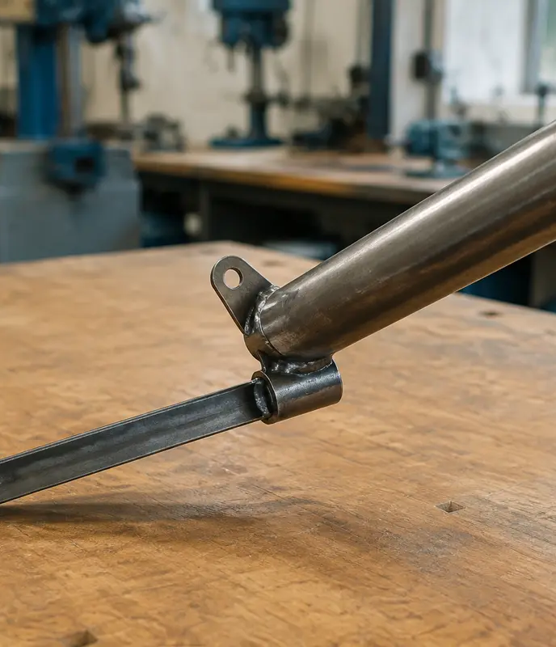
MODULE 3 · WEEKS 5–6
Mark, cut and form accurately
Establish reliable references, mark the waste side, secure the work and follow the demonstrated cutting and forming sequence.
Presentation → theory → guided checks → written evidence

Slide 2
FISHING ROD HOLDER · MODULE 3
THEORY 1
Accuracy before force
UNDERSTAND THE IDEA
APPLY IT TO THIS PROJECT
Accurate cutting and forming begin with accurate marking-out. A datum or reference edge provides one reliable starting point, so measurements and lines relate to the same known surface. Follow the teacher demonstration and issued plans for project-specific information. Before any cut or form, check that lines are clear, required features are identified and the waste side is marked correctly.
Secure the work using the approved method before cutting, drilling or forming. Do not use extra force to correct a poor line, wrong sequence or moving work. Stop and recheck the datum, waste side, orientation and planned next step. Force cannot repair information that was marked incorrectly at the start.
Datum, waste side, sequence and workholding come before force.
Follow the teacher-issued fishing rod holder drawings, demonstrations and workshop instructions for every practical step.

Slide 3
FISHING ROD HOLDER · MODULE 3
THEORY 2
Marking and measuring tools
UNDERSTAND THE IDEA
APPLY IT TO THIS PROJECT
Select the measuring and marking tools demonstrated for the feature: a steel rule or tape for suitable lengths, a square for perpendicular references, a scriber for clear layout lines and a centre punch for an approved hole location.
Measurement accuracy prevents wasted material. Read the issued dimension, work from the approved reference and complete an independent recheck before the material enters a cutting, drilling or forming setup.
The best cutting tool cannot rescue an incorrect line.
Follow the teacher-issued fishing rod holder drawings, demonstrations and workshop instructions for every practical step.

Slide 4
FISHING ROD HOLDER · MODULE 3
THEORY 3
Cutting and forming sequence
UNDERSTAND THE IDEA
APPLY IT TO THIS PROJECT
Use only the cutting or forming process shown for the material and feature. Support large or awkward material, keep hands outside the demonstrated danger zone and remove burrs using the approved process before passing work to the next stage.
Forming order can affect later dimensions, hole positions and access. Trial or check at the teacher-specified points, and record what changed rather than forcing a part to match.
Each irreversible step needs a check before and evidence after.
Follow the teacher-issued fishing rod holder drawings, demonstrations and workshop instructions for every practical step.

Slide 5
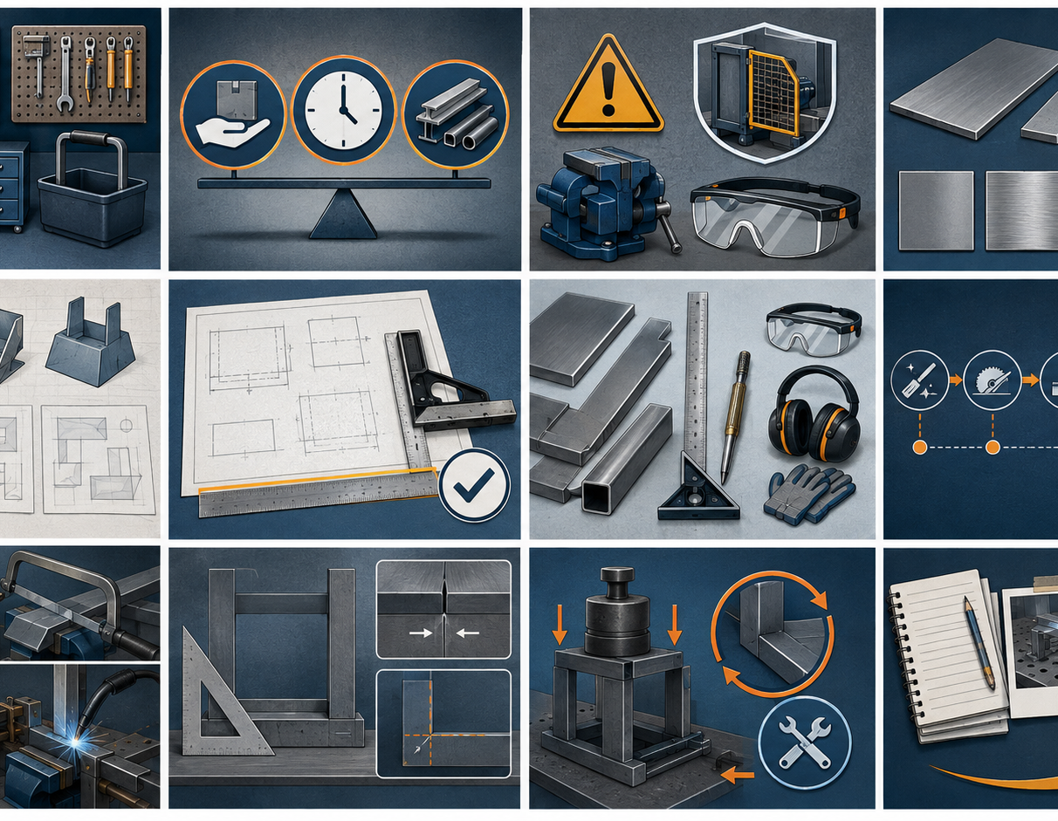
FISHING ROD HOLDER · MODULE 3
SAVE EVIDENCE
Explain your thinking
Explain how a datum edge, waste-side marking, planned sequence and secure workholding can improve the quality of a sheet-metal project.
Use your own project evidence. Save or print your response as directed by your teacher.
Complete the checks and written response on the course website.
Follow the teacher-issued fishing rod holder drawings, demonstrations and workshop instructions for every practical step.

