Slide 1
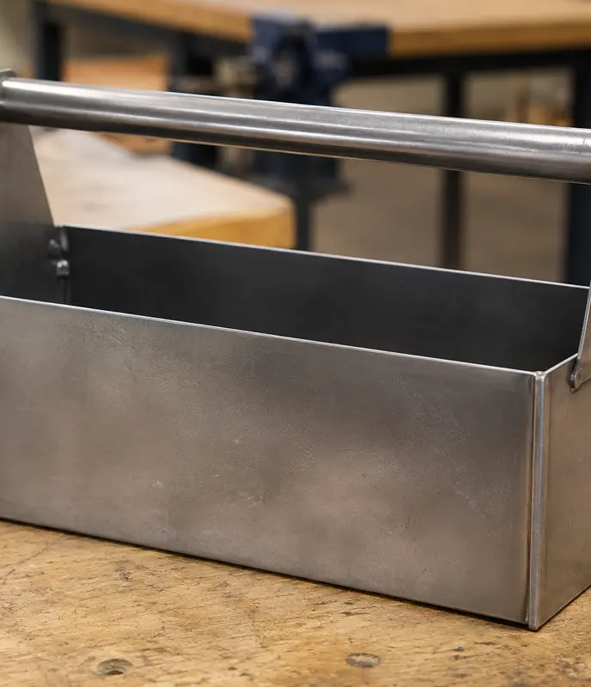
MODULE 1 · WEEKS 1–2
Workshop systems and risk management
Treat safety as a continuous process: identify hazards, judge risk, apply stronger controls and stop when conditions change.
Presentation → theory → guided checks → written evidence

Slide 2
SHEET-METAL TOOLBOX · MODULE 1
THEORY 1
Risk management is a process, not a poster
UNDERSTAND THE IDEA
APPLY IT TO THIS PROJECT
Risk management begins before any cutting, forming, drilling or assembly starts. First, identify hazards in the task, work area, material, tools and the behaviour of people nearby. Then consider how likely each hazard is to cause harm and how serious the consequence could be. A low-likelihood hazard with a severe possible injury still needs careful control. Use teacher-issued plans, classroom controls and demonstrations to decide what applies at each project stage.
Controls should follow the hierarchy: eliminate where possible, then substitute, isolate, use engineering controls, apply administrative controls and finally use personal protective equipment. PPE matters, but it is the final layer, not the whole plan. If a guard, material position, floor condition or work zone changes, stop, make the area safe and seek teacher direction before continuing.
Risk management is continuous: identify, assess, control and review.
Follow the teacher-issued sheet-metal toolbox drawings, demonstrations and workshop instructions for every practical step.

Slide 3
SHEET-METAL TOOLBOX · MODULE 1
THEORY 2
Safe workshop practices
UNDERSTAND THE IDEA
APPLY IT TO THIS PROJECT
A safe workshop begins with attention and housekeeping. Follow signage, return material to the correct storage area and keep benches and walkways clear of offcuts. Wear the PPE directed for the task, secure loose hair and clothing, and stay aware of others.
Machine permission applies to the trained person, approved machine, demonstrated setup and current task. Do not use a machine when tired, distracted, unsupervised or when the setup differs from the demonstration.
Good housekeeping removes hazards before PPE is needed.
Follow the teacher-issued sheet-metal toolbox drawings, demonstrations and workshop instructions for every practical step.

Slide 4
SHEET-METAL TOOLBOX · MODULE 1
THEORY 3
Incident response and reporting
UNDERSTAND THE IDEA
APPLY IT TO THIS PROJECT
If an incident or near miss occurs, stop work, make the immediate area safe and alert the teacher. Do not move equipment, material or an injured person unless directed or required to prevent further harm.
Report near misses as well as injuries. A near miss provides evidence that a control may have failed and allows the class to improve the system before someone is hurt.
Report the event, the conditions and the control that needs review.
Follow the teacher-issued sheet-metal toolbox drawings, demonstrations and workshop instructions for every practical step.

Slide 5
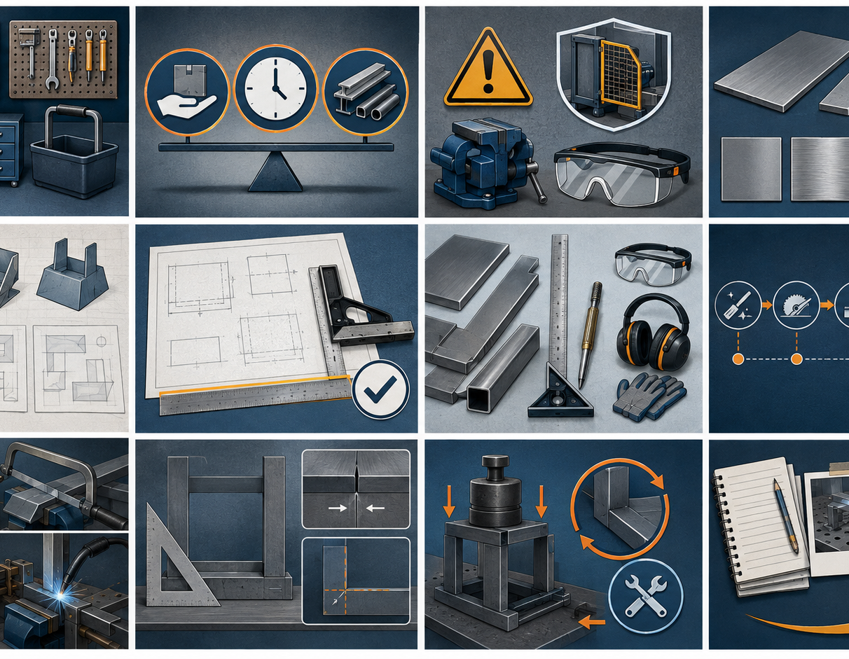
SHEET-METAL TOOLBOX · MODULE 1
SAVE EVIDENCE
Explain your thinking
Choose one stage from the teacher-issued project plans. Identify one possible hazard, describe its likelihood and consequence, and explain which hierarchy-of-controls measures should be used before work begins.
Use your own project evidence. Save or print your response as directed by your teacher.
Complete the checks and written response on the course website.
Follow the teacher-issued sheet-metal toolbox drawings, demonstrations and workshop instructions for every practical step.

