Slide 1
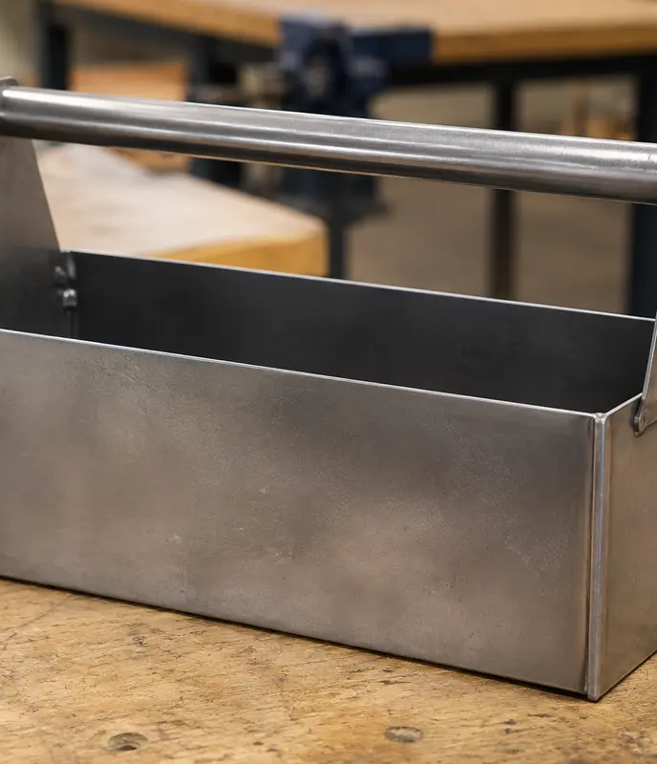
MODULE 2 · WEEKS 3–4
Toolbox brief, materials and planning
Connect material properties to performance, then read the Tool Carryall drawing and turn the approved Toolbox brief into a controlled production plan.
Presentation → theory → guided checks → written evidence

Slide 2
SHEET-METAL TOOLBOX · MODULE 2
THEORY 1
Choose metal for the job
UNDERSTAND THE IDEA
APPLY IT TO THIS PROJECT
Metals are often grouped as ferrous or non-ferrous. Ferrous metals contain iron and are commonly strong and magnetic, but many can rust if left unprotected. Non-ferrous metals may offer lower mass, corrosion resistance or easier forming, depending on the metal. A property is a characteristic such as hardness, strength, ductility or corrosion resistance; performance describes how well the material works in its intended situation.
Choose material by matching properties to function, fabrication processes, corrosion exposure, availability and finish. A metal may perform well but still be unsuitable if it cannot be safely processed using the approved workshop equipment. Use the teacher-issued plan to identify the project-specific metal, then justify why its properties support the Toolbox.
Link material properties to required performance and available processes.
Follow the teacher-issued sheet-metal toolbox drawings, demonstrations and workshop instructions for every practical step.

Slide 3
SHEET-METAL TOOLBOX · MODULE 2
THEORY 2
The Toolbox brief and production context
UNDERSTAND THE IDEA
APPLY IT TO THIS PROJECT
The existing program identifies a sheet-metal Toolbox, matching the teacher-issued drawing titled “TOOL CARRYALL DEVELOPMENT”. The teacher-issued brief and plan define the exact requirements; this unit does not substitute its own geometry.
Separate requirements from preferences. Record the user, function, environment, approved materials and processes, then identify which evidence will demonstrate that the finished Toolbox meets the brief.
Keep the project brief, drawing and production evidence connected.
Follow the teacher-issued sheet-metal toolbox drawings, demonstrations and workshop instructions for every practical step.

Slide 4
SHEET-METAL TOOLBOX · MODULE 2
THEORY 3
Design and project planning
UNDERSTAND THE IDEA
APPLY IT TO THIS PROJECT
Begin with the design brief, research relevant products, generate concept ideas and develop the approved direction. A working drawing communicates the information needed for production; a cutting list records the teacher-specified parts, material and dimensions.
A production plan sequences work, identifies checkpoints and notes demonstrations or permissions required. Review the plan when evidence shows a change is needed rather than improvising during an irreversible process.
Plans control production; folio evidence explains decisions.
Follow the teacher-issued sheet-metal toolbox drawings, demonstrations and workshop instructions for every practical step.

Slide 5
SHEET-METAL TOOLBOX · MODULE 2
THEORY 4
Read the Toolbox plan before marking out
UNDERSTAND THE IDEA
APPLY IT TO THIS PROJECT
Start by placing the teacher-issued A4 drawing so the title, “TOOL CARRYALL DEVELOPMENT”, reads normally and the views are upright. The website calls the matching project context “Sheet-metal Toolbox”; this is the website name, while the drawing title remains the source name. Scan the whole page before focusing on details. Locate the labels HANDLE, BODY and SIDE x 2, then match each label to the view that shows that part. Do not assume that the largest or simplest shape is a particular component; use the printed names and visible view information.
Next, trace the information for one part at a time. Begin with the BODY, then repeat the process for the HANDLE and the two SIDE pieces. Follow each dimension from its extension lines and arrows to the feature it controls. Identify the fold or edge lines shown in the view and distinguish them from the outside shape of the part. Check that you can explain which dimensions, lines and notes belong to each named component. Record anything that is unclear, incomplete or easy to confuse rather than filling gaps from memory or guessing.
Check the plan first; mark out only from confirmed information.
Follow the teacher-issued sheet-metal toolbox drawings, demonstrations and workshop instructions for every practical step.

Slide 6
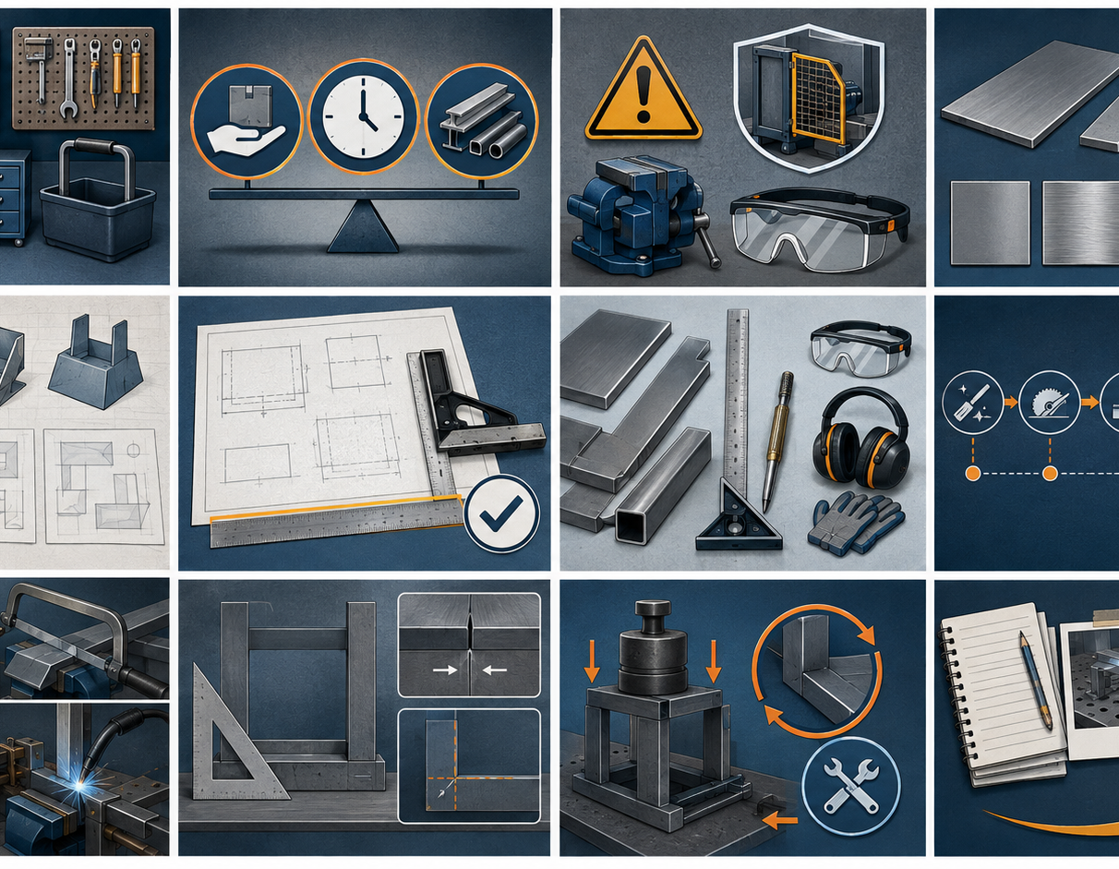
SHEET-METAL TOOLBOX · MODULE 2
SAVE EVIDENCE
Explain your thinking
Using the teacher-issued plans, identify the selected metal for one project part and justify the choice by referring to function, fabrication, corrosion, availability and finish.
Use your own project evidence. Save or print your response as directed by your teacher.
Complete the checks and written response on the course website.
Follow the teacher-issued sheet-metal toolbox drawings, demonstrations and workshop instructions for every practical step.

