Slide 1
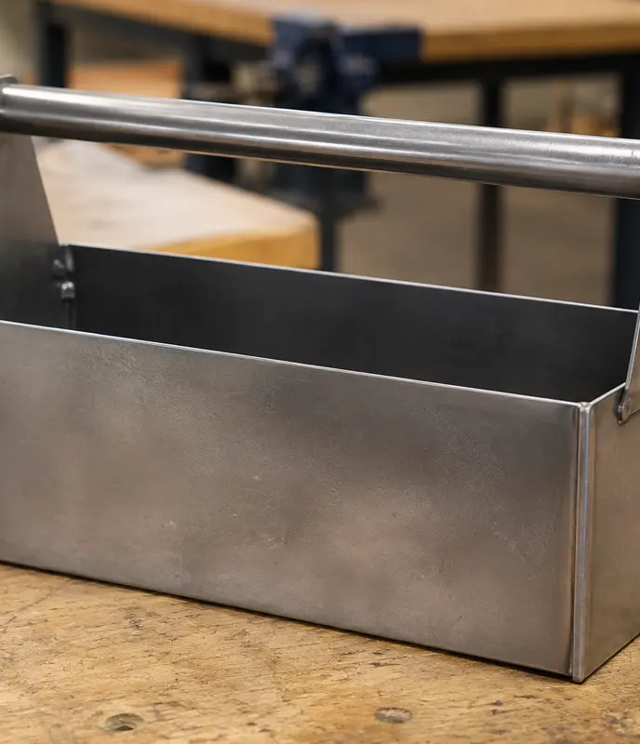
MODULE 4 · WEEKS 7–8
Join, machine and finish with purpose
Select and complete teacher-approved processes according to function, access, heat effects, appearance, corrosion and quality.
Presentation → theory → guided checks → written evidence

Slide 2
SHEET-METAL TOOLBOX · MODULE 4
THEORY 1
A joint is a design decision
UNDERSTAND THE IDEA
APPLY IT TO THIS PROJECT
A joining method should suit the job, not simply be familiar. Consider load, whether the connection must be permanent or removable, access to the joint, how heat could affect the metal or coating, and whether the finished joint must be neat or concealed. The plans, demonstrations and teacher permission determine which method is approved for each stage.
Appearance and corrosion also influence the decision. Before permanent joining, complete a trial fit using the demonstrated process. Check that parts meet correctly, edges align, holes or features match, and the assembly remains in position. Stop and seek direction if the fit or approved method is uncertain.
Select the joint, trial the fit, then make it permanent.
Follow the teacher-issued sheet-metal toolbox drawings, demonstrations and workshop instructions for every practical step.

Slide 3
SHEET-METAL TOOLBOX · MODULE 4
THEORY 2
Machining is permission-based
UNDERSTAND THE IDEA
APPLY IT TO THIS PROJECT
Drilling machines, lathes and other workshop machines require training, permission and the exact setup demonstrated by the teacher. The workpiece must be held using the approved device; hands are never a substitute for a vice, clamp, chuck or fixture.
Before starting, identify the stop control, remove setup tools such as chuck keys as directed, secure loose clothing and hair, and check the work zone. Stop immediately if sound, vibration, swarf behaviour or work position changes.
Permission does not carry across to a different machine, setup or task.
Follow the teacher-issued sheet-metal toolbox drawings, demonstrations and workshop instructions for every practical step.

Slide 4
SHEET-METAL TOOLBOX · MODULE 4
THEORY 3
Surface preparation and protection
UNDERSTAND THE IDEA
APPLY IT TO THIS PROJECT
A good finish begins with preparation. Treat burrs, scratches, scale, grease and dust using the approved classroom sequence. Protect prepared surfaces from contamination before the teacher-specified coating or finishing process.
Follow product labels, safety information and teacher direction for ventilation, PPE, application and curing. Record the actual product and process used; do not infer them from another project.
Finish quality and corrosion resistance depend on preparation.
Follow the teacher-issued sheet-metal toolbox drawings, demonstrations and workshop instructions for every practical step.

Slide 5
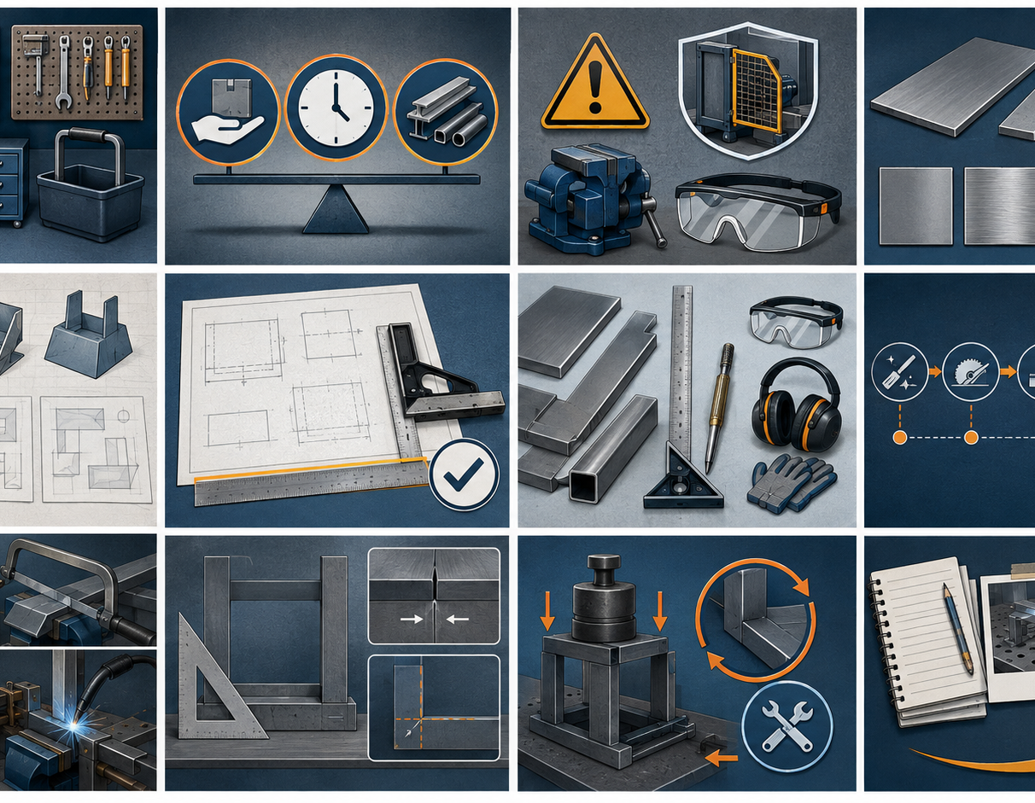
SHEET-METAL TOOLBOX · MODULE 4
SAVE EVIDENCE
Explain your thinking
Explain how load, permanence, access, heat effect, appearance and corrosion could influence a joining method. Include why a trial fit is needed.
Use your own project evidence. Save or print your response as directed by your teacher.
Complete the checks and written response on the course website.
Follow the teacher-issued sheet-metal toolbox drawings, demonstrations and workshop instructions for every practical step.

