Slide 1
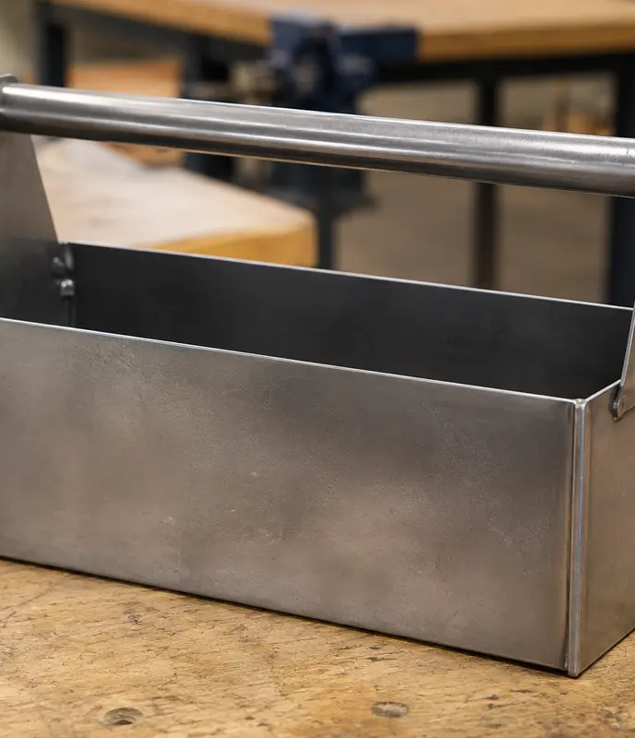
MODULE 5 · WEEKS 9–10
Technology, quality and evaluation
Compare processes by suitability, check quality throughout production and support the final evaluation with specific evidence.
Presentation → theory → guided checks → written evidence

Slide 2
SHEET-METAL TOOLBOX · MODULE 5
THEORY 1
Quality, technology and evaluation
UNDERSTAND THE IDEA
APPLY IT TO THIS PROJECT
Compare conventional and CNC processes by suitability, not by assuming newer technology is always better. Conventional processes can offer direct control, flexibility and skill development, while CNC can support repeatability and complex shapes when suitable digital information and equipment are available. The best choice depends on accuracy, quantity, material, resources and purpose.
Check quality throughout production using teacher-approved criteria. Evidence might include photographs, annotated sketches, measurements, trial fits and records of problems and corrections. A useful evaluation makes a specific judgement, supports it with evidence and identifies one realistic improvement.
Judge technology by suitability and evaluation by evidence.
Follow the teacher-issued sheet-metal toolbox drawings, demonstrations and workshop instructions for every practical step.

Slide 3
SHEET-METAL TOOLBOX · MODULE 5
THEORY 2
Current and emerging manufacturing
UNDERSTAND THE IDEA
APPLY IT TO THIS PROJECT
Computer numerical control uses programmed information to control machine movement. Depending on the equipment, digital design data can support repeatable parts and complex profiles, but it also requires validated files, correct setup, suitable material and trained supervision.
Laser, plasma, waterjet and CNC machining processes have different capabilities, limitations, costs and safety systems. Compare them using reliable evidence and the needs of the production context rather than promotional claims.
Advanced does not automatically mean appropriate.
Follow the teacher-issued sheet-metal toolbox drawings, demonstrations and workshop instructions for every practical step.

Slide 4
SHEET-METAL TOOLBOX · MODULE 5
THEORY 3
Folio and final evaluation
UNDERSTAND THE IDEA
APPLY IT TO THIS PROJECT
Organise evidence from the Toolbox project so the reader can follow the brief, research, planning, production, quality checks, problem solving and evaluation. Captions should explain what the evidence proves, not merely identify the photograph.
Compare the result with the teacher-approved criteria. Name specific strengths and limitations, cite the evidence, and propose one realistic change to the design, sequence, checking process or skill preparation.
A folio shows decisions and learning, not only finished products.
Follow the teacher-issued sheet-metal toolbox drawings, demonstrations and workshop instructions for every practical step.

Slide 5
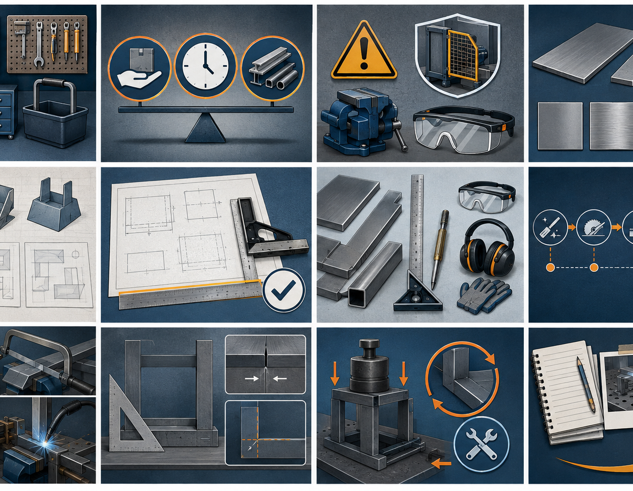
SHEET-METAL TOOLBOX · MODULE 5
SAVE EVIDENCE
Explain your thinking
Compare one conventional process with one CNC or emerging process by explaining when each would be suitable. Then evaluate one part of your project using specific evidence and identify one realistic improvement.
Use your own project evidence. Save or print your response as directed by your teacher.
Complete the checks and written response on the course website.
Follow the teacher-issued sheet-metal toolbox drawings, demonstrations and workshop instructions for every practical step.

