Slide 1
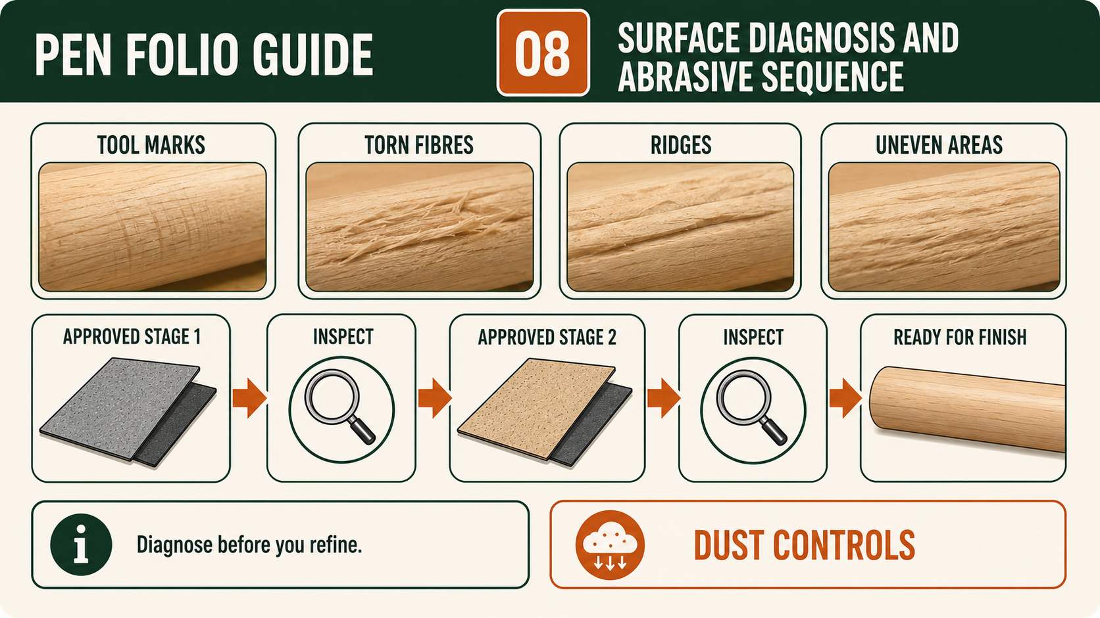
PEN
Weeks 11–12 · 1/8
Surface diagnosis, abrasives and finish
Weeks 11–12 guided learning
Read the theory. Check your understanding. Save useful evidence.
Notes:
Introduce the module purpose and connect it to the current project stage.
[Sources]
- Authorised local course theory: weeks11-12/index.html

Slide 2
PEN
Weeks 11–12 · 2/8
What you will learn
Use the module in order. Each idea supports the checks and written evidence that follow.
1
Diagnosing tool marks and surface defects before sanding
2
Using a progressive approved abrasive sequence
3
Selecting and applying the approved Pen finish from product information
Notes:
Preview the learning sequence without giving check answers.
[Sources]
- Authorised local course theory: weeks11-12/index.html

Slide 3
PEN
Weeks 11–12 · 3/8
Diagnosing tool marks and surface defects before sanding
Main idea
Inspecting the turned Pen bodies before sanding is a quality-control stage, not a quick transition between turning and finishing.
Check 2
The purpose is to identify visible defects while there is still an opportunity to understand them and seek an approved response.
Check 3
Sanding should refine a surface that has already been turned with control; it should not be treated as a way to erase every earlier mistake.
Return to the module page for the full explanation, visual and section video.
Notes:
Teach the source-grounded theory for Diagnosing tool marks and surface defects before sanding.
[Sources]
- Authorised local course theory: weeks11-12/index.html

Slide 4
PEN
Weeks 11–12 · 4/8
Using a progressive approved abrasive sequence
Main idea
Using a progressive approved abrasive sequence in the Pen project is about controlled refinement, not aggressive material removal.
Check 2
After the turning stage, the surface of the Pen bodies may show fine tool marks, slight ridges or variations that need to be reduced to achieve a consistent finish.
Check 3
The key principle is that each abrasive stage removes or refines the marks left by the previous stage.
Return to the module page for the full explanation, visual and section video.
Notes:
Teach the source-grounded theory for Using a progressive approved abrasive sequence.
[Sources]
- Authorised local course theory: weeks11-12/index.html

Slide 5
PEN
Weeks 11–12 · 5/8
Selecting and applying the approved Pen finish from…
Main idea
Selecting a finish for the Pen project is an evidence-based decision, not a matter of choosing the product with the most attractive container or the glossiest sample.
Check 2
The finish must be the actual product approved by the teacher for the supplied Pen project and current workshop conditions.
Check 3
Students read the product label, Safety Data Sheet, workshop SOP and teacher demonstration together because each source contributes different information.
Return to the module page for the full explanation, visual and section video.
Notes:
Teach the source-grounded theory for Selecting and applying the approved Pen finish from product information.
[Sources]
- Authorised local course theory: weeks11-12/index.html

Slide 6
PEN
Weeks 11–12 · 6/8
Pause and check your understanding
What is the controlling idea?
Diagnosing tool marks and surface defects before sanding
Which check would prevent a mistake?
Using a progressive approved abrasive sequence
What evidence would show your decision?
Selecting and applying the approved Pen finish from product information
Notes:
Use these prompts for retrieval before students open the interactive checks.
[Sources]
- Authorised local course theory: weeks11-12/index.html

Slide 7
PEN
Weeks 11–12 · 7/8
Build a stronger written response
Read
Underline the command word and the project detail.
Select
Return to the exact theory section and choose relevant evidence.
Explain
Connect the decision, reason and likely result.
Check
Make sure the response answers the question and stays source-accurate.
Notes:
Model the response process without supplying an answer to a live student question.
[Sources]
- Authorised local course theory: weeks11-12/index.html

Slide 8
PEN
Weeks 11–12 · 8/8
Exit ticket
Before you finish this module, answer these in your own words:
1. One idea I can now explain: Diagnosing tool marks and surface defects before sanding
2. One practical check I must remember before the next stage
3. One piece of evidence I should save or improve
Return to the module page to complete the checks, written response and folio evidence.
Notes:
Students complete the exit ticket, then return to the website to save evidence.
[Sources]
- Authorised local course theory: weeks11-12/index.html

