Slide 1
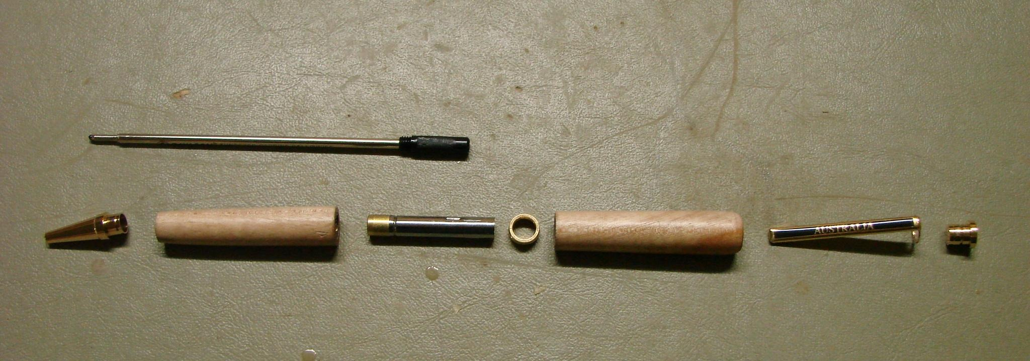
PEN
Weeks 13–14 · 1/8
Components, assembly and protection
Weeks 13–14 guided learning
Read the theory. Check your understanding. Save useful evidence.
Notes:
Introduce the module purpose and connect it to the current project stage.
[Sources]
- Authorised local course theory: weeks13-14/index.html

Slide 2
PEN
Weeks 13–14 · 2/8
What you will learn
Use the module in order. Each idea supports the checks and written evidence that follow.
1
Identifying and staging the Pen kit components for assembly
2
Assembling the clip/button and nib shroud in the approved sequence
3
Preventing misalignment and damage during Pen assembly
Notes:
Preview the learning sequence without giving check answers.
[Sources]
- Authorised local course theory: weeks13-14/index.html

Slide 3
PEN
Weeks 13–14 · 3/8
Identifying and staging the Pen kit components for…
Main idea
Identifying and staging the Pen kit components is a quality-control step completed before assembly begins.
Check 2
The approved Pen Making resource is the authoritative reference for recognising the supplied parts and understanding how they relate to the finished project.
Check 3
Verified components include the kit's clip/button and nib shroud, while the two finished timber bodies belong to one matched kit.
Return to the module page for the full explanation, visual and section video.
Notes:
Teach the source-grounded theory for Identifying and staging the Pen kit components for assembly.
[Sources]
- Authorised local course theory: weeks13-14/index.html

Slide 4
PEN
Weeks 13–14 · 4/8
Assembling the clip/button and nib shroud in the…
Main idea
Assembling the clip/button and nib shroud is a controlled Pen-making stage in which prepared kit components are joined to the finished timber bodies.
Check 2
The approved Pen Making resource confirms that these named components are part of the project, but it remains the authority for their actual orientation and sequence.
Check 3
The supplied kit information and teacher demonstration also control the approved pressing or support method and the criteria used to accept the completed result.
Return to the module page for the full explanation, visual and section video.
Notes:
Teach the source-grounded theory for Assembling the clip/button and nib shroud in the approved sequence.
[Sources]
- Authorised local course theory: weeks13-14/index.html

Slide 5
PEN
Weeks 13–14 · 5/8
Preventing misalignment and damage during Pen assembly
Main idea
Preventing misalignment and damage during Pen assembly relies on disciplined preparation and careful observation rather than force.
Check 2
The approved Pen Making resource, supplied kit information and teacher demonstration define how components are intended to meet.
Check 3
Students are responsible for checking that those conditions are present before and during assembly.
Return to the module page for the full explanation, visual and section video.
Notes:
Teach the source-grounded theory for Preventing misalignment and damage during Pen assembly.
[Sources]
- Authorised local course theory: weeks13-14/index.html

Slide 6
PEN
Weeks 13–14 · 6/8
Pause and check your understanding
What is the controlling idea?
Identifying and staging the Pen kit components for assembly
Which check would prevent a mistake?
Assembling the clip/button and nib shroud in the approved sequence
What evidence would show your decision?
Preventing misalignment and damage during Pen assembly
Notes:
Use these prompts for retrieval before students open the interactive checks.
[Sources]
- Authorised local course theory: weeks13-14/index.html

Slide 7
PEN
Weeks 13–14 · 7/8
Build a stronger written response
Read
Underline the command word and the project detail.
Select
Return to the exact theory section and choose relevant evidence.
Explain
Connect the decision, reason and likely result.
Check
Make sure the response answers the question and stays source-accurate.
Notes:
Model the response process without supplying an answer to a live student question.
[Sources]
- Authorised local course theory: weeks13-14/index.html

Slide 8
PEN
Weeks 13–14 · 8/8
Exit ticket
Before you finish this module, answer these in your own words:
1. One idea I can now explain: Identifying and staging the Pen kit components for assembly
2. One practical check I must remember before the next stage
3. One piece of evidence I should save or improve
Return to the module page to complete the checks, written response and folio evidence.
Notes:
Students complete the exit ticket, then return to the website to save evidence.
[Sources]
- Authorised local course theory: weeks13-14/index.html

