Slide 1
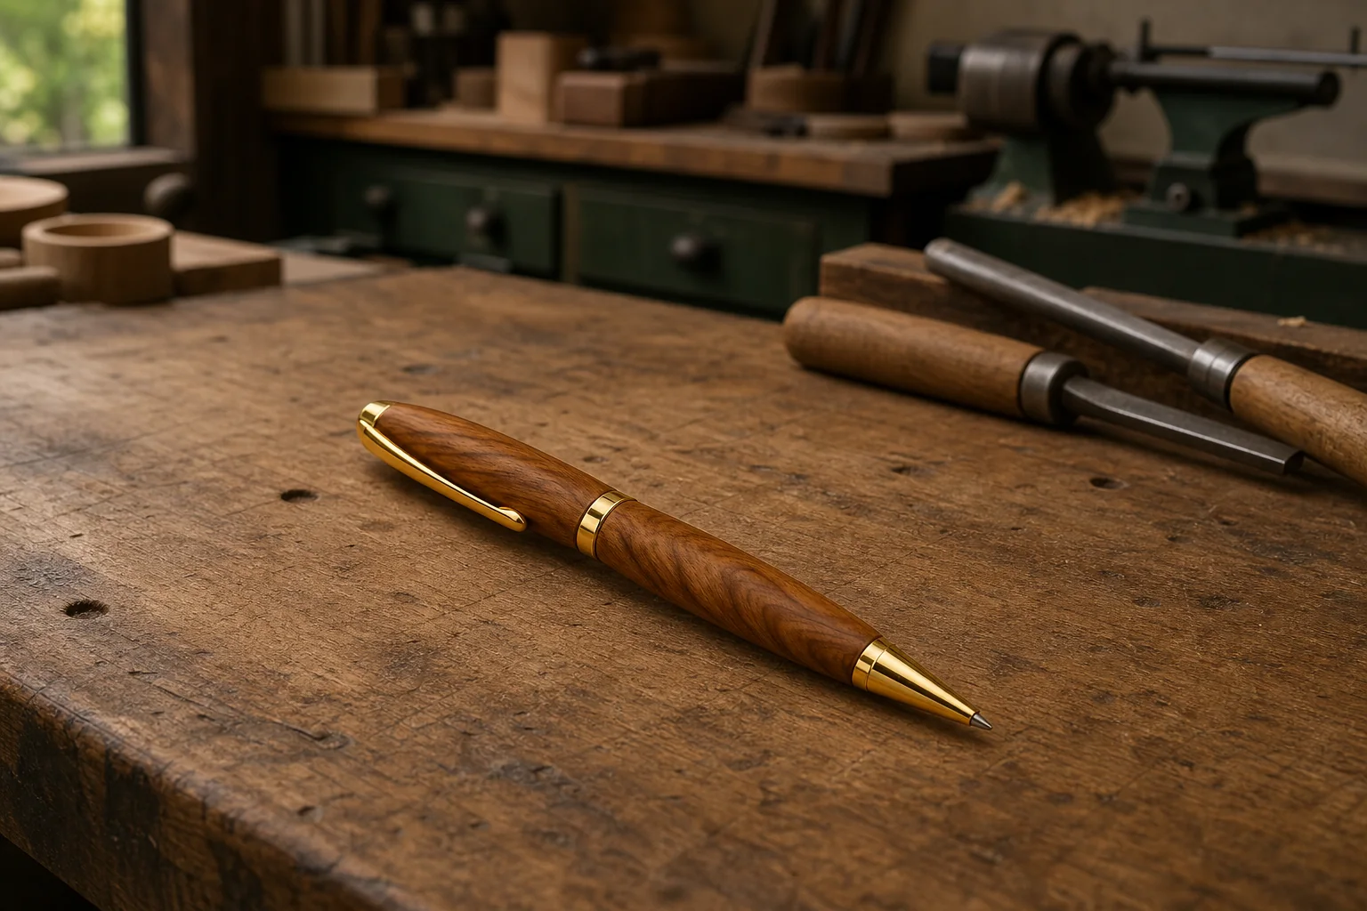
PEN
Weeks 15–16 · 1/8
Design, standards and production
Weeks 15–16 guided learning
Read the theory. Check your understanding. Save useful evidence.
Notes:
Introduce the module purpose and connect it to the current project stage.
[Sources]
- Authorised local course theory: weeks15-16/index.html

Slide 2
PEN
Weeks 15–16 · 2/8
What you will learn
Use the module in order. Each idea supports the checks and written evidence that follow.
1
Designing a comfortable and visually resolved Pen profile within kit…
2
Standards, quality control and production techniques in Pen manufacture
3
Comparing handcraft, jigs and repeat production technologies
Notes:
Preview the learning sequence without giving check answers.
[Sources]
- Authorised local course theory: weeks15-16/index.html

Slide 3
PEN
Weeks 15–16 · 3/8
Designing a comfortable and visually resolved Pen…
Main idea
Designing the Pen profile involves balancing function, appearance and the fixed requirements of the approved kit.
Check 2
A profile is the overall visible form of the two finished timber bodies, including how their surfaces change from one area to another.
Check 3
Students can make design decisions, but those decisions must remain feasible within the supplied kit references and teacher-approved process.
Return to the module page for the full explanation, visual and section video.
Notes:
Teach the source-grounded theory for Designing a comfortable and visually resolved Pen profile within kit constraints.
[Sources]
- Authorised local course theory: weeks15-16/index.html

Slide 4
PEN
Weeks 15–16 · 4/8
Standards, quality control and production techniques in…
Main idea
Standards in Pen manufacture are the agreed expectations used to judge whether the product and process are acceptable.
Check 2
In this school project, those expectations come from the supplied Pen Making resource, the approved kit information, teacher demonstrations, product information and…
Check 3
Students should not invent numerical tolerances, copy settings from another kit or assume that a visually similar Pen follows the same requirements.
Return to the module page for the full explanation, visual and section video.
Notes:
Teach the source-grounded theory for Standards, quality control and production techniques in Pen manufacture.
[Sources]
- Authorised local course theory: weeks15-16/index.html

Slide 5
PEN
Weeks 15–16 · 5/8
Comparing handcraft, jigs and repeat production…
Main idea
Manufacturing a Pen can be understood by comparing three approaches: skilled handcraft, teacherâ€‘approved jigs or workholding, and repeat production technologies…
Check 2
Each approach aims to produce a consistent, functional result, but they differ in how control is achieved, how decisions are made and how work is checked.
Check 3
In this school project, students mainly use handcraft skills supported by approved workholding and teacher guidance.
Return to the module page for the full explanation, visual and section video.
Notes:
Teach the source-grounded theory for Comparing handcraft, jigs and repeat production technologies.
[Sources]
- Authorised local course theory: weeks15-16/index.html

Slide 6
PEN
Weeks 15–16 · 6/8
Pause and check your understanding
What is the controlling idea?
Designing a comfortable and visually resolved Pen profile within kit constraints
Which check would prevent a mistake?
Standards, quality control and production techniques in Pen manufacture
What evidence would show your decision?
Comparing handcraft, jigs and repeat production technologies
Notes:
Use these prompts for retrieval before students open the interactive checks.
[Sources]
- Authorised local course theory: weeks15-16/index.html

Slide 7
PEN
Weeks 15–16 · 7/8
Build a stronger written response
Read
Underline the command word and the project detail.
Select
Return to the exact theory section and choose relevant evidence.
Explain
Connect the decision, reason and likely result.
Check
Make sure the response answers the question and stays source-accurate.
Notes:
Model the response process without supplying an answer to a live student question.
[Sources]
- Authorised local course theory: weeks15-16/index.html

Slide 8
PEN
Weeks 15–16 · 8/8
Exit ticket
Before you finish this module, answer these in your own words:
1. One idea I can now explain: Designing a comfortable and visually resolved Pen profile within kit…
2. One practical check I must remember before the next stage
3. One piece of evidence I should save or improve
Return to the module page to complete the checks, written response and folio evidence.
Notes:
Students complete the exit ticket, then return to the website to save evidence.
[Sources]
- Authorised local course theory: weeks15-16/index.html

