Slide 1
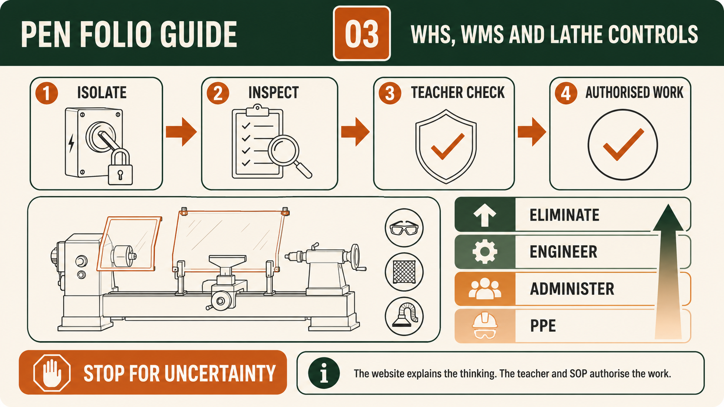
PEN
Weeks 17–18 · 1/8
WMS, process flow and impacts
Weeks 17–18 guided learning
Read the theory. Check your understanding. Save useful evidence.
Notes:
Introduce the module purpose and connect it to the current project stage.
[Sources]
- Authorised local course theory: weeks17-18/index.html

Slide 2
PEN
Weeks 17–18 · 2/8
What you will learn
Use the module in order. Each idea supports the checks and written evidence that follow.
1
Building a real Pen Work Method Statement
2
Creating the Pen production flowchart: inputs, processes and outputs
3
Explaining social and environmental impacts of Pen production and use
Notes:
Preview the learning sequence without giving check answers.
[Sources]
- Authorised local course theory: weeks17-18/index.html

Slide 3
PEN
Weeks 17–18 · 3/8
Building a real Pen Work Method Statement
Main idea
A Work Method Statement (WMS) for the Pen project is a practical plan that explains how the manufacture will be completed safely and in the correct sequence.
Check 2
It should show the real stages of this project, not a generic list that could belong to any workshop task.
Check 3
The assessment requires students to sequence Pen manufacture and identify the hazards and controls connected with that sequence.
Return to the module page for the full explanation, visual and section video.
Notes:
Teach the source-grounded theory for Building a real Pen Work Method Statement.
[Sources]
- Authorised local course theory: weeks17-18/index.html

Slide 4
PEN
Weeks 17–18 · 4/8
Creating the Pen production flowchart: inputs, processes…
Main idea
A Pen production flowchart is a visual explanation of how resources are transformed through an ordered series of processes into intended and unintended outputs.
Check 2
The assessment requires the flowchart to identify inputs, processes and outputs, while also allowing students to connect relevant social and environmental impacts.
Check 3
It should represent the approved Pen project accurately rather than filling gaps with guessed construction details.
Return to the module page for the full explanation, visual and section video.
Notes:
Teach the source-grounded theory for Creating the Pen production flowchart: inputs, processes and outputs.
[Sources]
- Authorised local course theory: weeks17-18/index.html

Slide 5
PEN
Weeks 17–18 · 5/8
Explaining social and environmental impacts of Pen…
Main idea
Social and environmental impacts are the effects that Pen production and use can have on people, communities, resources and natural systems.
Check 2
The assessment expects more than a claim that timber is sustainable or that handmade products are better.
Check 3
Students must connect each claim to evidence from the actual project and qualify anything that has not been verified.
Return to the module page for the full explanation, visual and section video.
Notes:
Teach the source-grounded theory for Explaining social and environmental impacts of Pen production and use.
[Sources]
- Authorised local course theory: weeks17-18/index.html

Slide 6
PEN
Weeks 17–18 · 6/8
Pause and check your understanding
What is the controlling idea?
Building a real Pen Work Method Statement
Which check would prevent a mistake?
Creating the Pen production flowchart: inputs, processes and outputs
What evidence would show your decision?
Explaining social and environmental impacts of Pen production and use
Notes:
Use these prompts for retrieval before students open the interactive checks.
[Sources]
- Authorised local course theory: weeks17-18/index.html

Slide 7
PEN
Weeks 17–18 · 7/8
Build a stronger written response
Read
Underline the command word and the project detail.
Select
Return to the exact theory section and choose relevant evidence.
Explain
Connect the decision, reason and likely result.
Check
Make sure the response answers the question and stays source-accurate.
Notes:
Model the response process without supplying an answer to a live student question.
[Sources]
- Authorised local course theory: weeks17-18/index.html

Slide 8
PEN
Weeks 17–18 · 8/8
Exit ticket
Before you finish this module, answer these in your own words:
1. One idea I can now explain: Building a real Pen Work Method Statement
2. One practical check I must remember before the next stage
3. One piece of evidence I should save or improve
Return to the module page to complete the checks, written response and folio evidence.
Notes:
Students complete the exit ticket, then return to the website to save evidence.
[Sources]
- Authorised local course theory: weeks17-18/index.html

