Slide 1
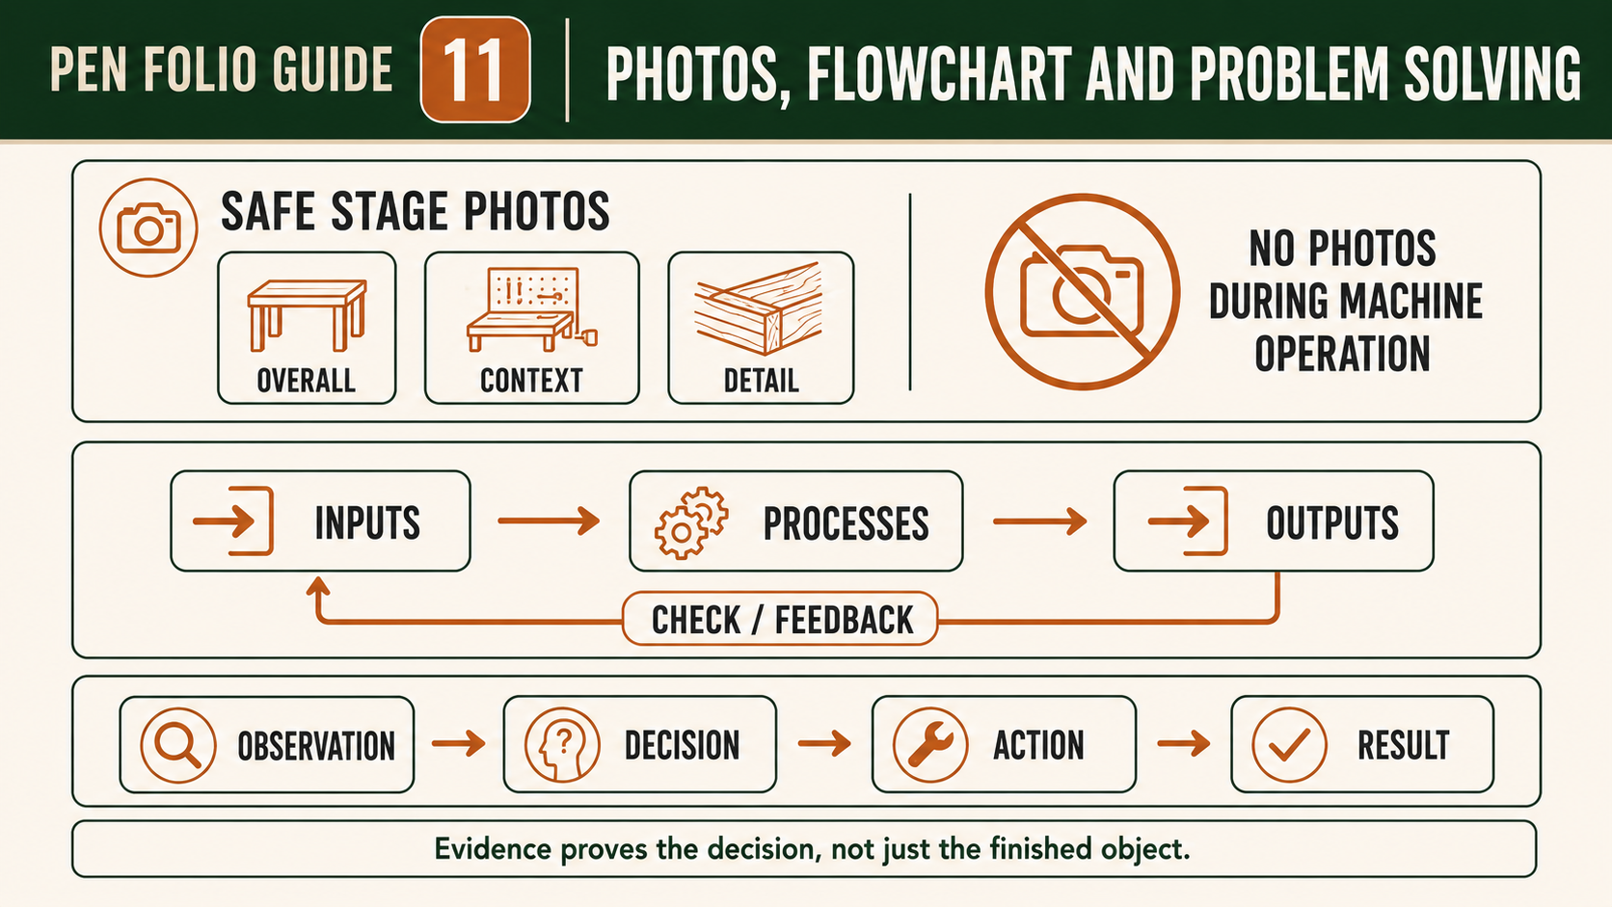
PEN
Weeks 19–20 · 1/8
Evidence, PMI and skill transfer
Weeks 19–20 guided learning
Read the theory. Check your understanding. Save useful evidence.
Notes:
Introduce the module purpose and connect it to the current project stage.
[Sources]
- Authorised local course theory: weeks19-20/index.html

Slide 2
PEN
Weeks 19–20 · 2/8
What you will learn
Use the module in order. Each idea supports the checks and written evidence that follow.
1
Photographing Pen stages and explaining problem solving
2
Using PMI to evaluate the completed Pen
3
Final reflection, evidence review and skill transfer
Notes:
Preview the learning sequence without giving check answers.
[Sources]
- Authorised local course theory: weeks19-20/index.html

Slide 3
PEN
Weeks 19–20 · 3/8
Photographing Pen stages and explaining problem solving
Main idea
Purposeful evidence photography records how the Pen developed, what decisions were made and how problems were managed.
Check 2
It is different from taking several attractive photographs after the project is complete.
Check 3
Final images can show the finished appearance, but they cannot reliably prove what happened during material selection, marking, drilling, turning, surface…
Return to the module page for the full explanation, visual and section video.
Notes:
Teach the source-grounded theory for Photographing Pen stages and explaining problem solving.
[Sources]
- Authorised local course theory: weeks19-20/index.html

Slide 4
PEN
Weeks 19–20 · 4/8
Using PMI to evaluate the completed Pen
Main idea
A PMI evaluation helps you make a balanced, evidence-based judgement about the completed Pen.
Check 2
PMI stands for Plus, Minus and Interesting.
Check 3
Plus identifies successful features and explains why they were successful.
Return to the module page for the full explanation, visual and section video.
Notes:
Teach the source-grounded theory for Using PMI to evaluate the completed Pen.
[Sources]
- Authorised local course theory: weeks19-20/index.html

Slide 5
PEN
Weeks 19–20 · 5/8
Final reflection, evidence review and skill transfer
Main idea
The final reflection brings together your Pen, your project report and all collected evidence to answer one question: do your claims match what actually happened?
Check 2
This is a verification step, not a place to add new content or guess missing details.
Check 3
Read your folio from start to finish and check that each statement is supported by a photograph, note, product label, teacher checkpoint or another reliable record.
Return to the module page for the full explanation, visual and section video.
Notes:
Teach the source-grounded theory for Final reflection, evidence review and skill transfer.
[Sources]
- Authorised local course theory: weeks19-20/index.html

Slide 6
PEN
Weeks 19–20 · 6/8
Pause and check your understanding
What is the controlling idea?
Photographing Pen stages and explaining problem solving
Which check would prevent a mistake?
Using PMI to evaluate the completed Pen
What evidence would show your decision?
Final reflection, evidence review and skill transfer
Notes:
Use these prompts for retrieval before students open the interactive checks.
[Sources]
- Authorised local course theory: weeks19-20/index.html

Slide 7
PEN
Weeks 19–20 · 7/8
Build a stronger written response
Read
Underline the command word and the project detail.
Select
Return to the exact theory section and choose relevant evidence.
Explain
Connect the decision, reason and likely result.
Check
Make sure the response answers the question and stays source-accurate.
Notes:
Model the response process without supplying an answer to a live student question.
[Sources]
- Authorised local course theory: weeks19-20/index.html

Slide 8
PEN
Weeks 19–20 · 8/8
Exit ticket
Before you finish this module, answer these in your own words:
1. One idea I can now explain: Photographing Pen stages and explaining problem solving
2. One practical check I must remember before the next stage
3. One piece of evidence I should save or improve
Return to the module page to complete the checks, written response and folio evidence.
Notes:
Students complete the exit ticket, then return to the website to save evidence.
[Sources]
- Authorised local course theory: weeks19-20/index.html

