Slide 1
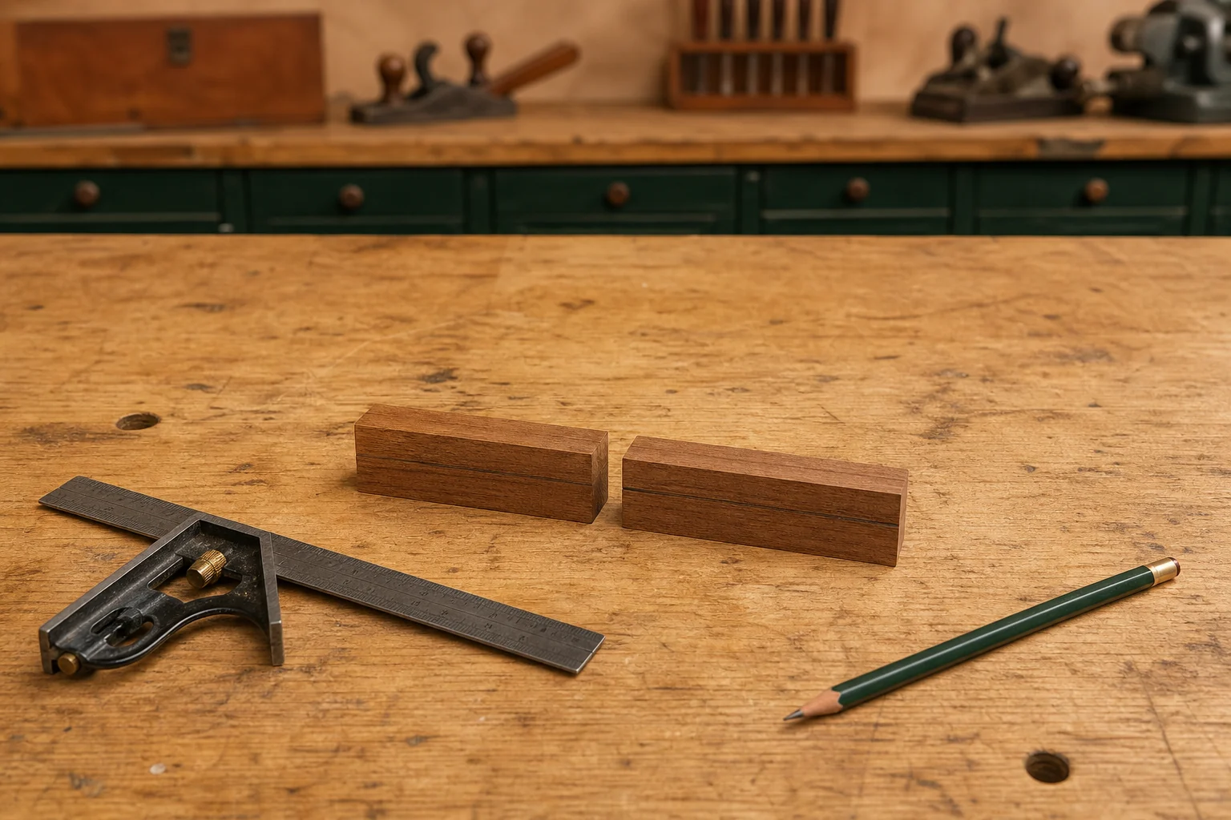
PEN
Weeks 3–4 · 1/8
Timber, grain and responsible planning
Weeks 3–4 guided learning
Read the theory. Check your understanding. Save useful evidence.
Notes:
Introduce the module purpose and connect it to the current project stage.
[Sources]
- Authorised local course theory: weeks3-4/index.html

Slide 2
PEN
Weeks 3–4 · 2/8
What you will learn
Use the module in order. Each idea supports the checks and written evidence that follow.
1
Selecting and inspecting timber for the Pen blank
2
Using grain orientation to keep the two Pen bodies visually connected
3
Planning responsible material use and the Pen cutting list
Notes:
Preview the learning sequence without giving check answers.
[Sources]
- Authorised local course theory: weeks3-4/index.html

Slide 3
PEN
Weeks 3–4 · 3/8
Selecting and inspecting timber for the Pen blank
Main idea
Selecting suitable timber is the first quality decision in the Pen project.
Check 2
The approved process begins with timber greater than 110 mm long Ã— 20 mm Ã— 20 mm, but this starting requirement does not define the final product or justify…
Check 3
It simply sets a minimum size for preparation.
Return to the module page for the full explanation, visual and section video.
Notes:
Teach the source-grounded theory for Selecting and inspecting timber for the Pen blank.
[Sources]
- Authorised local course theory: weeks3-4/index.html

Slide 4
PEN
Weeks 3–4 · 4/8
Using grain orientation to keep the two Pen bodies…
Main idea
Grain orientation helps the two timber bodies of the Pen appear as parts of one coordinated design rather than as unrelated pieces.
Check 2
Grain is the general direction of the timber fibres, while figure is the visible pattern produced by features such as colour variation, lines and natural changes in…
Check 3
When the two prepared parts are kept in their intended relationship, parts of this pattern may appear to continue from one body to the other.
Return to the module page for the full explanation, visual and section video.
Notes:
Teach the source-grounded theory for Using grain orientation to keep the two Pen bodies visually connected.
[Sources]
- Authorised local course theory: weeks3-4/index.html

Slide 5
PEN
Weeks 3–4 · 5/8
Planning responsible material use and the Pen cutting list
Main idea
Planning responsible material use begins with understanding what the cutting list communicates in the Pen project.
Check 2
A cutting list is not a guess or a set of invented sizes; it is a clear, organised record of the components you intend to prepare, using only verified information.
Check 3
For this project, the only confirmed starting stock size is timber greater than 110 mm long Ã— 20 mm Ã— 20 mm.
Return to the module page for the full explanation, visual and section video.
Notes:
Teach the source-grounded theory for Planning responsible material use and the Pen cutting list.
[Sources]
- Authorised local course theory: weeks3-4/index.html

Slide 6
PEN
Weeks 3–4 · 6/8
Pause and check your understanding
What is the controlling idea?
Selecting and inspecting timber for the Pen blank
Which check would prevent a mistake?
Using grain orientation to keep the two Pen bodies visually connected
What evidence would show your decision?
Planning responsible material use and the Pen cutting list
Notes:
Use these prompts for retrieval before students open the interactive checks.
[Sources]
- Authorised local course theory: weeks3-4/index.html

Slide 7
PEN
Weeks 3–4 · 7/8
Build a stronger written response
Read
Underline the command word and the project detail.
Select
Return to the exact theory section and choose relevant evidence.
Explain
Connect the decision, reason and likely result.
Check
Make sure the response answers the question and stays source-accurate.
Notes:
Model the response process without supplying an answer to a live student question.
[Sources]
- Authorised local course theory: weeks3-4/index.html

Slide 8
PEN
Weeks 3–4 · 8/8
Exit ticket
Before you finish this module, answer these in your own words:
1. One idea I can now explain: Selecting and inspecting timber for the Pen blank
2. One practical check I must remember before the next stage
3. One piece of evidence I should save or improve
Return to the module page to complete the checks, written response and folio evidence.
Notes:
Students complete the exit ticket, then return to the website to save evidence.
[Sources]
- Authorised local course theory: weeks3-4/index.html

