Slide 1
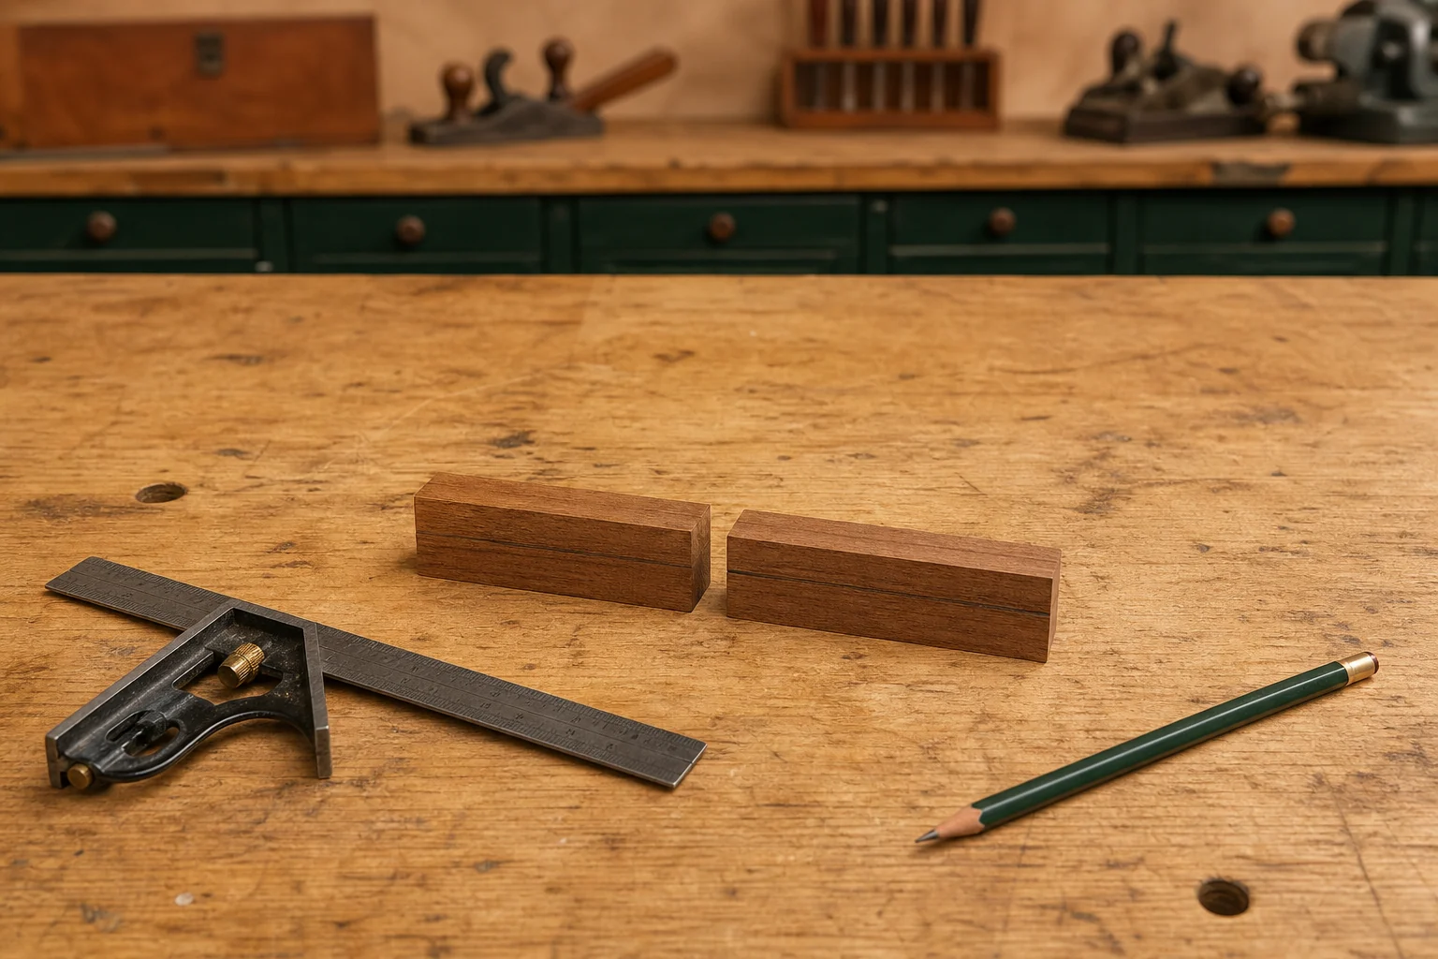
PEN
Weeks 5–6 · 1/8
Marking, sleeves and clean drilling
Weeks 5–6 guided learning
Read the theory. Check your understanding. Save useful evidence.
Notes:
Introduce the module purpose and connect it to the current project stage.
[Sources]
- Authorised local course theory: weeks5-6/index.html

Slide 2
PEN
Weeks 5–6 · 2/8
What you will learn
Use the module in order. Each idea supports the checks and written evidence that follow.
1
Marking the Pen billet and preserving reliable references
2
Preparing the two brass sleeves for the approved Pen kit
3
Drilling clean Pen blank holes and clearing swarf
Notes:
Preview the learning sequence without giving check answers.
[Sources]
- Authorised local course theory: weeks5-6/index.html

Slide 3
PEN
Weeks 5–6 · 3/8
Marking the Pen billet and preserving reliable references
Main idea
Marking the Pen billet establishes the references that guide every later decision.
Check 2
At this stage you are not creating a set of cutting dimensions; you are creating reliable information that helps you keep parts identified and aligned.
Check 3
The verified requirement is to place a mark along the timber length that crosses the centre.
Return to the module page for the full explanation, visual and section video.
Notes:
Teach the source-grounded theory for Marking the Pen billet and preserving reliable references.
[Sources]
- Authorised local course theory: weeks5-6/index.html

Slide 4
PEN
Weeks 5–6 · 4/8
Preparing the two brass sleeves for the approved Pen kit
Main idea
The approved Pen kit contains two brass sleeves that must be identified and prepared carefully before the bonding stage.
Check 2
The verified process begins by removing the two sleeves from the plastic kit bag and confirming that they belong to the supplied kit.
Check 3
Although the parts may appear simple, their preparation affects the quality and reliability of later work.
Return to the module page for the full explanation, visual and section video.
Notes:
Teach the source-grounded theory for Preparing the two brass sleeves for the approved Pen kit.
[Sources]
- Authorised local course theory: weeks5-6/index.html

Slide 5
PEN
Weeks 5–6 · 5/8
Drilling clean Pen blank holes and clearing swarf
Main idea
Drilling the Pen blank creates the internal holes required for the approved kit, so this stage affects both safety and later product quality.
Check 2
The goal is a straight, clean and kit-matched result produced through the teacher-approved local method.
Check 3
Students must not select a bit, setup or procedure from memory or from another Pen kit.
Return to the module page for the full explanation, visual and section video.
Notes:
Teach the source-grounded theory for Drilling clean Pen blank holes and clearing swarf.
[Sources]
- Authorised local course theory: weeks5-6/index.html

Slide 6
PEN
Weeks 5–6 · 6/8
Pause and check your understanding
What is the controlling idea?
Marking the Pen billet and preserving reliable references
Which check would prevent a mistake?
Preparing the two brass sleeves for the approved Pen kit
What evidence would show your decision?
Drilling clean Pen blank holes and clearing swarf
Notes:
Use these prompts for retrieval before students open the interactive checks.
[Sources]
- Authorised local course theory: weeks5-6/index.html

Slide 7
PEN
Weeks 5–6 · 7/8
Build a stronger written response
Read
Underline the command word and the project detail.
Select
Return to the exact theory section and choose relevant evidence.
Explain
Connect the decision, reason and likely result.
Check
Make sure the response answers the question and stays source-accurate.
Notes:
Model the response process without supplying an answer to a live student question.
[Sources]
- Authorised local course theory: weeks5-6/index.html

Slide 8
PEN
Weeks 5–6 · 8/8
Exit ticket
Before you finish this module, answer these in your own words:
1. One idea I can now explain: Marking the Pen billet and preserving reliable references
2. One practical check I must remember before the next stage
3. One piece of evidence I should save or improve
Return to the module page to complete the checks, written response and folio evidence.
Notes:
Students complete the exit ticket, then return to the website to save evidence.
[Sources]
- Authorised local course theory: weeks5-6/index.html

