Slide 1
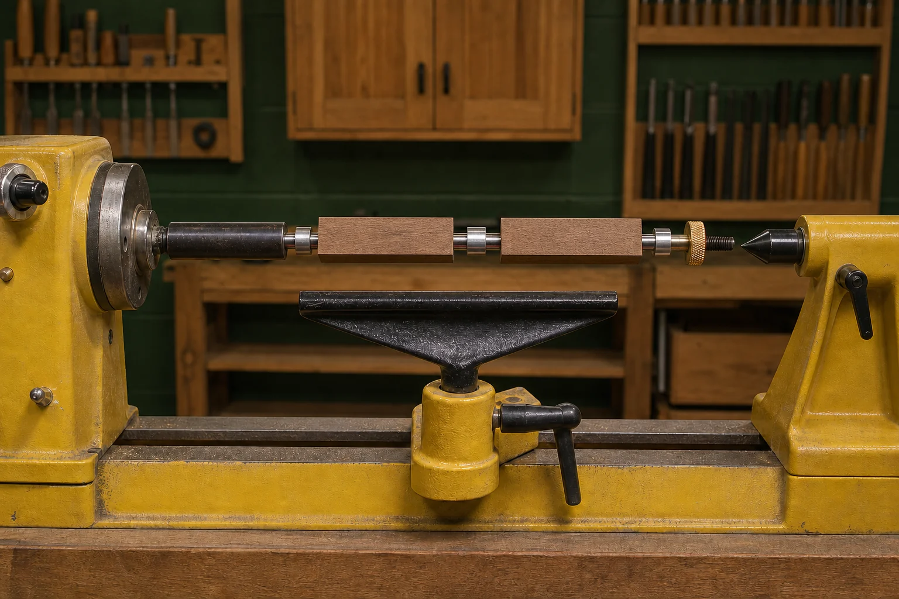
PEN
Weeks 7–8 · 1/8
Mandrel principles and pre-start checks
Weeks 7–8 guided learning
Read the theory. Check your understanding. Save useful evidence.
Notes:
Introduce the module purpose and connect it to the current project stage.
[Sources]
- Authorised local course theory: weeks7-8/index.html

Slide 2
PEN
Weeks 7–8 · 2/8
What you will learn
Use the module in order. Each idea supports the checks and written evidence that follow.
1
Understanding between-centres turning and the approved Pen mandrel
2
Assembling the approved mandrel with three collets and brass thumb screw
3
Lathe pre-start checks and secure approved workholding
Notes:
Preview the learning sequence without giving check answers.
[Sources]
- Authorised local course theory: weeks7-8/index.html

Slide 3
PEN
Weeks 7–8 · 3/8
Understanding between-centres turning and the approved…
Main idea
Between-centres turning is a broad woodturning principle in which a timber workpiece is supported along a central axis and rotated so its form can be developed evenly…
Check 2
The learning value is not simply producing a round shape.
Check 3
Students learn to read the behaviour of timber, maintain attention to alignment, compare one section with another and make gradual quality decisions.
Return to the module page for the full explanation, visual and section video.
Notes:
Teach the source-grounded theory for Understanding between-centres turning and the approved Pen mandrel.
[Sources]
- Authorised local course theory: weeks7-8/index.html

Slide 4
PEN
Weeks 7–8 · 4/8
Assembling the approved mandrel with three collets and…
Main idea
Assembling the approved Pen mandrel is a preparation and quality-control stage, not simply a matter of placing parts together.
Check 2
The supplied Pen Making resource shows the approved mandrel with three collets and a brass thumb screw.
Check 3
These verified features help students identify the correct equipment for this project, but they do not provide permission to invent an arrangement, spacing,…
Return to the module page for the full explanation, visual and section video.
Notes:
Teach the source-grounded theory for Assembling the approved mandrel with three collets and brass thumb screw.
[Sources]
- Authorised local course theory: weeks7-8/index.html

Slide 5
PEN
Weeks 7–8 · 5/8
Lathe pre-start checks and secure approved workholding
Main idea
A lathe pre-start check is a deliberate safety and quality routine completed before any Pen turning begins.
Check 2
Its purpose is to confirm that the machine, approved workholding, surrounding area and student are ready for the planned task.
Check 3
The check is not a quick glance and it is not replaced by having used the lathe before.
Return to the module page for the full explanation, visual and section video.
Notes:
Teach the source-grounded theory for Lathe pre-start checks and secure approved workholding.
[Sources]
- Authorised local course theory: weeks7-8/index.html

Slide 6
PEN
Weeks 7–8 · 6/8
Pause and check your understanding
What is the controlling idea?
Understanding between-centres turning and the approved Pen mandrel
Which check would prevent a mistake?
Assembling the approved mandrel with three collets and brass thumb screw
What evidence would show your decision?
Lathe pre-start checks and secure approved workholding
Notes:
Use these prompts for retrieval before students open the interactive checks.
[Sources]
- Authorised local course theory: weeks7-8/index.html

Slide 7
PEN
Weeks 7–8 · 7/8
Build a stronger written response
Read
Underline the command word and the project detail.
Select
Return to the exact theory section and choose relevant evidence.
Explain
Connect the decision, reason and likely result.
Check
Make sure the response answers the question and stays source-accurate.
Notes:
Model the response process without supplying an answer to a live student question.
[Sources]
- Authorised local course theory: weeks7-8/index.html

Slide 8
PEN
Weeks 7–8 · 8/8
Exit ticket
Before you finish this module, answer these in your own words:
1. One idea I can now explain: Understanding between-centres turning and the approved Pen mandrel
2. One practical check I must remember before the next stage
3. One piece of evidence I should save or improve
Return to the module page to complete the checks, written response and folio evidence.
Notes:
Students complete the exit ticket, then return to the website to save evidence.
[Sources]
- Authorised local course theory: weeks7-8/index.html

