Slide 1
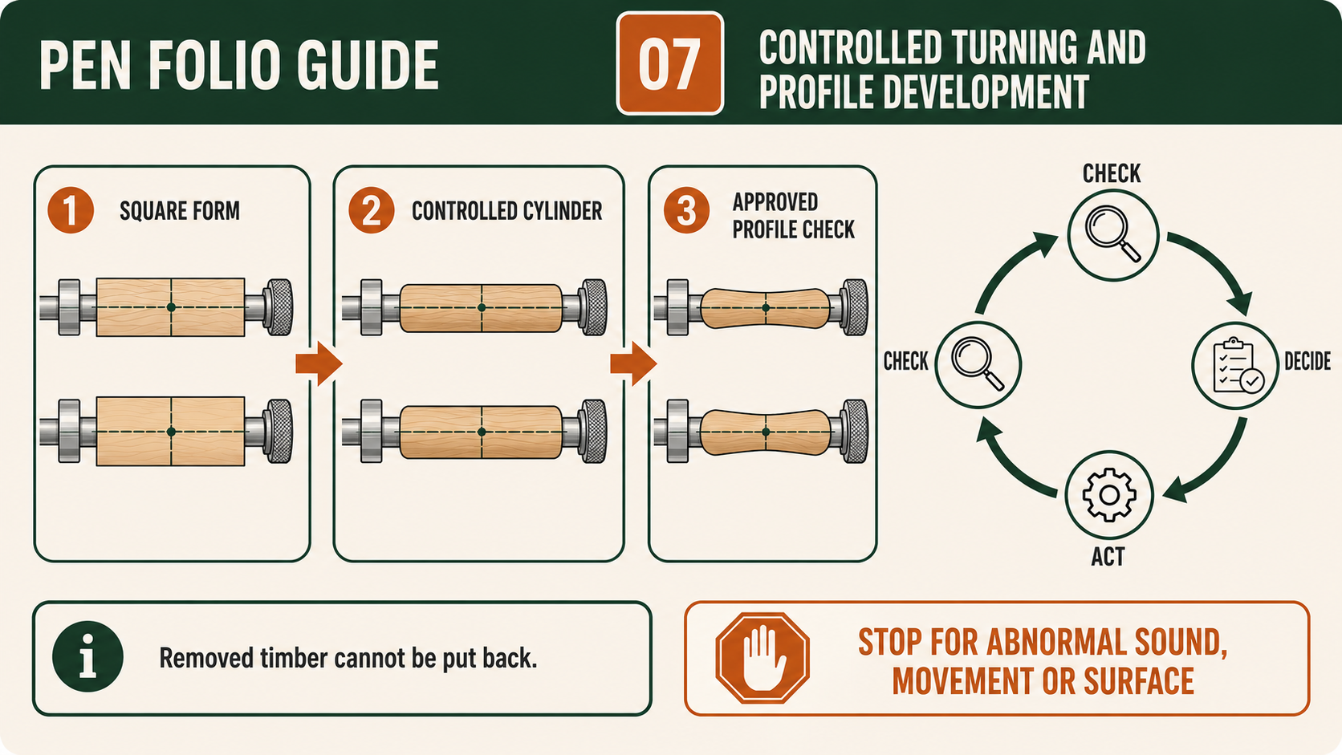
PEN
Weeks 9–10 · 1/8
Controlled turning and profile checks
Weeks 9–10 guided learning
Read the theory. Check your understanding. Save useful evidence.
Notes:
Introduce the module purpose and connect it to the current project stage.
[Sources]
- Authorised local course theory: weeks9-10/index.html

Slide 2
PEN
Weeks 9–10 · 2/8
What you will learn
Use the module in order. Each idea supports the checks and written evidence that follow.
1
From square blank to controlled cylindrical form
2
Understanding cutting and scraping during Pen turning
3
Monitoring profile, alignment and material removal against approved kit…
Notes:
Preview the learning sequence without giving check answers.
[Sources]
- Authorised local course theory: weeks9-10/index.html

Slide 3
PEN
Weeks 9–10 · 3/8
From square blank to controlled cylindrical form
Main idea
Transforming an approved square Pen blank into a controlled cylindrical form is a gradual shaping process based on observation, restraint and repeated checking.
Check 2
At the beginning, the blank has flat faces, straight edges and corners.
Check 3
During teacher-approved turning, material is removed so the rotating work gradually becomes round around its central axis.
Return to the module page for the full explanation, visual and section video.
Notes:
Teach the source-grounded theory for From square blank to controlled cylindrical form.
[Sources]
- Authorised local course theory: weeks9-10/index.html

Slide 4
PEN
Weeks 9–10 · 4/8
Understanding cutting and scraping during Pen turning
Main idea
During the authorised Pen turning stage, students may use cutting and scraping actions as demonstrated by the teacher.
Check 2
These actions both remove timber, but they interact with the fibres in different ways and can leave different surface results.
Check 3
The purpose of learning about them is not to memorise a tool recipe.
Return to the module page for the full explanation, visual and section video.
Notes:
Teach the source-grounded theory for Understanding cutting and scraping during Pen turning.
[Sources]
- Authorised local course theory: weeks9-10/index.html

Slide 5
PEN
Weeks 9–10 · 5/8
Monitoring profile, alignment and material removal…
Main idea
Monitoring profile, alignment and material removal is the stage where careful observation and disciplined checking determine the quality of the finished Pen.
Check 2
As the two timber bodies develop on the approved mandrel, students must compare what they see with the supplied kit instructions, the teacher demonstration and the…
Check 3
This is not about guessing a final shape or copying another student’s work.
Return to the module page for the full explanation, visual and section video.
Notes:
Teach the source-grounded theory for Monitoring profile, alignment and material removal against approved kit references.
[Sources]
- Authorised local course theory: weeks9-10/index.html

Slide 6
PEN
Weeks 9–10 · 6/8
Pause and check your understanding
What is the controlling idea?
From square blank to controlled cylindrical form
Which check would prevent a mistake?
Understanding cutting and scraping during Pen turning
What evidence would show your decision?
Monitoring profile, alignment and material removal against approved kit references
Notes:
Use these prompts for retrieval before students open the interactive checks.
[Sources]
- Authorised local course theory: weeks9-10/index.html

Slide 7
PEN
Weeks 9–10 · 7/8
Build a stronger written response
Read
Underline the command word and the project detail.
Select
Return to the exact theory section and choose relevant evidence.
Explain
Connect the decision, reason and likely result.
Check
Make sure the response answers the question and stays source-accurate.
Notes:
Model the response process without supplying an answer to a live student question.
[Sources]
- Authorised local course theory: weeks9-10/index.html

Slide 8
PEN
Weeks 9–10 · 8/8
Exit ticket
Before you finish this module, answer these in your own words:
1. One idea I can now explain: From square blank to controlled cylindrical form
2. One practical check I must remember before the next stage
3. One piece of evidence I should save or improve
Return to the module page to complete the checks, written response and folio evidence.
Notes:
Students complete the exit ticket, then return to the website to save evidence.
[Sources]
- Authorised local course theory: weeks9-10/index.html

