Slide 1
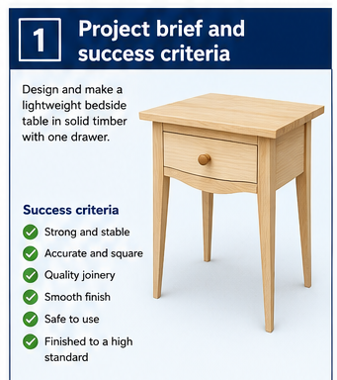
BEDSIDE TABLE
Weeks 1–2 · 1/8
Project brief, plans, WHS, design and accurate mark-out
Weeks 1–2 guided learning
Read the theory. Check your understanding. Save useful evidence.
Notes:
Introduce the module purpose and connect it to the current project stage.
[Sources]
- Authorised local course theory: weeks1-2/index.html

Slide 2
BEDSIDE TABLE
Weeks 1–2 · 2/8
What you will learn
Use the module in order. Each idea supports the checks and written evidence that follow.
1
Understanding the project brief and success criteria
4
Workshop safety and risk controls
2
Reading the project plans accurately
5
Design criteria, sketches and approved choices
3
How the bedside table carries load and stays stable
6
Datums, face side, face edge and matched components
Notes:
Preview the learning sequence without giving check answers.
[Sources]
- Authorised local course theory: weeks1-2/index.html

Slide 3
BEDSIDE TABLE
Weeks 1–2 · 3/8
Understanding the project brief and success criteria +…
Understanding the project brief and success criteria
The project brief is to design and manufacture a timber bedside table that is stable, functional, accurately made and suitable for everyday use.
Reading the project plans accurately
The approved working drawing is the main guide for building the bedside table.
Return to the module page for the full explanation, visual and section video.
Notes:
Teach the source-grounded theory for Understanding the project brief and success criteria and Reading the project plans accurately.
[Sources]
- Authorised local course theory: weeks1-2/index.html

Slide 4
BEDSIDE TABLE
Weeks 1–2 · 4/8
How the bedside table carries load and stays stable +…
How the bedside table carries load and stays stable
The table works as a connected frame.
Workshop safety and risk controls
Building a tapered-leg bedside table involves hazards during marking, cutting, sanding and assembly.
Return to the module page for the full explanation, visual and section video.
Notes:
Teach the source-grounded theory for How the bedside table carries load and stays stable and Workshop safety and risk controls.
[Sources]
- Authorised local course theory: weeks1-2/index.html

Slide 5
BEDSIDE TABLE
Weeks 1–2 · 5/8
Design criteria, sketches and approved choices + Datums,…
Design criteria, sketches and approved choices
Design decisions must improve the complete project rather than one feature in isolation.
Datums, face side, face edge and matched components
A datum is a fixed reference face, edge or point from which related measurements are taken.
Return to the module page for the full explanation, visual and section video.
Notes:
Teach the source-grounded theory for Design criteria, sketches and approved choices and Datums, face side, face edge and matched components.
[Sources]
- Authorised local course theory: weeks1-2/index.html

Slide 6
BEDSIDE TABLE
Weeks 1–2 · 6/8
Pause and check your understanding
What is the controlling idea?
Understanding the project brief and success criteria
Which check would prevent a mistake?
Workshop safety and risk controls
What evidence would show your decision?
Datums, face side, face edge and matched components
Notes:
Use these prompts for retrieval before students open the interactive checks.
[Sources]
- Authorised local course theory: weeks1-2/index.html

Slide 7
BEDSIDE TABLE
Weeks 1–2 · 7/8
Build a stronger written response
Read
Underline the command word and the project detail.
Select
Return to the exact theory section and choose relevant evidence.
Explain
Connect the decision, reason and likely result.
Check
Make sure the response answers the question and stays source-accurate.
Notes:
Model the response process without supplying an answer to a live student question.
[Sources]
- Authorised local course theory: weeks1-2/index.html

Slide 8
BEDSIDE TABLE
Weeks 1–2 · 8/8
Exit ticket
Before you finish this module, answer these in your own words:
1. One idea I can now explain: Understanding the project brief and success criteria
2. One practical check I must remember before the next stage
3. One piece of evidence I should save or improve
Return to the module page to complete the checks, written response and folio evidence.
Notes:
Students complete the exit ticket, then return to the website to save evidence.
[Sources]
- Authorised local course theory: weeks1-2/index.html

