Slide 1
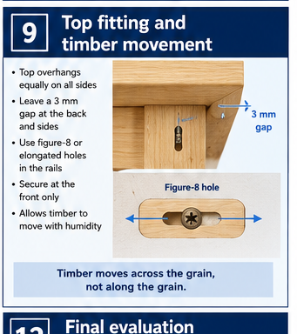
BEDSIDE TABLE
Weeks 11–12 · 1/8
Top fitting, timber movement and final hardware checks
Weeks 11–12 guided learning
Read the theory. Check your understanding. Save useful evidence.
Notes:
Introduce the module purpose and connect it to the current project stage.
[Sources]
- Authorised local course theory: weeks11-12/index.html

Slide 2
BEDSIDE TABLE
Weeks 11–12 · 2/8
What you will learn
Use the module in order. Each idea supports the checks and written evidence that follow.
1
Aligning the thick top accurately
4
Final hardware checks
2
Why solid timber moves across the grain
5
Diagnosing a top that rocks, cups or sits unevenly
3
Using the approved top-fixing method
6
Final assembly tolerances and quality gates
Notes:
Preview the learning sequence without giving check answers.
[Sources]
- Authorised local course theory: weeks11-12/index.html

Slide 3
BEDSIDE TABLE
Weeks 11–12 · 3/8
Aligning the thick top accurately + Why solid timber…
Aligning the thick top accurately
The thick solid-timber top should be fitted so it sits flat, centred and slightly overhangs the slim tapered-leg frame as shown on the approved drawing.
Why solid timber moves across the grain
Solid timber changes moisture content as surrounding conditions change.
Return to the module page for the full explanation, visual and section video.
Notes:
Teach the source-grounded theory for Aligning the thick top accurately and Why solid timber moves across the grain.
[Sources]
- Authorised local course theory: weeks11-12/index.html

Slide 4
BEDSIDE TABLE
Weeks 11–12 · 4/8
Using the approved top-fixing method + Final hardware…
Using the approved top-fixing method
Grain direction determines how a solid timber top responds to seasonal moisture changes.
Final hardware checks
Complete a final inspection of only the hardware shown on the approved plan.
Return to the module page for the full explanation, visual and section video.
Notes:
Teach the source-grounded theory for Using the approved top-fixing method and Final hardware checks.
[Sources]
- Authorised local course theory: weeks11-12/index.html

Slide 5
BEDSIDE TABLE
Weeks 11–12 · 5/8
Diagnosing a top that rocks, cups or sits unevenly +…
Diagnosing a top that rocks, cups or sits unevenly
The cause may be in the top, the frame, the fitting surfaces, the hardware or the bench used for checking.
Final assembly tolerances and quality gates
Tolerance is the acceptable amount of variation from the intended result.
Return to the module page for the full explanation, visual and section video.
Notes:
Teach the source-grounded theory for Diagnosing a top that rocks, cups or sits unevenly and Final assembly tolerances and quality gates.
[Sources]
- Authorised local course theory: weeks11-12/index.html

Slide 6
BEDSIDE TABLE
Weeks 11–12 · 6/8
Pause and check your understanding
What is the controlling idea?
Aligning the thick top accurately
Which check would prevent a mistake?
Final hardware checks
What evidence would show your decision?
Final assembly tolerances and quality gates
Notes:
Use these prompts for retrieval before students open the interactive checks.
[Sources]
- Authorised local course theory: weeks11-12/index.html

Slide 7
BEDSIDE TABLE
Weeks 11–12 · 7/8
Build a stronger written response
Read
Underline the command word and the project detail.
Select
Return to the exact theory section and choose relevant evidence.
Explain
Connect the decision, reason and likely result.
Check
Make sure the response answers the question and stays source-accurate.
Notes:
Model the response process without supplying an answer to a live student question.
[Sources]
- Authorised local course theory: weeks11-12/index.html

Slide 8
BEDSIDE TABLE
Weeks 11–12 · 8/8
Exit ticket
Before you finish this module, answer these in your own words:
1. One idea I can now explain: Aligning the thick top accurately
2. One practical check I must remember before the next stage
3. One piece of evidence I should save or improve
Return to the module page to complete the checks, written response and folio evidence.
Notes:
Students complete the exit ticket, then return to the website to save evidence.
[Sources]
- Authorised local course theory: weeks11-12/index.html

