Slide 1
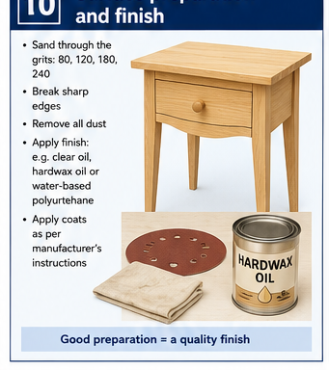
BEDSIDE TABLE
Weeks 13–14 · 1/8
Surface preparation, defect repair and final inspection
Weeks 13–14 guided learning
Read the theory. Check your understanding. Save useful evidence.
Notes:
Introduce the module purpose and connect it to the current project stage.
[Sources]
- Authorised local course theory: weeks13-14/index.html

Slide 2
BEDSIDE TABLE
Weeks 13–14 · 2/8
What you will learn
Use the module in order. Each idea supports the checks and written evidence that follow.
1
Inspect before sanding
4
Defect repair and glue residue
2
Abrasive grit, scratch pattern and grain direction
5
Final surface inspection with raking light and touch
3
Sanding tapered legs, curves and edges without changing shape
6
Dust control, clean-up and pre-finish quality assurance
Notes:
Preview the learning sequence without giving check answers.
[Sources]
- Authorised local course theory: weeks13-14/index.html

Slide 3
BEDSIDE TABLE
Weeks 13–14 · 3/8
Inspect before sanding + Abrasive grit, scratch pattern…
Inspect before sanding
Complete a systematic inspection of the slim tapered-leg bedside table before any finish is applied.
Abrasive grit, scratch pattern and grain direction
Before applying a finish, inspect the completed tapered-leg bedside table under strong, even light.
Return to the module page for the full explanation, visual and section video.
Notes:
Teach the source-grounded theory for Inspect before sanding and Abrasive grit, scratch pattern and grain direction.
[Sources]
- Authorised local course theory: weeks13-14/index.html

Slide 4
BEDSIDE TABLE
Weeks 13–14 · 4/8
Sanding tapered legs, curves and edges without changing…
Sanding tapered legs, curves and edges without changing shape
The slim tapers and broad curved apron are easy to damage through uneven sanding pressure.
Defect repair and glue residue
Inspect the completed slim tapered-leg bedside table under strong, even light before any finish is applied.
Return to the module page for the full explanation, visual and section video.
Notes:
Teach the source-grounded theory for Sanding tapered legs, curves and edges without changing shape and Defect repair and glue residue.
[Sources]
- Authorised local course theory: weeks13-14/index.html

Slide 5
BEDSIDE TABLE
Weeks 13–14 · 5/8
Final surface inspection with raking light and touch +…
Final surface inspection with raking light and touch
Raking light travels across the surface at a low angle and exaggerates scratches, glue patches, dents, waves and dust.
Dust control, clean-up and pre-finish quality assurance
Fine timber dust affects health, finish quality and workshop safety.
Return to the module page for the full explanation, visual and section video.
Notes:
Teach the source-grounded theory for Final surface inspection with raking light and touch and Dust control, clean-up and pre-finish quality assurance.
[Sources]
- Authorised local course theory: weeks13-14/index.html

Slide 6
BEDSIDE TABLE
Weeks 13–14 · 6/8
Pause and check your understanding
What is the controlling idea?
Inspect before sanding
Which check would prevent a mistake?
Defect repair and glue residue
What evidence would show your decision?
Dust control, clean-up and pre-finish quality assurance
Notes:
Use these prompts for retrieval before students open the interactive checks.
[Sources]
- Authorised local course theory: weeks13-14/index.html

Slide 7
BEDSIDE TABLE
Weeks 13–14 · 7/8
Build a stronger written response
Read
Underline the command word and the project detail.
Select
Return to the exact theory section and choose relevant evidence.
Explain
Connect the decision, reason and likely result.
Check
Make sure the response answers the question and stays source-accurate.
Notes:
Model the response process without supplying an answer to a live student question.
[Sources]
- Authorised local course theory: weeks13-14/index.html

Slide 8
BEDSIDE TABLE
Weeks 13–14 · 8/8
Exit ticket
Before you finish this module, answer these in your own words:
1. One idea I can now explain: Inspect before sanding
2. One practical check I must remember before the next stage
3. One piece of evidence I should save or improve
Return to the module page to complete the checks, written response and folio evidence.
Notes:
Students complete the exit ticket, then return to the website to save evidence.
[Sources]
- Authorised local course theory: weeks13-14/index.html

