Slide 1
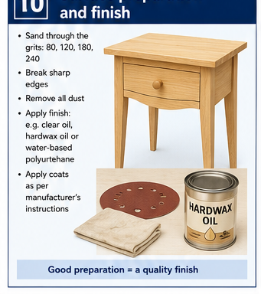
BEDSIDE TABLE
Weeks 15–16 · 1/8
Timber finishing, chemical safety and sustainability
Weeks 15–16 guided learning
Read the theory. Check your understanding. Save useful evidence.
Notes:
Introduce the module purpose and connect it to the current project stage.
[Sources]
- Authorised local course theory: weeks15-16/index.html

Slide 2
BEDSIDE TABLE
Weeks 15–16 · 2/8
What you will learn
Use the module in order. Each idea supports the checks and written evidence that follow.
1
Follow the approved finish system
4
Chemical safety
2
Applying a timber finish evenly
5
Using the label, SDS and hierarchy of controls
3
Drying, curing, handling and between-stage preparation
6
Sustainable practice and responsible waste handling
Notes:
Preview the learning sequence without giving check answers.
[Sources]
- Authorised local course theory: weeks15-16/index.html

Slide 3
BEDSIDE TABLE
Weeks 15–16 · 3/8
Follow the approved finish system + Applying a timber…
Follow the approved finish system
The finish system is selected and approved by the teacher for the project, timber, workshop and available controls.
Applying a timber finish evenly
Apply only the teacher-approved finish system and follow the product instructions provided in the workshop.
Return to the module page for the full explanation, visual and section video.
Notes:
Teach the source-grounded theory for Follow the approved finish system and Applying a timber finish evenly.
[Sources]
- Authorised local course theory: weeks15-16/index.html

Slide 4
BEDSIDE TABLE
Weeks 15–16 · 4/8
Drying, curing, handling and between-stage preparation +…
Drying, curing, handling and between-stage preparation
A surface may feel dry enough to touch while the finish is still developing hardness, adhesion and resistance underneath.
Chemical safety
Before applying the approved timber finish, read the supplied product label and Safety Data Sheet (SDS) so you understand the hazards, required controls and emergency information.
Return to the module page for the full explanation, visual and section video.
Notes:
Teach the source-grounded theory for Drying, curing, handling and between-stage preparation and Chemical safety.
[Sources]
- Authorised local course theory: weeks15-16/index.html

Slide 5
BEDSIDE TABLE
Weeks 15–16 · 5/8
Using the label, SDS and hierarchy of controls +…
Using the label, SDS and hierarchy of controls
The label provides immediate product information; the Safety Data Sheet provides detailed hazard, first-aid, exposure-control, storage and spill information.
Sustainable practice and responsible waste handling
Sustainable practice during finishing and final work means using materials carefully while still achieving a safe, durable and high-quality bedside table.
Return to the module page for the full explanation, visual and section video.
Notes:
Teach the source-grounded theory for Using the label, SDS and hierarchy of controls and Sustainable practice and responsible waste handling.
[Sources]
- Authorised local course theory: weeks15-16/index.html

Slide 6
BEDSIDE TABLE
Weeks 15–16 · 6/8
Pause and check your understanding
What is the controlling idea?
Follow the approved finish system
Which check would prevent a mistake?
Chemical safety
What evidence would show your decision?
Sustainable practice and responsible waste handling
Notes:
Use these prompts for retrieval before students open the interactive checks.
[Sources]
- Authorised local course theory: weeks15-16/index.html

Slide 7
BEDSIDE TABLE
Weeks 15–16 · 7/8
Build a stronger written response
Read
Underline the command word and the project detail.
Select
Return to the exact theory section and choose relevant evidence.
Explain
Connect the decision, reason and likely result.
Check
Make sure the response answers the question and stays source-accurate.
Notes:
Model the response process without supplying an answer to a live student question.
[Sources]
- Authorised local course theory: weeks15-16/index.html

Slide 8
BEDSIDE TABLE
Weeks 15–16 · 8/8
Exit ticket
Before you finish this module, answer these in your own words:
1. One idea I can now explain: Follow the approved finish system
2. One practical check I must remember before the next stage
3. One piece of evidence I should save or improve
Return to the module page to complete the checks, written response and folio evidence.
Notes:
Students complete the exit ticket, then return to the website to save evidence.
[Sources]
- Authorised local course theory: weeks15-16/index.html

