Slide 1
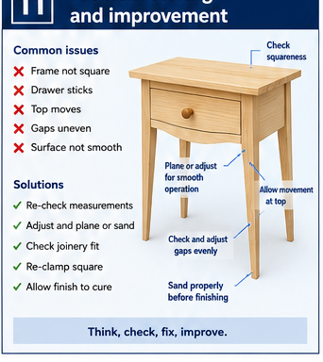
BEDSIDE TABLE
Weeks 17–18 · 1/8
Quality checks, evidence, problem solving and evaluation
Weeks 17–18 guided learning
Read the theory. Check your understanding. Save useful evidence.
Notes:
Introduce the module purpose and connect it to the current project stage.
[Sources]
- Authorised local course theory: weeks17-18/index.html

Slide 2
BEDSIDE TABLE
Weeks 17–18 · 2/8
What you will learn
Use the module in order. Each idea supports the checks and written evidence that follow.
1
Systematic final quality checks
4
Writing captions that explain what the evidence proves
2
From problem to cause, correction and result
5
Evaluation is a judgement supported by evidence
3
Collecting purposeful evidence
6
Selecting a concise portfolio evidence set
Notes:
Preview the learning sequence without giving check answers.
[Sources]
- Authorised local course theory: weeks17-18/index.html

Slide 3
BEDSIDE TABLE
Weeks 17–18 · 3/8
Systematic final quality checks + From problem to cause,…
Systematic final quality checks
A final quality check should compare the completed bedside table with the approved drawing and success criteria, using clear evidence rather than general impressions.
From problem to cause, correction and result
Strong problem solving explains more than the visible fault.
Return to the module page for the full explanation, visual and section video.
Notes:
Teach the source-grounded theory for Systematic final quality checks and From problem to cause, correction and result.
[Sources]
- Authorised local course theory: weeks17-18/index.html

Slide 4
BEDSIDE TABLE
Weeks 17–18 · 4/8
Collecting purposeful evidence + Writing captions that…
Collecting purposeful evidence
Evidence for the completed bedside table should be clear, purposeful and directly linked to the approved success criteria.
Writing captions that explain what the evidence proves
A caption makes a photograph interpretable.
Return to the module page for the full explanation, visual and section video.
Notes:
Teach the source-grounded theory for Collecting purposeful evidence and Writing captions that explain what the evidence proves.
[Sources]
- Authorised local course theory: weeks17-18/index.html

Slide 5
BEDSIDE TABLE
Weeks 17–18 · 5/8
Evaluation is a judgement supported by evidence +…
Evaluation is a judgement supported by evidence
An evaluation is an honest judgement of how successfully the completed bedside table meets the design brief and approved success criteria.
Selecting a concise portfolio evidence set
The project folio should form an evidence chain from the brief to the finished table.
Return to the module page for the full explanation, visual and section video.
Notes:
Teach the source-grounded theory for Evaluation is a judgement supported by evidence and Selecting a concise portfolio evidence set.
[Sources]
- Authorised local course theory: weeks17-18/index.html

Slide 6
BEDSIDE TABLE
Weeks 17–18 · 6/8
Pause and check your understanding
What is the controlling idea?
Systematic final quality checks
Which check would prevent a mistake?
Writing captions that explain what the evidence proves
What evidence would show your decision?
Selecting a concise portfolio evidence set
Notes:
Use these prompts for retrieval before students open the interactive checks.
[Sources]
- Authorised local course theory: weeks17-18/index.html

Slide 7
BEDSIDE TABLE
Weeks 17–18 · 7/8
Build a stronger written response
Read
Underline the command word and the project detail.
Select
Return to the exact theory section and choose relevant evidence.
Explain
Connect the decision, reason and likely result.
Check
Make sure the response answers the question and stays source-accurate.
Notes:
Model the response process without supplying an answer to a live student question.
[Sources]
- Authorised local course theory: weeks17-18/index.html

Slide 8
BEDSIDE TABLE
Weeks 17–18 · 8/8
Exit ticket
Before you finish this module, answer these in your own words:
1. One idea I can now explain: Systematic final quality checks
2. One practical check I must remember before the next stage
3. One piece of evidence I should save or improve
Return to the module page to complete the checks, written response and folio evidence.
Notes:
Students complete the exit ticket, then return to the website to save evidence.
[Sources]
- Authorised local course theory: weeks17-18/index.html

