Slide 1
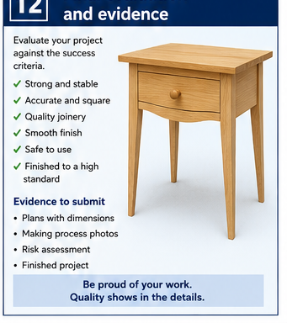
BEDSIDE TABLE
Weeks 19–20 · 1/8
Final quality, submission, care and reflection
Weeks 19–20 guided learning
Read the theory. Check your understanding. Save useful evidence.
Notes:
Introduce the module purpose and connect it to the current project stage.
[Sources]
- Authorised local course theory: weeks19-20/index.html

Slide 2
BEDSIDE TABLE
Weeks 19–20 · 2/8
What you will learn
Use the module in order. Each idea supports the checks and written evidence that follow.
1
Final presentation and systematic inspection
4
Final submission as quality assurance
2
Correct the cause, not only the symptom
5
Reflection and transferable improvement
3
Care, maintenance and safe handling
6
Workshop reset and responsible handover
Notes:
Preview the learning sequence without giving check answers.
[Sources]
- Authorised local course theory: weeks19-20/index.html

Slide 3
BEDSIDE TABLE
Weeks 19–20 · 3/8
Final presentation and systematic inspection + Correct…
Final presentation and systematic inspection
Final presentation prepares the completed bedside table for teacher inspection without disguising faults or changing the approved design.
Correct the cause, not only the symptom
Late faults often tempt rushed sanding, tightening or touching up.
Return to the module page for the full explanation, visual and section video.
Notes:
Teach the source-grounded theory for Final presentation and systematic inspection and Correct the cause, not only the symptom.
[Sources]
- Authorised local course theory: weeks19-20/index.html

Slide 4
BEDSIDE TABLE
Weeks 19–20 · 4/8
Care, maintenance and safe handling + Final submission…
Care, maintenance and safe handling
A well-made bedside table needs suitable care to retain its stability, finish and service life.
Final submission as quality assurance
Final submission should present a complete and organised record of the guided-course evidence that supports the finished bedside table.
Return to the module page for the full explanation, visual and section video.
Notes:
Teach the source-grounded theory for Care, maintenance and safe handling and Final submission as quality assurance.
[Sources]
- Authorised local course theory: weeks19-20/index.html

Slide 5
BEDSIDE TABLE
Weeks 19–20 · 5/8
Reflection and transferable improvement + Workshop reset…
Reflection and transferable improvement
Reflection identifies what happened, why it happened and what should change next time.
Workshop reset and responsible handover
Reflection should consider the skills, decisions, safety practices and quality achieved across the full bedside table project.
Return to the module page for the full explanation, visual and section video.
Notes:
Teach the source-grounded theory for Reflection and transferable improvement and Workshop reset and responsible handover.
[Sources]
- Authorised local course theory: weeks19-20/index.html

Slide 6
BEDSIDE TABLE
Weeks 19–20 · 6/8
Pause and check your understanding
What is the controlling idea?
Final presentation and systematic inspection
Which check would prevent a mistake?
Final submission as quality assurance
What evidence would show your decision?
Workshop reset and responsible handover
Notes:
Use these prompts for retrieval before students open the interactive checks.
[Sources]
- Authorised local course theory: weeks19-20/index.html

Slide 7
BEDSIDE TABLE
Weeks 19–20 · 7/8
Build a stronger written response
Read
Underline the command word and the project detail.
Select
Return to the exact theory section and choose relevant evidence.
Explain
Connect the decision, reason and likely result.
Check
Make sure the response answers the question and stays source-accurate.
Notes:
Model the response process without supplying an answer to a live student question.
[Sources]
- Authorised local course theory: weeks19-20/index.html

Slide 8
BEDSIDE TABLE
Weeks 19–20 · 8/8
Exit ticket
Before you finish this module, answer these in your own words:
1. One idea I can now explain: Final presentation and systematic inspection
2. One practical check I must remember before the next stage
3. One piece of evidence I should save or improve
Return to the module page to complete the checks, written response and folio evidence.
Notes:
Students complete the exit ticket, then return to the website to save evidence.
[Sources]
- Authorised local course theory: weeks19-20/index.html

