Slide 1
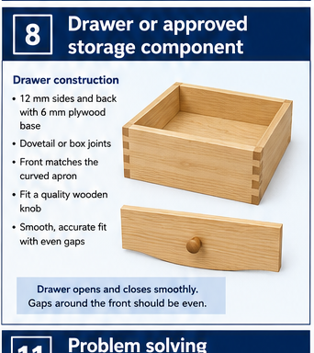
BEDSIDE TABLE
Weeks 9–10 · 1/8
Approved storage component, clearances and hardware
Weeks 9–10 guided learning
Read the theory. Check your understanding. Save useful evidence.
Notes:
Introduce the module purpose and connect it to the current project stage.
[Sources]
- Authorised local course theory: weeks9-10/index.html

Slide 2
BEDSIDE TABLE
Weeks 9–10 · 2/8
What you will learn
Use the module in order. Each idea supports the checks and written evidence that follow.
1
Follow the approved storage design
4
Aligning the visible front or approved face
2
Clearances, reveals and fit
5
Pilot holes, hardware alignment and controlled adjustment
3
Constructing a square drawer or approved component
6
Functional testing and fault diagnosis
Notes:
Preview the learning sequence without giving check answers.
[Sources]
- Authorised local course theory: weeks9-10/index.html

Slide 3
BEDSIDE TABLE
Weeks 9–10 · 3/8
Follow the approved storage design + Clearances, reveals…
Follow the approved storage design
The approved drawing must guide construction because the bedside table may use a drawer, a shelf or another specified storage arrangement.
Clearances, reveals and fit
A moving or removable component needs controlled clearance.
Return to the module page for the full explanation, visual and section video.
Notes:
Teach the source-grounded theory for Follow the approved storage design and Clearances, reveals and fit.
[Sources]
- Authorised local course theory: weeks9-10/index.html

Slide 4
BEDSIDE TABLE
Weeks 9–10 · 4/8
Constructing a square drawer or approved component +…
Constructing a square drawer or approved component
Construct a drawer only when it is shown on the approved plan.
Aligning the visible front or approved face
The visible front is judged against the table, not only against the box behind it.
Return to the module page for the full explanation, visual and section video.
Notes:
Teach the source-grounded theory for Constructing a square drawer or approved component and Aligning the visible front or approved face.
[Sources]
- Authorised local course theory: weeks9-10/index.html

Slide 5
BEDSIDE TABLE
Weeks 9–10 · 5/8
Pilot holes, hardware alignment and controlled…
Pilot holes, hardware alignment and controlled adjustment
Fit hardware or runners only when they are specified on the approved plan.
Functional testing and fault diagnosis
A storage component is tested through its full travel, under light normal use and from several positions.
Return to the module page for the full explanation, visual and section video.
Notes:
Teach the source-grounded theory for Pilot holes, hardware alignment and controlled adjustment and Functional testing and fault diagnosis.
[Sources]
- Authorised local course theory: weeks9-10/index.html

Slide 6
BEDSIDE TABLE
Weeks 9–10 · 6/8
Pause and check your understanding
What is the controlling idea?
Follow the approved storage design
Which check would prevent a mistake?
Aligning the visible front or approved face
What evidence would show your decision?
Functional testing and fault diagnosis
Notes:
Use these prompts for retrieval before students open the interactive checks.
[Sources]
- Authorised local course theory: weeks9-10/index.html

Slide 7
BEDSIDE TABLE
Weeks 9–10 · 7/8
Build a stronger written response
Read
Underline the command word and the project detail.
Select
Return to the exact theory section and choose relevant evidence.
Explain
Connect the decision, reason and likely result.
Check
Make sure the response answers the question and stays source-accurate.
Notes:
Model the response process without supplying an answer to a live student question.
[Sources]
- Authorised local course theory: weeks9-10/index.html

Slide 8
BEDSIDE TABLE
Weeks 9–10 · 8/8
Exit ticket
Before you finish this module, answer these in your own words:
1. One idea I can now explain: Follow the approved storage design
2. One practical check I must remember before the next stage
3. One piece of evidence I should save or improve
Return to the module page to complete the checks, written response and folio evidence.
Notes:
Students complete the exit ticket, then return to the website to save evidence.
[Sources]
- Authorised local course theory: weeks9-10/index.html

