Slide 1

MODULE 1 OF 5 · WEEKS 1–2
Workshop readiness and accurate marking
Understand the project, manage risk and read the supplied plan before making a mark.
Bread Board Guided Course

Slide 2
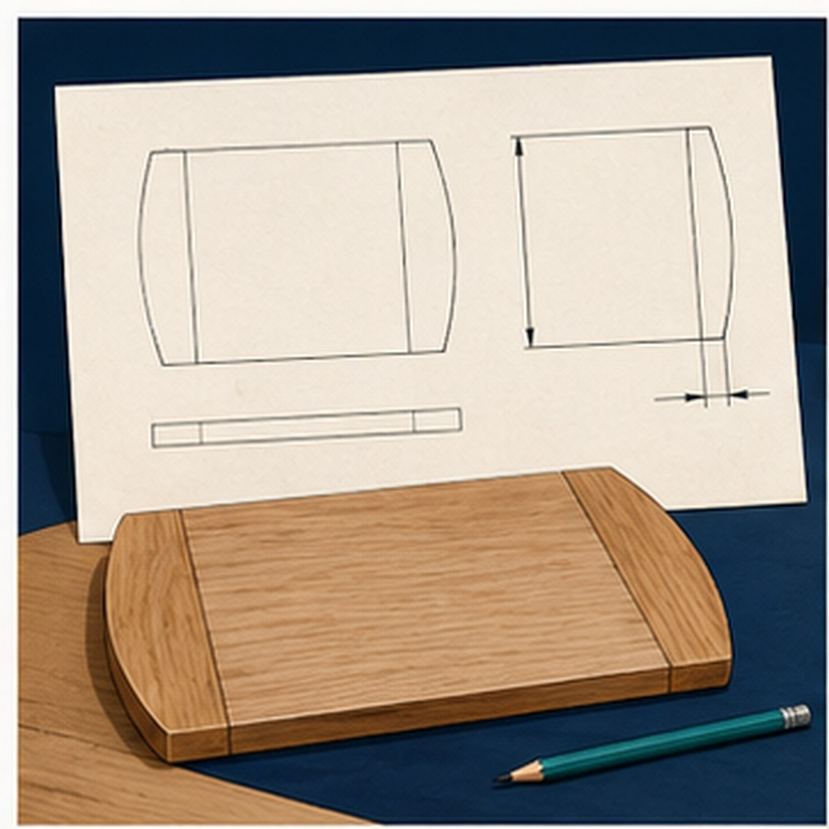
MODULE 1 OF 5 · WEEKS 1–2
Begin with the brief and a ready workspace
Confirm the required outcome, inspect the shared workspace and follow teacher directions before practical work begins.
Stop when the plan, stock, tool or next action is uncertain.
2

Slide 3

MODULE 1 OF 5 · WEEKS 1–2
A hazard needs a suitable control
Identify what could cause harm, consider the risk and apply the strongest suitable control available in the school workshop.
PPE is one layer; it does not make an unsafe setup acceptable.
3

Slide 4
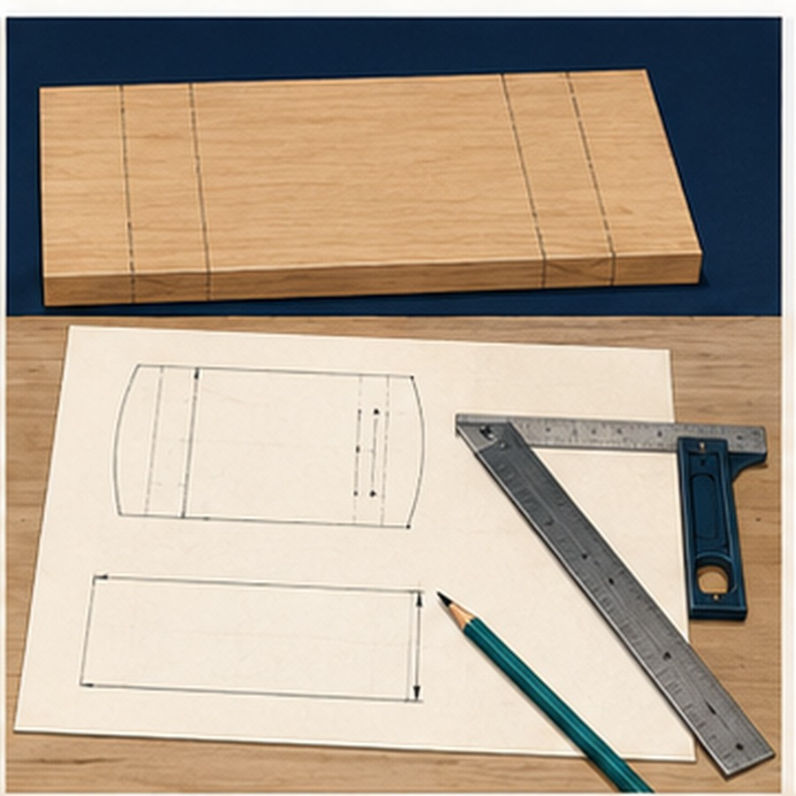
MODULE 1 OF 5 · WEEKS 1–2
One reliable datum keeps marks connected
Read the supplied plan, measure from the agreed reference and use one fine checked line before material is removed.
Measure twice, check square and preserve the working boundary.
4

Slide 5
BEFORE YOU MOVE ON
Ready means brief understood, hazards controlled and every mark traceable to the supplied plan.
Complete the knowledge checks and written responses, then save your evidence as directed.
5

