Slide 1
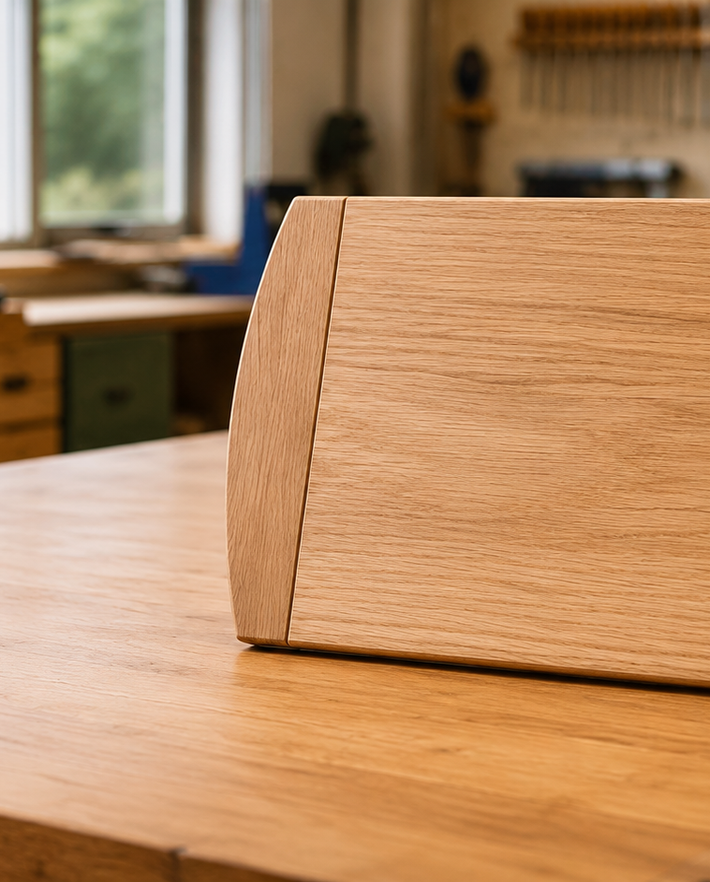
MODULE 2 OF 5 · WEEKS 3–4
Grain, joint layout and controlled shaping
Plan component orientation, transfer matching biscuit positions and preserve the approved boundaries.
Bread Board Guided Course

Slide 2
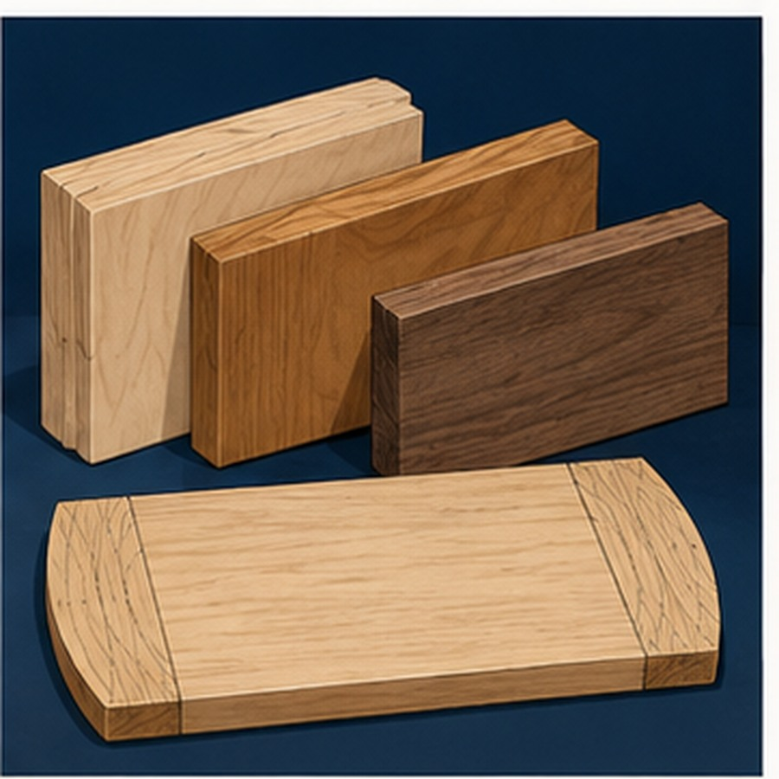
MODULE 2 OF 5 · WEEKS 3–4
Read the grain before arranging components
Inspect grain direction and visible defects, then keep reference faces and component order clear during layout.
Orientation decisions affect appearance, shaping and later assembly.
2

Slide 3

MODULE 2 OF 5 · WEEKS 3–4
Matching biscuit marks must share a reference
Pair and label components, transfer joint positions carefully and verify that matching marks align before machining.
The school machine, settings and permission process remain teacher controlled.
3

Slide 4
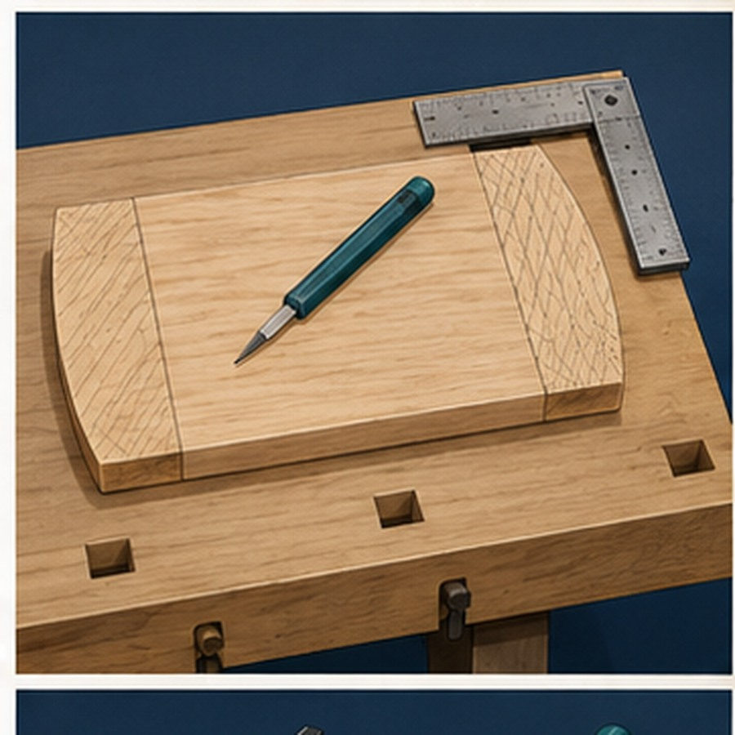
MODULE 2 OF 5 · WEEKS 3–4
Shape progressively towards the boundary
Read the planned profile, remove waste in controlled stages and compare both ends before the line is lost.
Stop for advice if the grain, profile or safe process is unclear.
4

Slide 5
BEFORE YOU MOVE ON
Reliable orientation and transferred marks make later dry assembly easier to check and correct.
Complete the knowledge checks and written responses, then save your evidence as directed.
5

