Slide 1
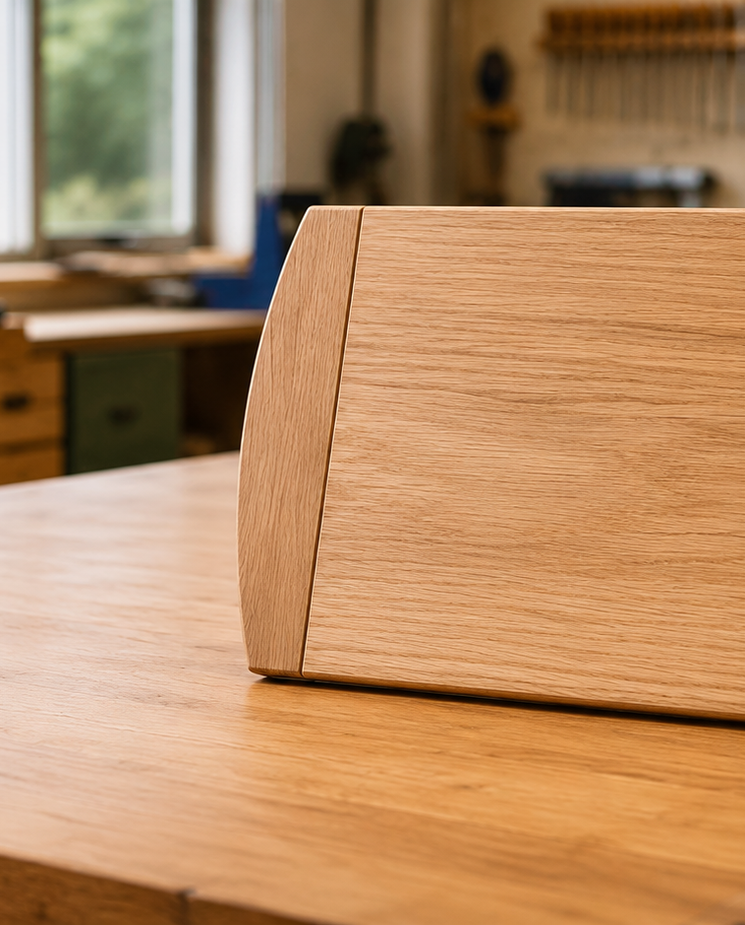
MODULE 3 OF 5 · WEEKS 5–6
Dry assembly, glue-up and routed profiles
Use reversible checks before adhesive and treat every router decision as teacher controlled.
Bread Board Guided Course

Slide 2
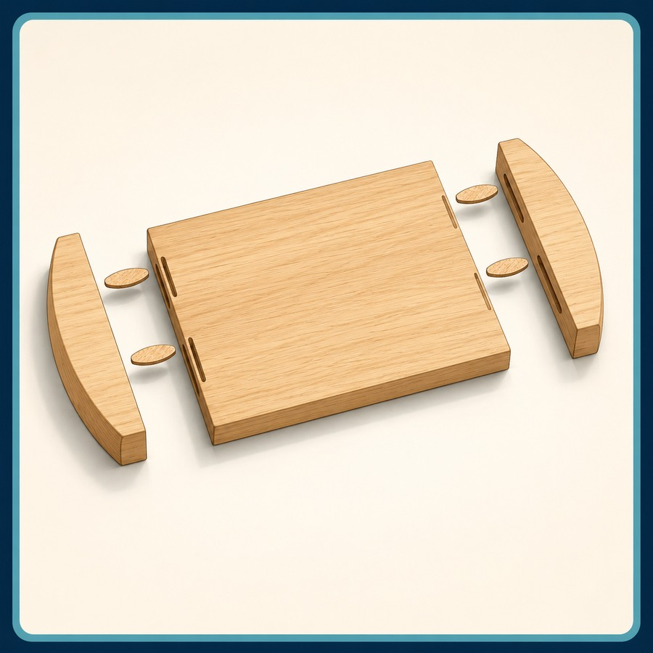
MODULE 3 OF 5 · WEEKS 5–6
Dry assembly exposes problems while they are reversible
Check orientation, biscuit alignment, edge contact and overall panel condition before glue is introduced.
Do not force a joint or hide a fit problem.
2

Slide 3
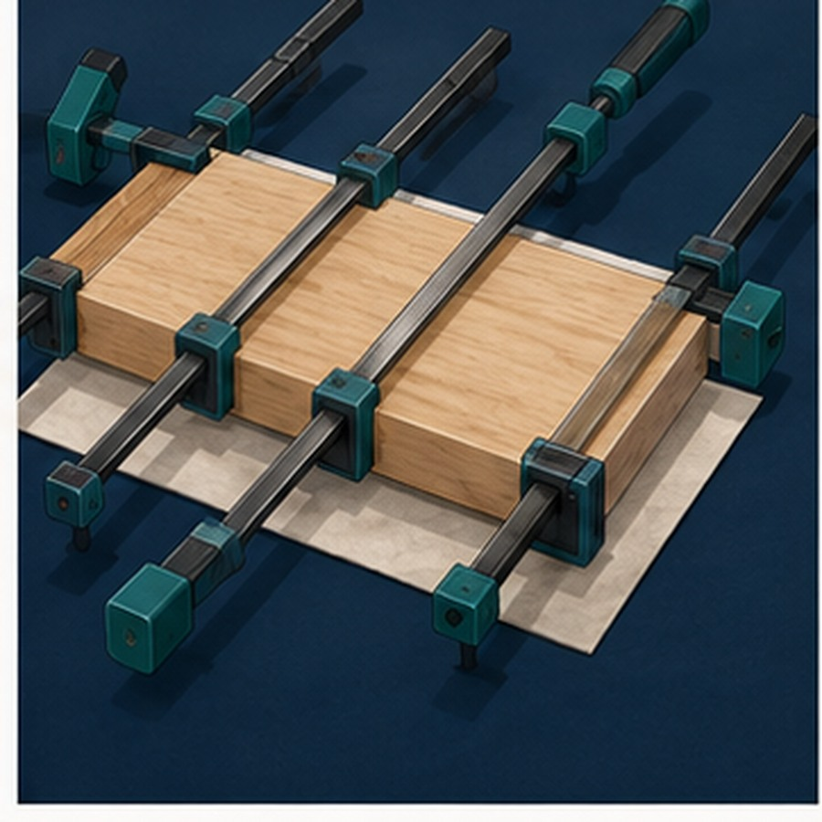
MODULE 3 OF 5 · WEEKS 5–6
Plan the glue-up before opening adhesive
Prepare the sequence, clamp positions and alignment checks so pressure can be applied evenly and corrected promptly.
Adhesive choice, timing and exact clamping remain teacher controlled.
3

Slide 4
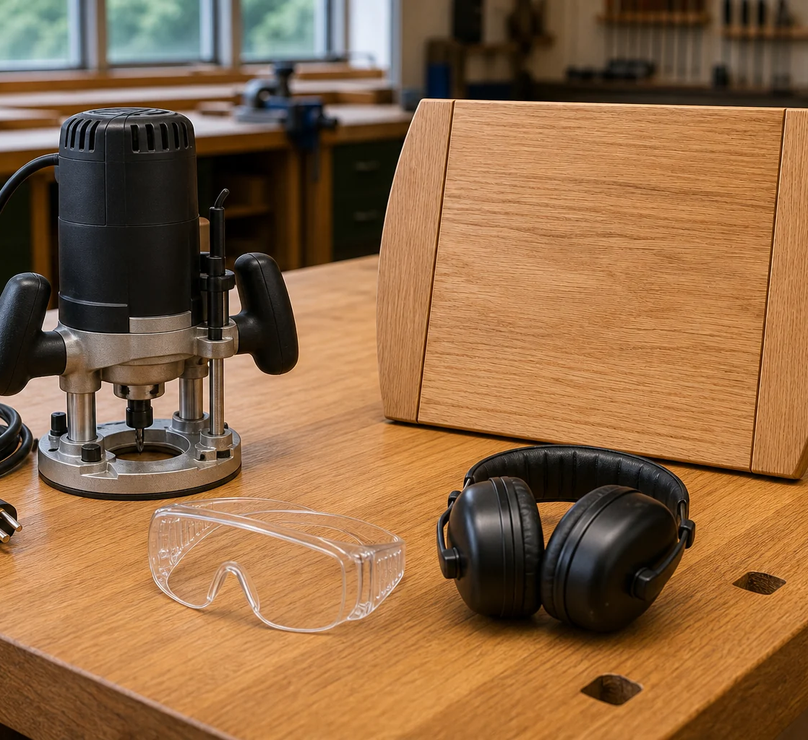
MODULE 3 OF 5 · WEEKS 5–6
Router preparation begins before the machine starts
Confirm the approved profile, cutter relationship, guards, extraction and secure workholding through the demonstrated process.
A video or prior experience never authorises machine use.
4

Slide 5
BEFORE YOU MOVE ON
Check first, glue only when ready and use the router only through the approved school process.
Complete the knowledge checks and written responses, then save your evidence as directed.
5

