Slide 1
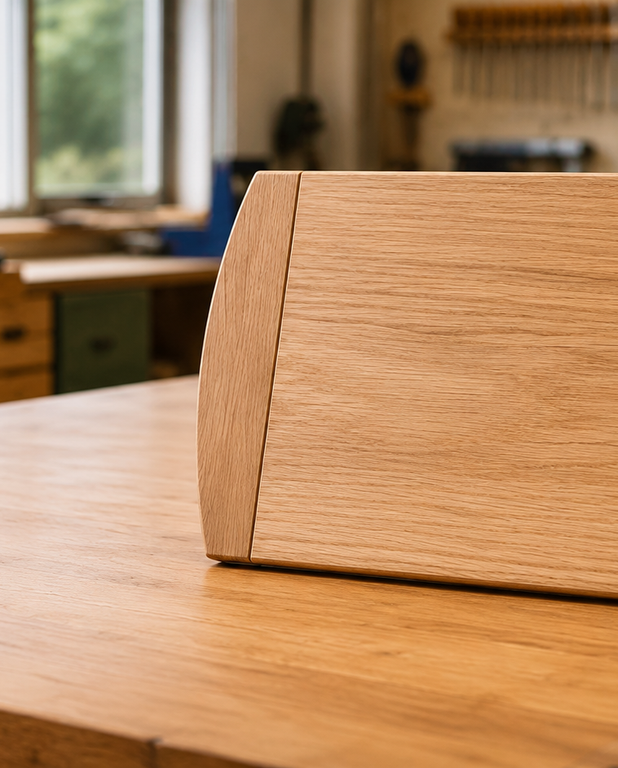
MODULE 4 OF 5 · WEEKS 7–8
Consistent sanding and responsible finishing
Prepare the complete surface, control finishing hazards and manage materials without unnecessary waste.
Bread Board Guided Course

Slide 2
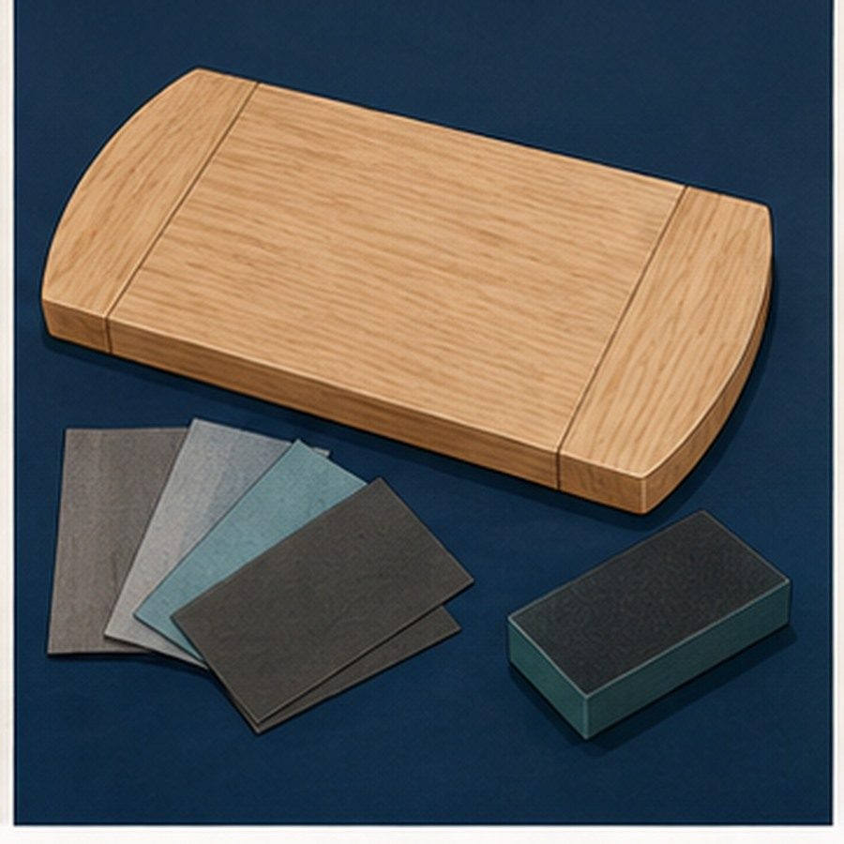
MODULE 4 OF 5 · WEEKS 7–8
A consistent surface needs a planned sanding sequence
Inspect the whole board, work evenly and remove the previous scratch pattern before moving to the next approved stage.
One smooth patch does not prove the complete surface is ready.
2

Slide 3
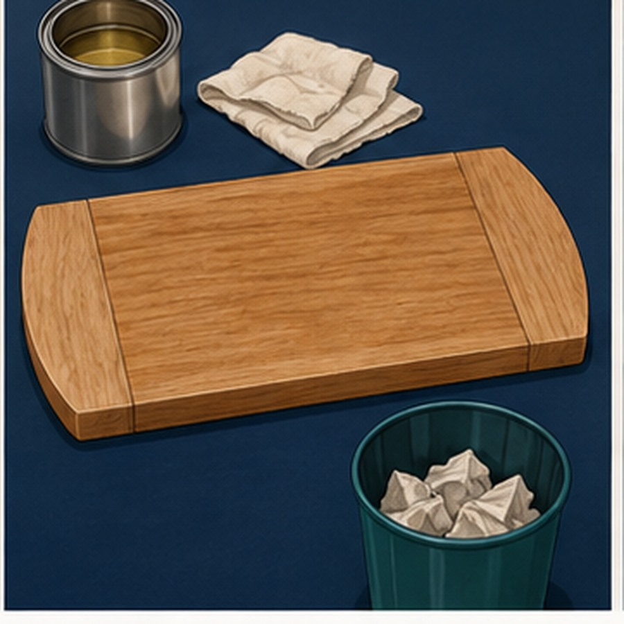
MODULE 4 OF 5 · WEEKS 7–8
Finish preparation includes safety and cleanliness
Confirm the approved product, label, SDS, ventilation, PPE and clean work area before finishing materials are opened.
Use only the product and process supplied or approved by the teacher.
3

Slide 4
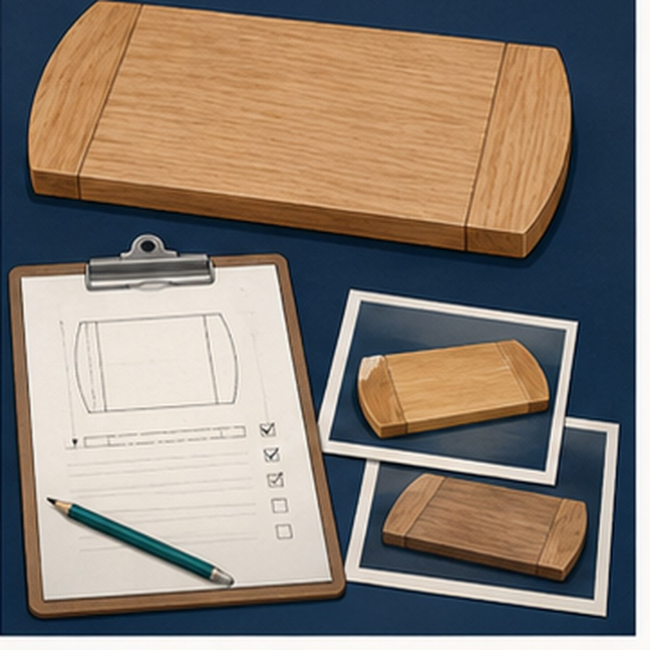
MODULE 4 OF 5 · WEEKS 7–8
Responsible finishing protects people and resources
Use only what is needed, prevent contamination and handle oily rags and finish waste exactly as directed.
Durability and correct waste control are part of sustainability.
4

Slide 5
BEFORE YOU MOVE ON
A finish succeeds only when the whole surface, workspace and safety system are ready.
Complete the knowledge checks and written responses, then save your evidence as directed.
5

