Slide 1

MODULE 5 OF 5 · WEEKS 9–10
Evaluate, document and hand over
Use observable evidence, purposeful folio records and a professional workshop handover.
Bread Board Guided Course

Slide 2
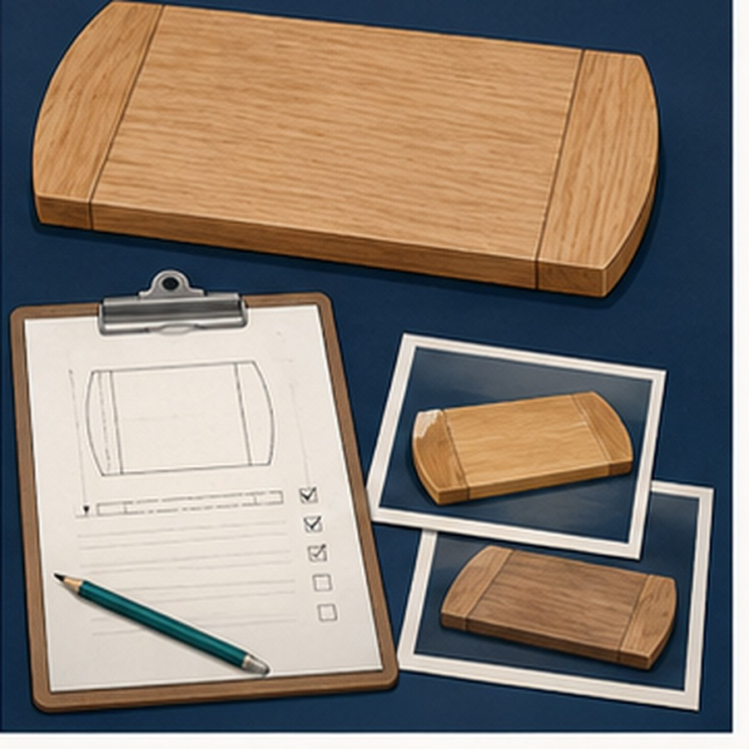
MODULE 5 OF 5 · WEEKS 9–10
Evaluate the result against the brief
Compare the finished bread board with the plan, brief and teacher criteria, then separate observations from opinions.
Name the evidence, likely cause and realistic improvement.
2

Slide 3
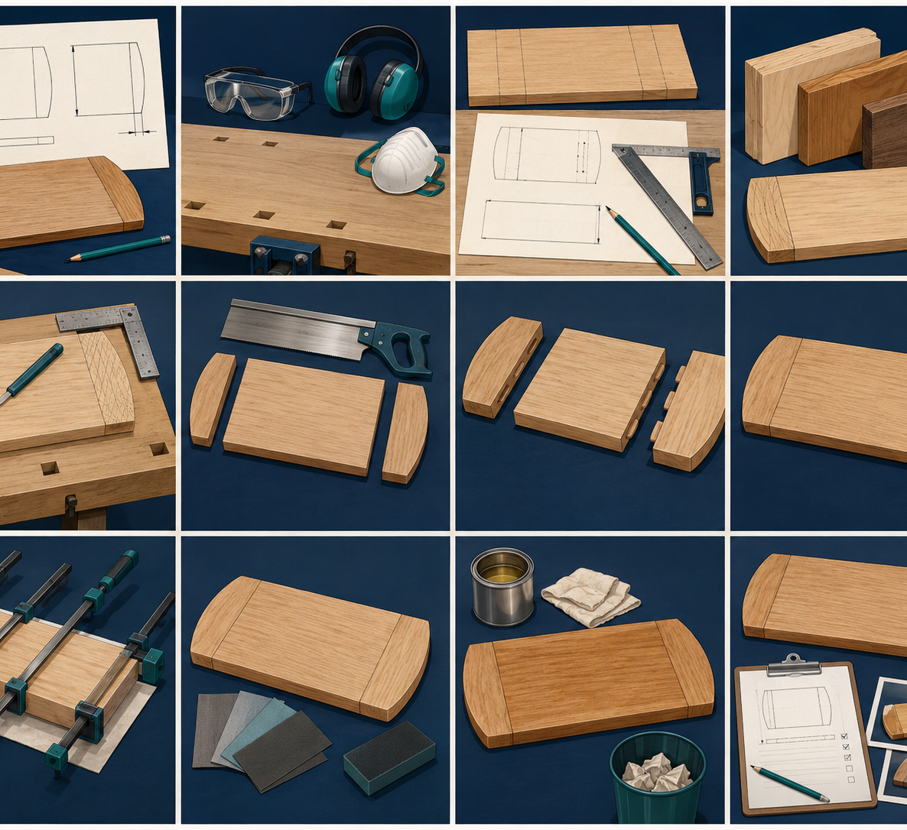
MODULE 5 OF 5 · WEEKS 9–10
Folio evidence must show a decision or change
Select authentic photographs and captions that explain what was checked, corrected or learned during the project.
Protect privacy and avoid evidence that does not belong to you.
3

Slide 4
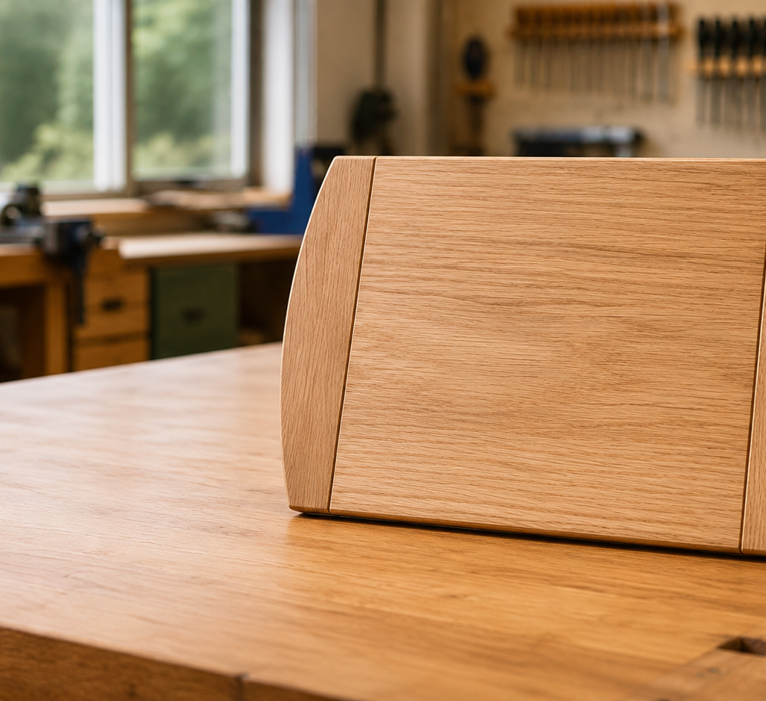
MODULE 5 OF 5 · WEEKS 9–10
Handover leaves the workshop ready for others
Return tools, report damage, separate reusable material and waste, and store the project and records safely.
Do not repair equipment or invent disposal methods without authority.
4

Slide 5
BEFORE YOU MOVE ON
Finish the project by saving evidence, making an honest judgement and leaving the workshop ready.
Complete the knowledge checks and written responses, then save your evidence as directed.
5

