Slide 1
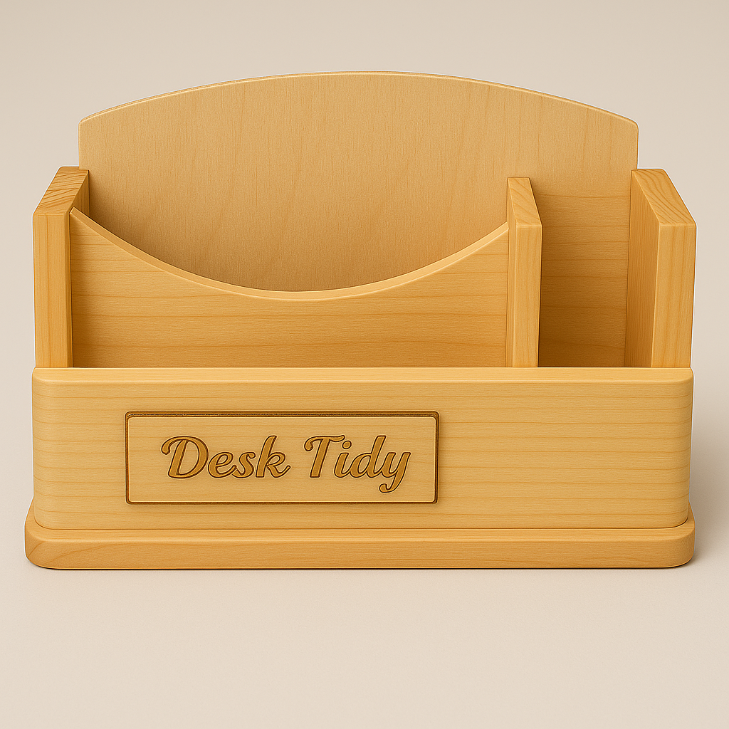
DESK TIDY · WEEKS 5-6
Plan before production
Read the theory, check your understanding and save your own evidence.
BEFORE YOU BEGIN
What do you already know—and what evidence would prove it?
Notes:
Open with the retrieval question. Accept tentative ideas, then direct students to the module theory.
[Sources]
- assets/desk-tidy-reference.png

Slide 2
Three ideas build one evidence trail
Move from understanding → safe application → evidence you can explain.
01
02
03
Communicating the selected design with working drawings
Match: Confirm the drawings represent the approved design.
Cutting lists and a realistic production schedule
Good production starts with accurate information and a realistic sequence.
Datums and accurate marking out
Select: Identify the reliable datum or reference edge.
2
Notes:
Preview the three named theory sections and tell students what evidence they will retain.
[Sources]
- weeks5-6/index.html

Slide 3
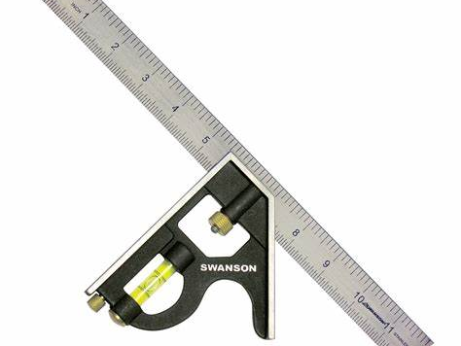
THEORY 1 OF 3
Communicating the selected design with working drawings
01 Match: Confirm the drawings represent the approved design.
02 Compare: Check that components align across all views.
03 Dimension: Record required sizes clearly in millimetres.
EVIDENCE Save a labelled note, check or photograph that proves your decision.
A drawing controls production only when its dimensions and conventions are checked.
3
Notes:
Use the visual to explain the section. Ask students to connect each takeaway to the adjacent course theory; do not add unconfirmed practical details.
[Sources]
- assets/combination-square.jpg

Slide 4

THEORY 2 OF 3
Cutting lists and a realistic production schedule
01
Good production starts with accurate information and a realistic sequence.
02
Once the Desk Tidy design and working drawings are approved, the next step is to prepare a cutting list.
03
Accuracy matters because one mistake can affect several later stages.
Plan parts, sequence and checkpoints before material is cut.
4
Notes:
Use the visual to explain the section. Ask students to connect each takeaway to the adjacent course theory; do not add unconfirmed practical details.
[Sources]
- assets/tenon-saw.jpg

Slide 5
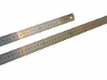
THEORY 3 OF 3
Datums and accurate marking out
01 Select: Identify the reliable datum or reference edge.
02 Measure: Work from zero and read directly above the rule.
03 Mark: Use a sharp pencil and extend square lines clearly.
EVIDENCE Save a labelled note, check or photograph that proves your decision.
Work from a datum and check each measurement before cutting.
5
Notes:
Use the visual to explain the section. Ask students to connect each takeaway to the adjacent course theory; do not add unconfirmed practical details.
[Sources]
- assets/steel-rule.jpeg

Slide 6
Pause and check what you can explain
Answer aloud or jot one clear sentence for each question.
01
02
03
What is the key idea in “Communicating the selected design with working drawings”?
What evidence would show that you understood it?
What is the key idea in “Cutting lists and a realistic production schedule”?
What evidence would show that you understood it?
What is the key idea in “Datums and accurate marking out”?
What evidence would show that you understood it?
6
Notes:
Use this as a formative pause. Do not display or supply teacher-only answers.
[Sources]
- weeks5-6/index.html

Slide 7
Build a response that shows your thinking
Prompt: Explain one decision from this module and justify it with evidence.
READ
What is the question asking?
SELECT
Return to the precise theory.
EXPLAIN
Connect the idea to your evidence.
CHECK
Answer every part in your own words.
Sentence starter: I chose … because … The evidence I will save is …
7
Notes:
Model the response process without giving an answer to a live student question.
[Sources]
- weeks5-6/index.html

Slide 8
YOUR NEXT MOVE
Exit ticket: prove what you learned
1. Name one decision you can now justify.
2. Identify the evidence you will save.
3. State your next safe, accurate action.
Notes:
Finish with a student response, then return to the course module for checks, written evidence and folio saving.
[Sources]
- assets/desk-tidy-reference.png

