Slide 1
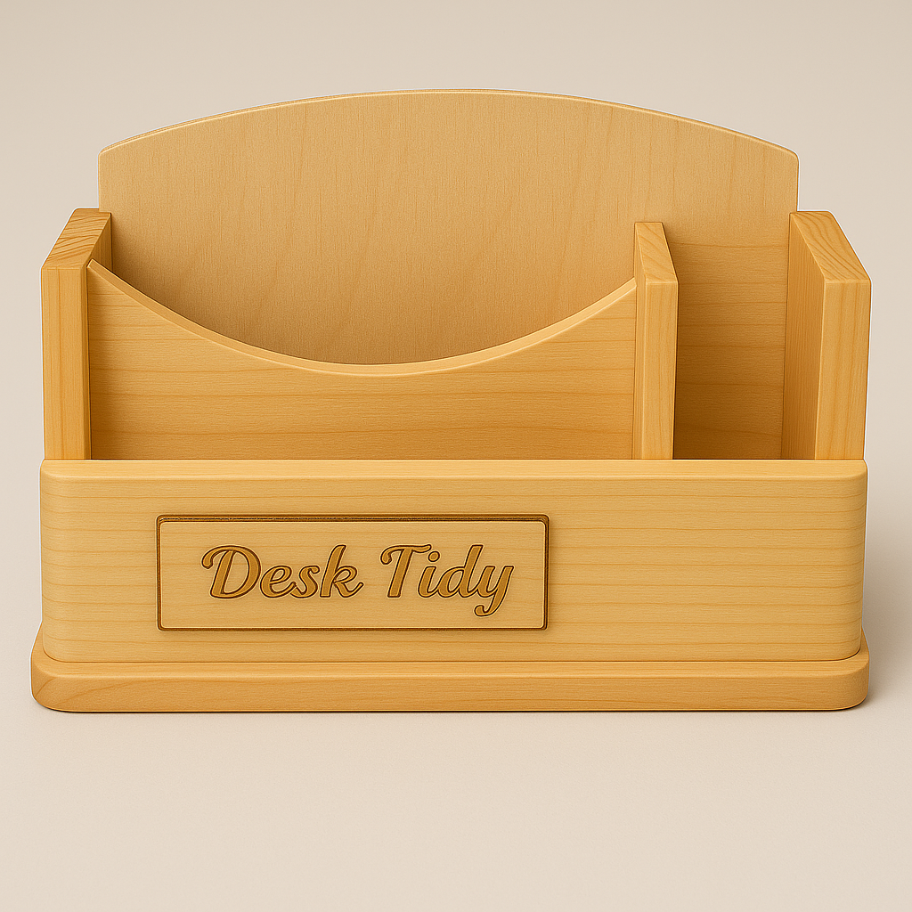
DESK TIDY · WEEKS 7-8
Produce and assemble safely
Read the theory, check your understanding and save your own evidence.
BEFORE YOU BEGIN
What do you already know—and what evidence would prove it?
Notes:
Open with the retrieval question. Accept tentative ideas, then direct students to the module theory.
[Sources]
- assets/desk-tidy-reference.png

Slide 2
Three ideas build one evidence trail
Move from understanding → safe application → evidence you can explain.
01
02
03
Cutting and shaping components accurately
Secure: Hold the work in the demonstrated bench hook or vice setup.
Butt, rebate and dowel joints in a Desk Tidy
A joint should suit the parts being connected, the required accuracy and the approved design.
Dry fitting, PVA assembly and surface preparation
Dry fit: Assemble all parts and check order, fit, square and stability.
2
Notes:
Preview the three named theory sections and tell students what evidence they will retain.
[Sources]
- weeks7-8/index.html

Slide 3
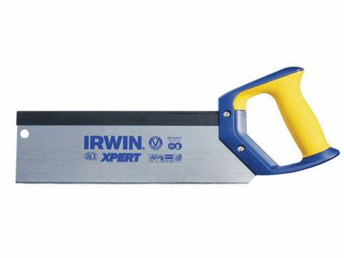
THEORY 1 OF 3
Cutting and shaping components accurately
01 Secure: Hold the work in the demonstrated bench hook or vice setup.
02 Confirm: Check the approved mark-out and identify the waste side.
03 Cut: Remove material with controlled strokes on the waste side.
EVIDENCE Save a labelled note, check or photograph that proves your decision.
Secure the work and cut on the waste side of the line.
3
Notes:
Use the visual to explain the section. Ask students to connect each takeaway to the adjacent course theory; do not add unconfirmed practical details.
[Sources]
- assets/tenon-saw.jpg

Slide 4
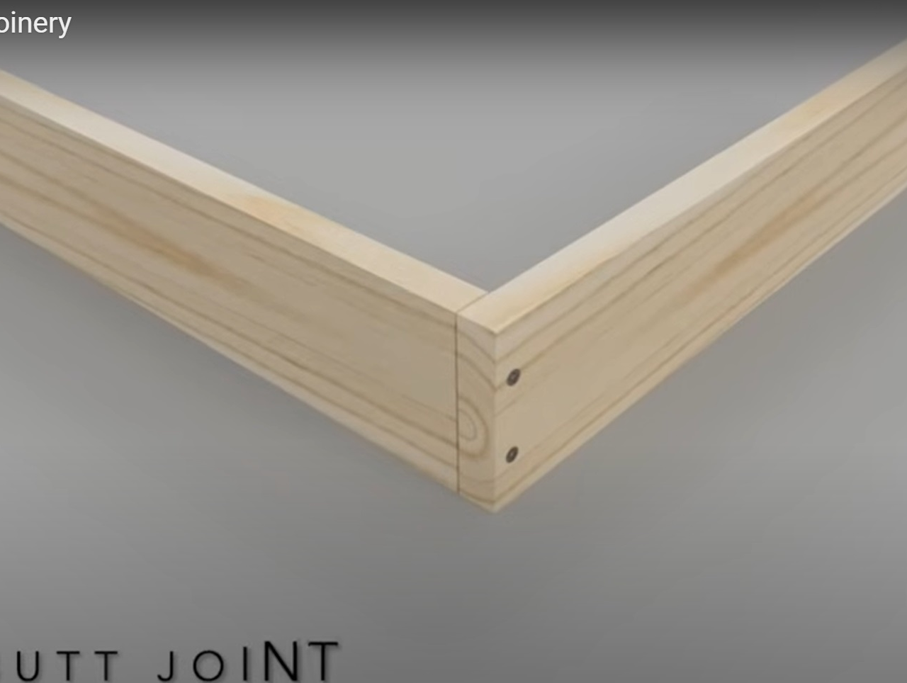
THEORY 2 OF 3
Butt, rebate and dowel joints in a Desk Tidy
01
A joint should suit the parts being connected, the required accuracy and the approved design.
02
A joint connects two or more components so they work as one structure.
03
A butt joint places the end or edge of one component directly against another.
Select a joint for its purpose, then test the fit before assembly.
4
Notes:
Use the visual to explain the section. Ask students to connect each takeaway to the adjacent course theory; do not add unconfirmed practical details.
[Sources]
- assets/butt-joint.jpg

Slide 5
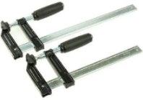
THEORY 3 OF 3
Dry fitting, PVA assembly and surface preparation
01 Dry fit: Assemble all parts and check order, fit, square and stability.
02 Approve: Resolve faults and gain teacher approval.
03 Assemble: Apply PVA and clamp using demonstrated methods.
EVIDENCE Save a labelled note, check or photograph that proves your decision.
Dry fitting finds problems before adhesive makes them permanent.
5
Notes:
Use the visual to explain the section. Ask students to connect each takeaway to the adjacent course theory; do not add unconfirmed practical details.
[Sources]
- assets/f-clamps.jpeg

Slide 6
Pause and check what you can explain
Answer aloud or jot one clear sentence for each question.
01
02
03
What is the key idea in “Cutting and shaping components accurately”?
What evidence would show that you understood it?
What is the key idea in “Butt, rebate and dowel joints in a Desk Tidy”?
What evidence would show that you understood it?
What is the key idea in “Dry fitting, PVA assembly and surface preparation”?
What evidence would show that you understood it?
6
Notes:
Use this as a formative pause. Do not display or supply teacher-only answers.
[Sources]
- weeks7-8/index.html

Slide 7
Build a response that shows your thinking
Prompt: Explain one decision from this module and justify it with evidence.
READ
What is the question asking?
SELECT
Return to the precise theory.
EXPLAIN
Connect the idea to your evidence.
CHECK
Answer every part in your own words.
Sentence starter: I chose … because … The evidence I will save is …
7
Notes:
Model the response process without giving an answer to a live student question.
[Sources]
- weeks7-8/index.html

Slide 8
YOUR NEXT MOVE
Exit ticket: prove what you learned
1. Name one decision you can now justify.
2. Identify the evidence you will save.
3. State your next safe, accurate action.
Notes:
Finish with a student response, then return to the course module for checks, written evidence and folio saving.
[Sources]
- assets/desk-tidy-reference.png

