Slide 1
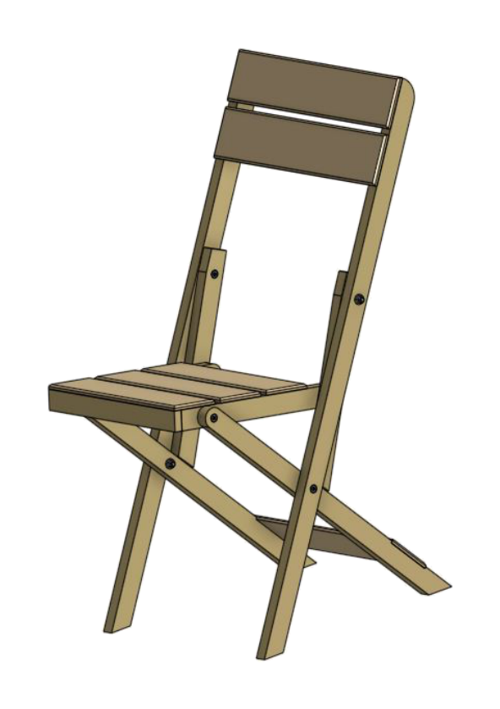
FOLDING CHAIR
Weeks 1–2 · 1/8
Project brief, plans, WHS, design and accurate mark-out
Weeks 1–2 guided learning
Read the theory. Check your understanding. Save useful evidence.
Notes:
Introduce the module purpose and connect it to the current project stage.
[Sources]
- Authorised local course theory: weeks1-2/index.html

Slide 2
FOLDING CHAIR
Weeks 1–2 · 2/8
What you will learn
Use the module in order. Each idea supports the checks and written evidence that follow.
1
Understanding the project brief
4
Design criteria, sketches and justified decisions
2
Reading the working drawings accurately
5
Datums, face side, face edge and accurate mark-out
3
How the folding mechanism and hardware work
6
Matching and mirrored chair components
Notes:
Preview the learning sequence without giving check answers.
[Sources]
- Authorised local course theory: weeks1-2/index.html

Slide 3
FOLDING CHAIR
Weeks 1–2 · 3/8
Understanding the project brief + Reading the working…
Understanding the project brief
A project brief is the starting point for design and manufacture.
Reading the working drawings accurately
A working drawing communicates exact information needed to manufacture the product.
Return to the module page for the full explanation, visual and section video.
Notes:
Teach the source-grounded theory for Understanding the project brief and Reading the working drawings accurately.
[Sources]
- Authorised local course theory: weeks1-2/index.html

Slide 4
FOLDING CHAIR
Weeks 1–2 · 4/8
How the folding mechanism and hardware work + Design…
How the folding mechanism and hardware work
A pivot is the centre around which one component rotates relative to another.
Design criteria, sketches and justified decisions
Design is a process of comparing alternatives against criteria.
Return to the module page for the full explanation, visual and section video.
Notes:
Teach the source-grounded theory for How the folding mechanism and hardware work and Design criteria, sketches and justified decisions.
[Sources]
- Authorised local course theory: weeks1-2/index.html

Slide 5
FOLDING CHAIR
Weeks 1–2 · 5/8
Datums, face side, face edge and accurate mark-out +…
Datums, face side, face edge and accurate mark-out
A datum is a fixed reference face, edge, point or line from which measurements are taken.
Matching and mirrored chair components
Matching components have the same dimensions and orientation.
Return to the module page for the full explanation, visual and section video.
Notes:
Teach the source-grounded theory for Datums, face side, face edge and accurate mark-out and Matching and mirrored chair components.
[Sources]
- Authorised local course theory: weeks1-2/index.html

Slide 6
FOLDING CHAIR
Weeks 1–2 · 6/8
Pause and check your understanding
What is the controlling idea?
Understanding the project brief
Which check would prevent a mistake?
Design criteria, sketches and justified decisions
What evidence would show your decision?
Matching and mirrored chair components
Notes:
Use these prompts for retrieval before students open the interactive checks.
[Sources]
- Authorised local course theory: weeks1-2/index.html

Slide 7
FOLDING CHAIR
Weeks 1–2 · 7/8
Build a stronger written response
Read
Underline the command word and the project detail.
Select
Return to the exact theory section and choose relevant evidence.
Explain
Connect the decision, reason and likely result.
Check
Make sure the response answers the question and stays source-accurate.
Notes:
Model the response process without supplying an answer to a live student question.
[Sources]
- Authorised local course theory: weeks1-2/index.html

Slide 8
FOLDING CHAIR
Weeks 1–2 · 8/8
Exit ticket
Before you finish this module, answer these in your own words:
1. One idea I can now explain: Understanding the project brief
2. One practical check I must remember before the next stage
3. One piece of evidence I should save or improve
Return to the module page to complete the checks, written response and folio evidence.
Notes:
Students complete the exit ticket, then return to the website to save evidence.
[Sources]
- Authorised local course theory: weeks1-2/index.html

