Slide 1
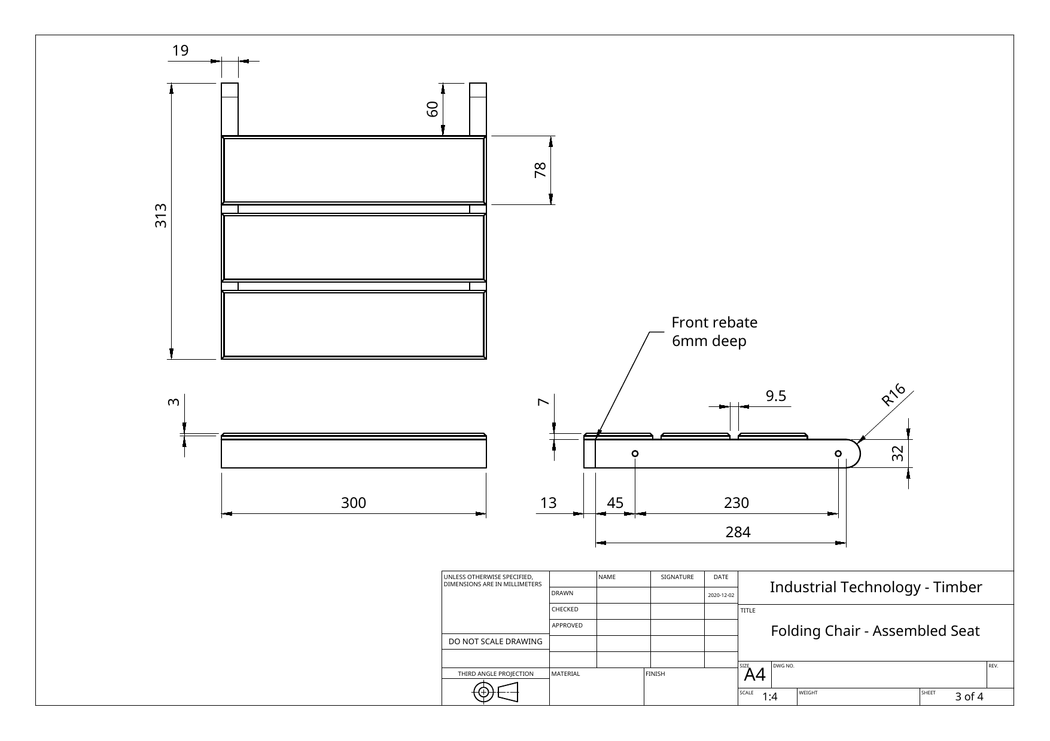
FOLDING CHAIR
Weeks 11–12 · 1/8
Assembly sequence, adhesives, clamping, costing and realistic time planning
Weeks 11–12 guided learning
Read the theory. Check your understanding. Save useful evidence.
Notes:
Introduce the module purpose and connect it to the current project stage.
[Sources]
- Authorised local course theory: weeks11-12/index.html

Slide 2
FOLDING CHAIR
Weeks 11–12 · 2/8
What you will learn
Use the module in order. Each idea supports the checks and written evidence that follow.
1
Assembly order is a design decision
4
Costing converts quantities into evidence
2
Adhesive selection and the conditions for a strong bond
5
Dependencies determine what can happen next
3
Clamp pressure must close the joint without distorting it
6
Hold points protect the project from rushed rework
Notes:
Preview the learning sequence without giving check answers.
[Sources]
- Authorised local course theory: weeks11-12/index.html

Slide 3
FOLDING CHAIR
Weeks 11–12 · 3/8
Assembly order is a design decision + Adhesive selection…
Assembly order is a design decision
Assembly should be divided into manageable subassemblies.
Adhesive selection and the conditions for a strong bond
For many indoor timber assemblies, a suitable woodworking PVA adhesive provides a strong bond when the joint fits correctly and the surfaces are clean, sound and properly clamped.
Return to the module page for the full explanation, visual and section video.
Notes:
Teach the source-grounded theory for Assembly order is a design decision and Adhesive selection and the conditions for a strong bond.
[Sources]
- Authorised local course theory: weeks11-12/index.html

Slide 4
FOLDING CHAIR
Weeks 11–12 · 4/8
Clamp pressure must close the joint without distorting…
Clamp pressure must close the joint without distorting it
Position clamps so the force closes the joint rather than bending the assembly.
Costing converts quantities into evidence
A project cost is based on quantities and unit costs, not a guess at the final total.
Return to the module page for the full explanation, visual and section video.
Notes:
Teach the source-grounded theory for Clamp pressure must close the joint without distorting it and Costing converts quantities into evidence.
[Sources]
- Authorised local course theory: weeks11-12/index.html

Slide 5
FOLDING CHAIR
Weeks 11–12 · 5/8
Dependencies determine what can happen next + Hold…
Dependencies determine what can happen next
A dependency is a task that must be completed before another task can begin.
Hold points protect the project from rushed rework
A hold point is a planned stop where evidence is checked before permanent or high-cost work continues.
Return to the module page for the full explanation, visual and section video.
Notes:
Teach the source-grounded theory for Dependencies determine what can happen next and Hold points protect the project from rushed rework.
[Sources]
- Authorised local course theory: weeks11-12/index.html

Slide 6
FOLDING CHAIR
Weeks 11–12 · 6/8
Pause and check your understanding
What is the controlling idea?
Assembly order is a design decision
Which check would prevent a mistake?
Costing converts quantities into evidence
What evidence would show your decision?
Hold points protect the project from rushed rework
Notes:
Use these prompts for retrieval before students open the interactive checks.
[Sources]
- Authorised local course theory: weeks11-12/index.html

Slide 7
FOLDING CHAIR
Weeks 11–12 · 7/8
Build a stronger written response
Read
Underline the command word and the project detail.
Select
Return to the exact theory section and choose relevant evidence.
Explain
Connect the decision, reason and likely result.
Check
Make sure the response answers the question and stays source-accurate.
Notes:
Model the response process without supplying an answer to a live student question.
[Sources]
- Authorised local course theory: weeks11-12/index.html

Slide 8
FOLDING CHAIR
Weeks 11–12 · 8/8
Exit ticket
Before you finish this module, answer these in your own words:
1. One idea I can now explain: Assembly order is a design decision
2. One practical check I must remember before the next stage
3. One piece of evidence I should save or improve
Return to the module page to complete the checks, written response and folio evidence.
Notes:
Students complete the exit ticket, then return to the website to save evidence.
[Sources]
- Authorised local course theory: weeks11-12/index.html

