Slide 1
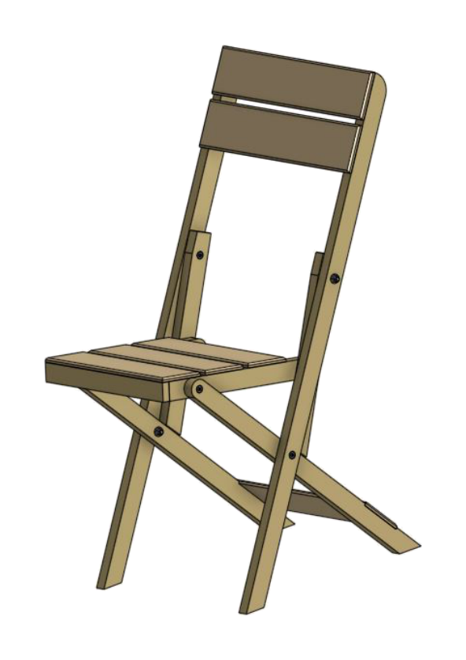
FOLDING CHAIR
Weeks 13–14 · 1/8
Surface preparation, finishing systems, defect correction and industry quality practice
Weeks 13–14 guided learning
Read the theory. Check your understanding. Save useful evidence.
Notes:
Introduce the module purpose and connect it to the current project stage.
[Sources]
- Authorised local course theory: weeks13-14/index.html

Slide 2
FOLDING CHAIR
Weeks 13–14 · 2/8
What you will learn
Use the module in order. Each idea supports the checks and written evidence that follow.
1
Inspect before sanding
4
Coating, drying, curing and de-nibbing
2
Abrasive grit, scratch pattern and sanding direction
5
Finish defects are symptoms with causes
3
Select a finish for the chair’s use—not simply its colour
6
Industry quality is built into the process
Notes:
Preview the learning sequence without giving check answers.
[Sources]
- Authorised local course theory: weeks13-14/index.html

Slide 3
FOLDING CHAIR
Weeks 13–14 · 3/8
Inspect before sanding + Abrasive grit, scratch pattern…
Inspect before sanding
Surface preparation begins with diagnosis.
Abrasive grit, scratch pattern and sanding direction
Abrasive paper contains cutting particles.
Return to the module page for the full explanation, visual and section video.
Notes:
Teach the source-grounded theory for Inspect before sanding and Abrasive grit, scratch pattern and sanding direction.
[Sources]
- Authorised local course theory: weeks13-14/index.html

Slide 4
FOLDING CHAIR
Weeks 13–14 · 4/8
Select a finish for the chair’s use—not simply its…
Select a finish for the chair’s use—not simply its colour
A finish changes appearance and can reduce moisture exchange, staining and surface wear.
Coating, drying, curing and de-nibbing
Application method depends on the selected product and school controls.
Return to the module page for the full explanation, visual and section video.
Notes:
Teach the source-grounded theory for Select a finish for the chair’s use—not simply its colour and Coating, drying, curing and de-nibbing.
[Sources]
- Authorised local course theory: weeks13-14/index.html

Slide 5
FOLDING CHAIR
Weeks 13–14 · 5/8
Finish defects are symptoms with causes + Industry…
Finish defects are symptoms with causes
The safest correction depends on the product and its state of cure.
Industry quality is built into the process
Timber and furniture workplaces use drawings, job sheets, safe procedures, jigs, sampling, inspection and traceable records to achieve consistent production.
Return to the module page for the full explanation, visual and section video.
Notes:
Teach the source-grounded theory for Finish defects are symptoms with causes and Industry quality is built into the process.
[Sources]
- Authorised local course theory: weeks13-14/index.html

Slide 6
FOLDING CHAIR
Weeks 13–14 · 6/8
Pause and check your understanding
What is the controlling idea?
Inspect before sanding
Which check would prevent a mistake?
Coating, drying, curing and de-nibbing
What evidence would show your decision?
Industry quality is built into the process
Notes:
Use these prompts for retrieval before students open the interactive checks.
[Sources]
- Authorised local course theory: weeks13-14/index.html

Slide 7
FOLDING CHAIR
Weeks 13–14 · 7/8
Build a stronger written response
Read
Underline the command word and the project detail.
Select
Return to the exact theory section and choose relevant evidence.
Explain
Connect the decision, reason and likely result.
Check
Make sure the response answers the question and stays source-accurate.
Notes:
Model the response process without supplying an answer to a live student question.
[Sources]
- Authorised local course theory: weeks13-14/index.html

Slide 8
FOLDING CHAIR
Weeks 13–14 · 8/8
Exit ticket
Before you finish this module, answer these in your own words:
1. One idea I can now explain: Inspect before sanding
2. One practical check I must remember before the next stage
3. One piece of evidence I should save or improve
Return to the module page to complete the checks, written response and folio evidence.
Notes:
Students complete the exit ticket, then return to the website to save evidence.
[Sources]
- Authorised local course theory: weeks13-14/index.html

