Slide 1
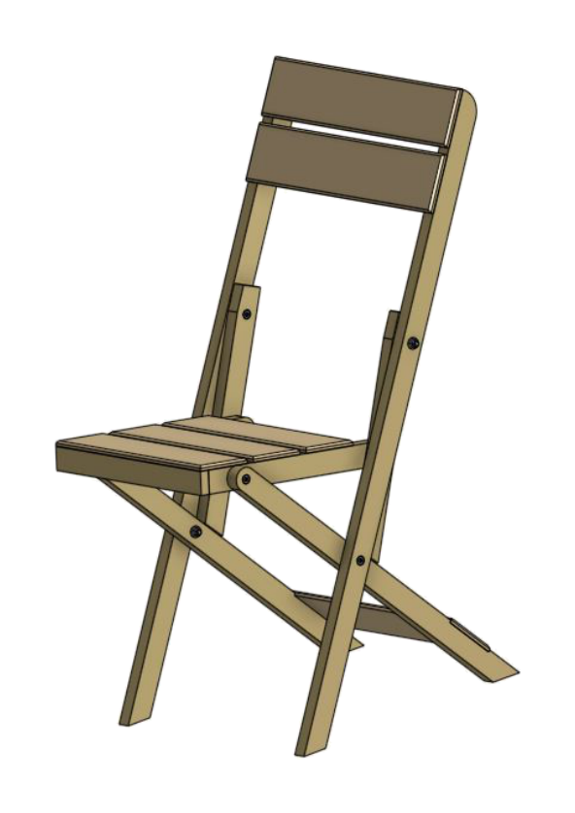
FOLDING CHAIR
Weeks 17–18 · 1/8
Portfolio evidence, evaluation, retrieval practice and assessment preparation
Weeks 17–18 guided learning
Read the theory. Check your understanding. Save useful evidence.
Notes:
Introduce the module purpose and connect it to the current project stage.
[Sources]
- Authorised local course theory: weeks17-18/index.html

Slide 2
FOLDING CHAIR
Weeks 17–18 · 2/8
What you will learn
Use the module in order. Each idea supports the checks and written evidence that follow.
1
Build an evidence chain from brief to finished chair
4
Retrieval practice and interleaving build usable knowledge
2
A caption should make the evidence interpretable
5
Command words determine the depth of the answer
3
Evaluation is a judgement supported by evidence
6
Integrated answers connect stages of the project
Notes:
Preview the learning sequence without giving check answers.
[Sources]
- Authorised local course theory: weeks17-18/index.html

Slide 3
FOLDING CHAIR
Weeks 17–18 · 3/8
Build an evidence chain from brief to finished chair + A…
Build an evidence chain from brief to finished chair
A portfolio is not a scrapbook of everything produced.
A caption should make the evidence interpretable
A weak caption merely repeats what can be seen: “This is my chair.
Return to the module page for the full explanation, visual and section video.
Notes:
Teach the source-grounded theory for Build an evidence chain from brief to finished chair and A caption should make the evidence interpretable.
[Sources]
- Authorised local course theory: weeks17-18/index.html

Slide 4
FOLDING CHAIR
Weeks 17–18 · 4/8
Evaluation is a judgement supported by evidence +…
Evaluation is a judgement supported by evidence
Description states what the chair is like.
Retrieval practice and interleaving build usable knowledge
Retrieval practice means attempting to recall information without first looking at the answer.
Return to the module page for the full explanation, visual and section video.
Notes:
Teach the source-grounded theory for Evaluation is a judgement supported by evidence and Retrieval practice and interleaving build usable knowledge.
[Sources]
- Authorised local course theory: weeks17-18/index.html

Slide 5
FOLDING CHAIR
Weeks 17–18 · 5/8
Command words determine the depth of the answer +…
Command words determine the depth of the answer
A high-mark response also follows the scope of the question.
Integrated answers connect stages of the project
Longer assessment questions often combine ideas.
Return to the module page for the full explanation, visual and section video.
Notes:
Teach the source-grounded theory for Command words determine the depth of the answer and Integrated answers connect stages of the project.
[Sources]
- Authorised local course theory: weeks17-18/index.html

Slide 6
FOLDING CHAIR
Weeks 17–18 · 6/8
Pause and check your understanding
What is the controlling idea?
Build an evidence chain from brief to finished chair
Which check would prevent a mistake?
Retrieval practice and interleaving build usable knowledge
What evidence would show your decision?
Integrated answers connect stages of the project
Notes:
Use these prompts for retrieval before students open the interactive checks.
[Sources]
- Authorised local course theory: weeks17-18/index.html

Slide 7
FOLDING CHAIR
Weeks 17–18 · 7/8
Build a stronger written response
Read
Underline the command word and the project detail.
Select
Return to the exact theory section and choose relevant evidence.
Explain
Connect the decision, reason and likely result.
Check
Make sure the response answers the question and stays source-accurate.
Notes:
Model the response process without supplying an answer to a live student question.
[Sources]
- Authorised local course theory: weeks17-18/index.html

Slide 8
FOLDING CHAIR
Weeks 17–18 · 8/8
Exit ticket
Before you finish this module, answer these in your own words:
1. One idea I can now explain: Build an evidence chain from brief to finished chair
2. One practical check I must remember before the next stage
3. One piece of evidence I should save or improve
Return to the module page to complete the checks, written response and folio evidence.
Notes:
Students complete the exit ticket, then return to the website to save evidence.
[Sources]
- Authorised local course theory: weeks17-18/index.html

